Slide 1

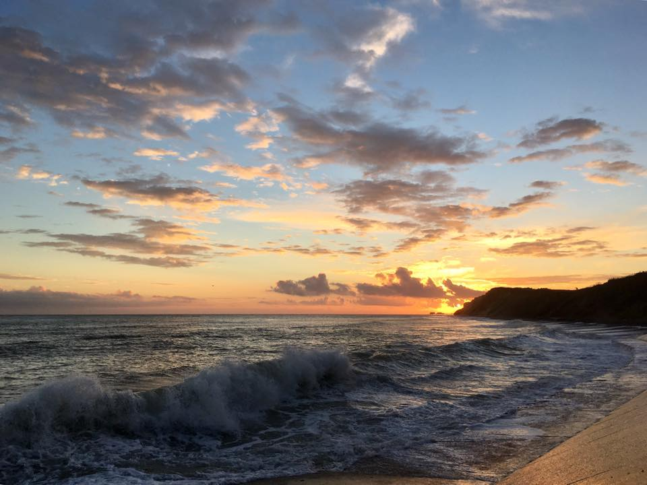

Welcome to West Runton
Saving Norfolk’s Wildlife for the Future
Notes:
Photo: West Runton Beach Cafe

Slide 2
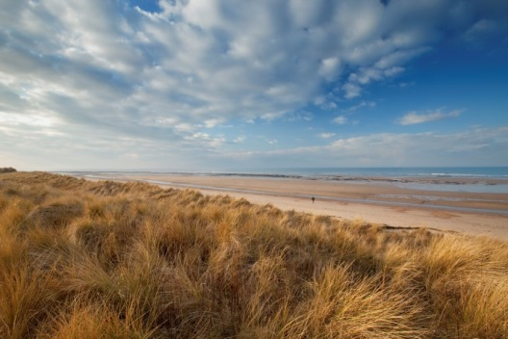
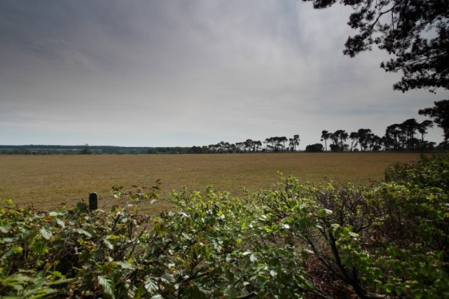
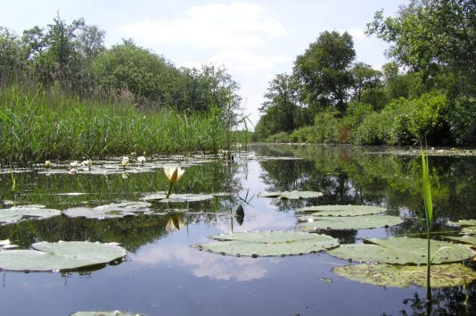
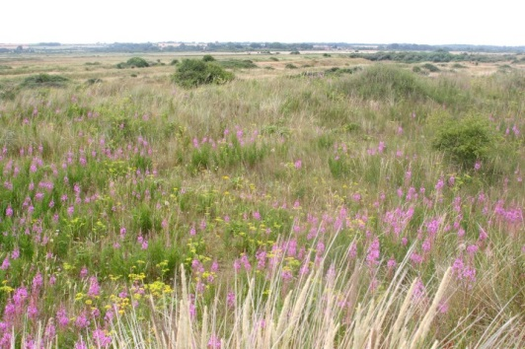
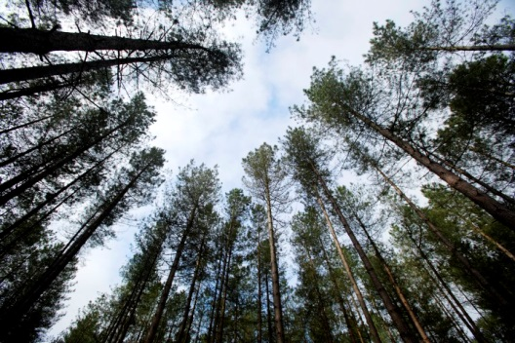
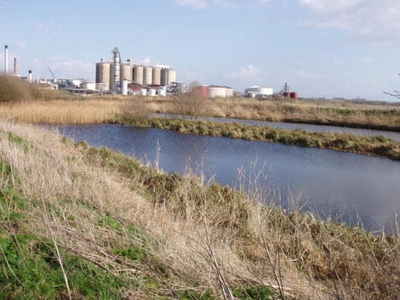
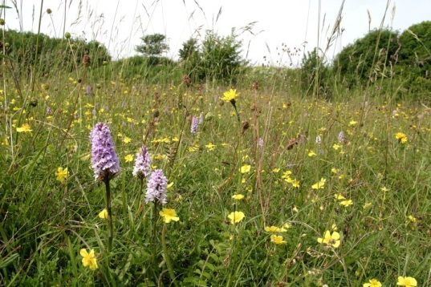
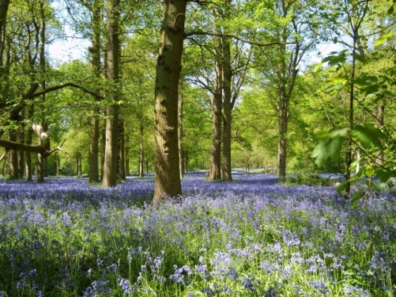
A bit about Norfolk Wildlife Trust…
We protect more than 60 nature reserves across Norfolk for wildlife and people
Saving Norfolk’s Wildlife for the Future
Notes:
Different animals and plants need different sorts of places to live.
Photos: Richard Osbourne, Ray Jones, Tasha North, Nick Carter, Wildstock and Russel Bayell.

Slide 3
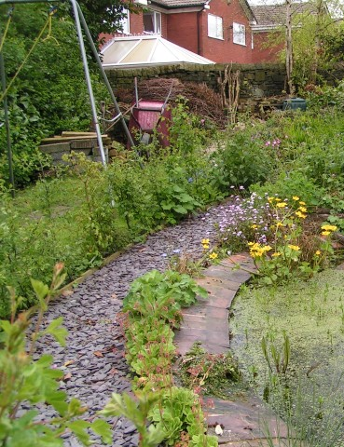
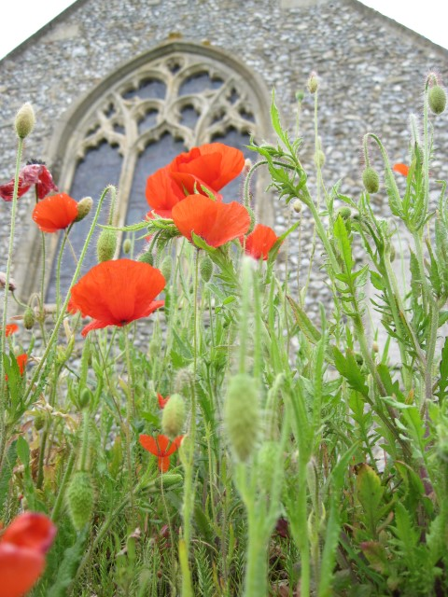
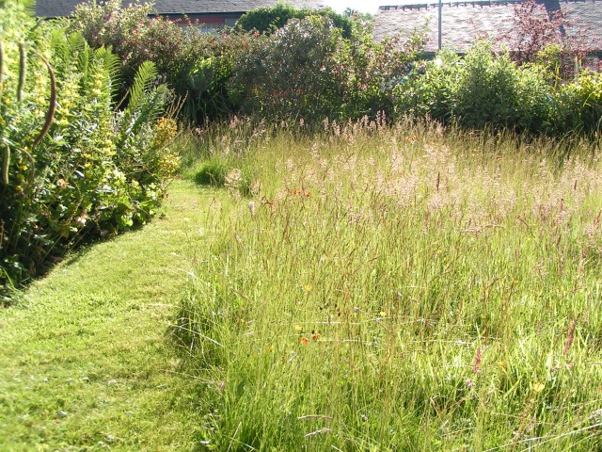
We also help to make gardens, parks, schools, churchyards, roadsides and other areas more wildlife-friendly so that nature reserves are joined up. We call this a “Nature Recovery Network”.
Saving Norfolk’s Wildlife for the Future
Notes:
These areas aren’t immaculately tidy, which is great for wildlife. Some grass is long, there is a pond and the species are native to Britain.
Photos: Richard Burkmarr and David North

Slide 4
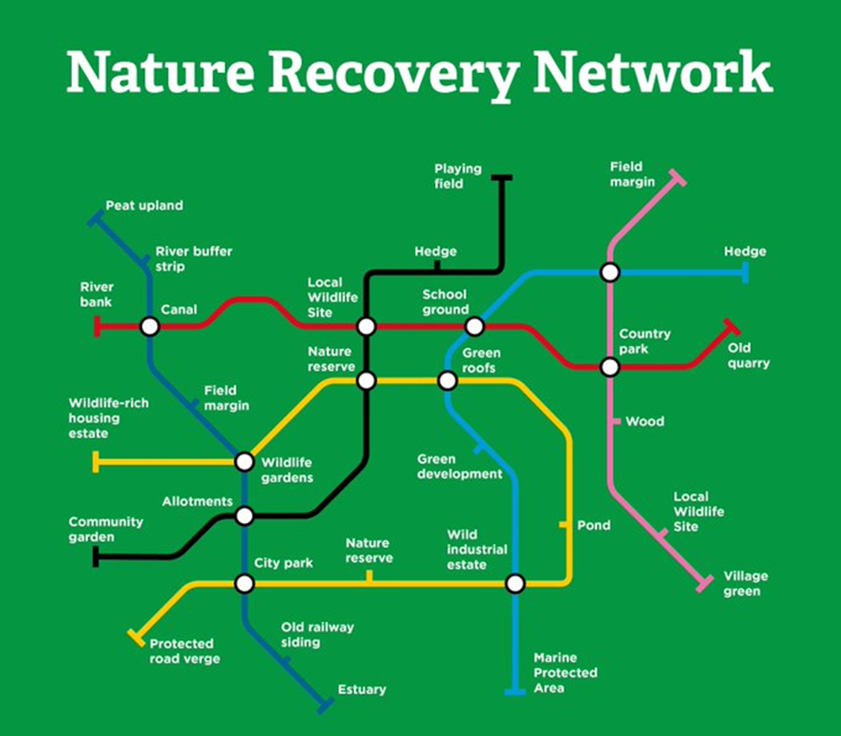
Notes:
Diagram: The Wildlife Trusts

Slide 5
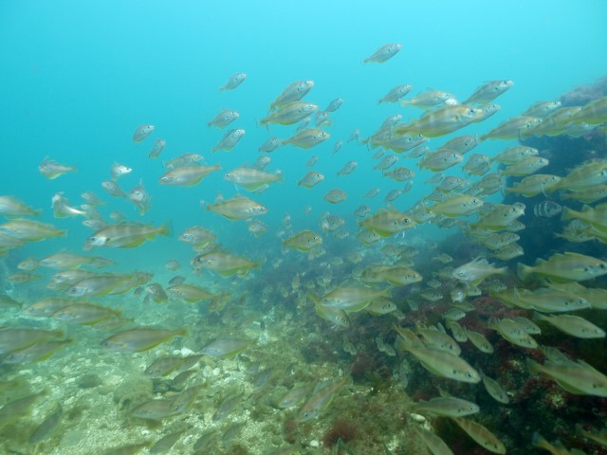
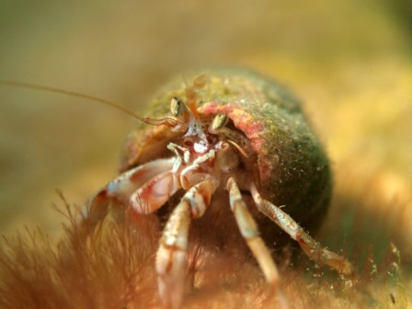
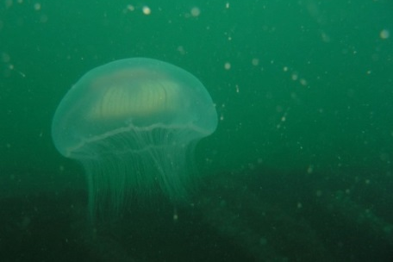
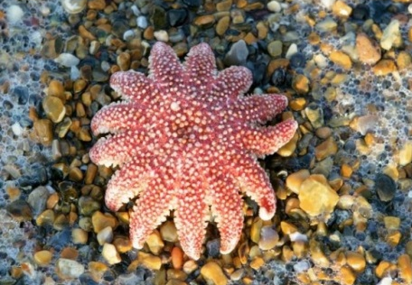
We would also like to create nature reserves in the sea as well as on land because sea life is just as important, but far less protected. Can you think of problems that life in the sea faces? How about any ways that we can all help?
Saving Norfolk’s Wildlife for the Future
Notes:
Hermit crab, jellyfish, sun star
Threats could include pollution, litter, climate change and overfishing.
Solutions could include taking litter home, buying less plastic, reducing waste, reducing fossil fuel use e.g. walking to school, switching off monitors etc and buying sustainably caught seafood.
Photos: Rob Spray, Helen Nott and Terry Stanford.

Slide 6
These are words we might use during your visit. Can you work out what they are?
1) A place where plants and animals can live
H
A
B
I
T
A
T
2) An exact type of animal or plant
S
P
E
C
I
E
S
3) An area which is protected for wildlife
N
A
T
U
R
E
R
E
S
E
R
V
E
4) Something plants and animals have done over time so that they can live in their habitat
A
D
A
P
T
5) The number of different plant and animal species in an area
B
I
O
D
I
T
Y
V
E
R
S
I
6) A person who looks after a nature reserve
W
A
R
D
E
N
Saving Norfolk’s Wildlife for the Future

Slide 7
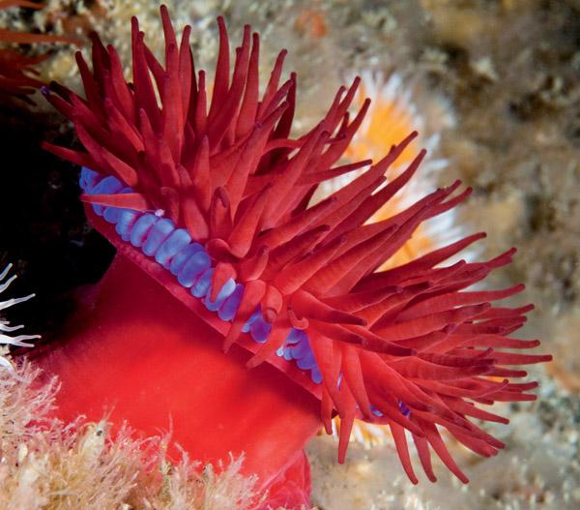
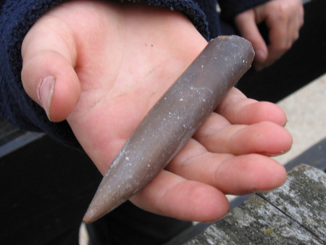
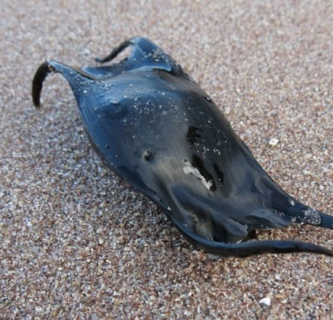
After your visit, you’ll know more about different environments and what lives in them
We’ll find plenty of animals, minerals and plants, but they’re all wild so what we’ll see is a mystery!
We’ll explore different habitats at West Runton, each with its own different species
Saving Norfolk’s Wildlife for the Future
Notes:
Photos: Divergent, Discovering Fossils and Assynt Field Club

Slide 8
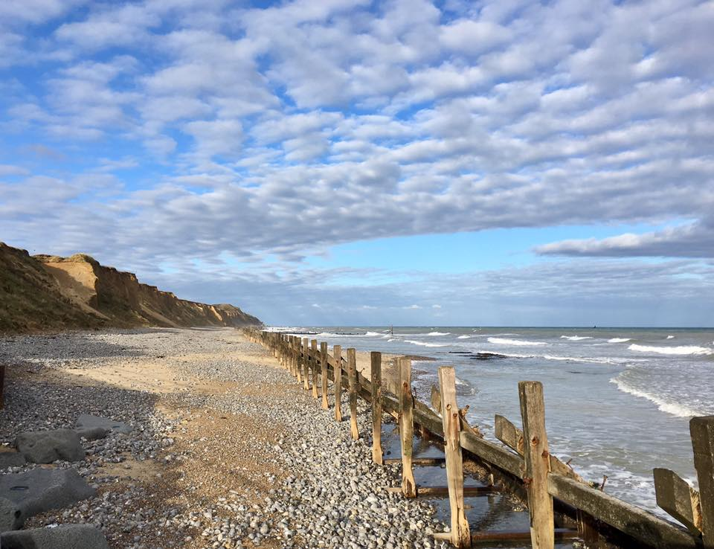
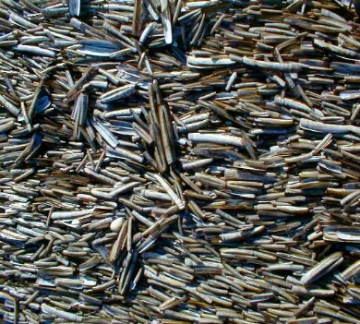
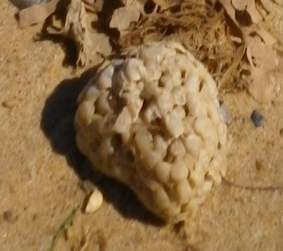
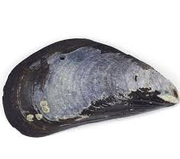
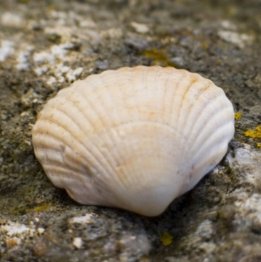
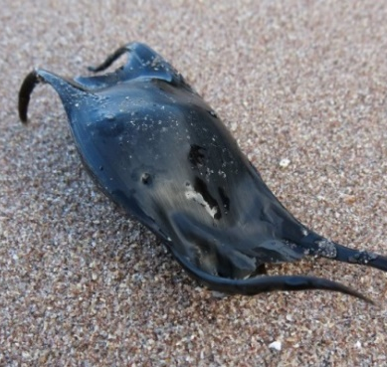
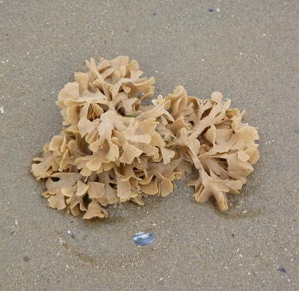
Beach Strandline
Saving Norfolk’s Wildlife for the Future
Notes:
From top left: Razor shells, common whelk eggs, common mussel, cockle, mermaids purse (ray egg case), Hornwrack.
Photos: David Gittens, Tabitha Peaman, Behance, Trkearth.com, Assynt Field Club, West Runton Beach Café and Wild Hastings.

Slide 9
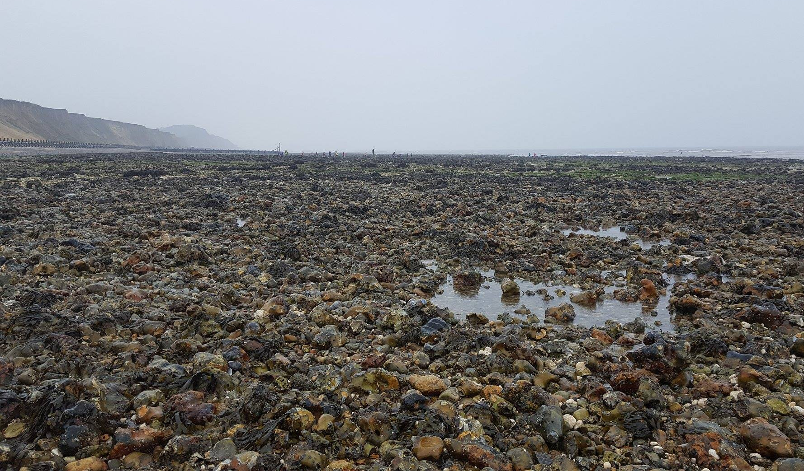
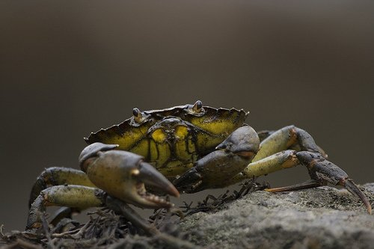
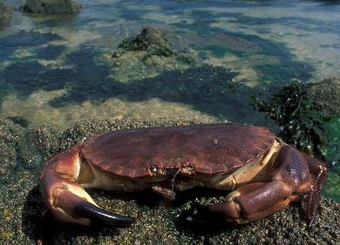
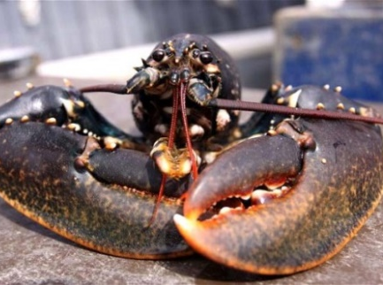
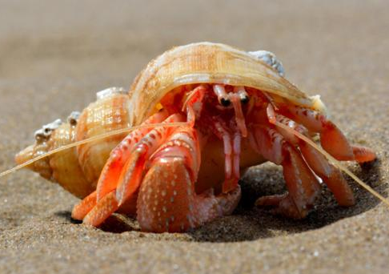
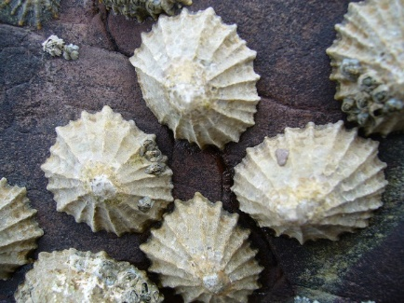
Rock Pools
Saving Norfolk’s Wildlife for the Future
Notes:
From top left: Shore crab, edible crab, common lobster, beadlet anenome, limpets, hermit crab.
Photos: Merkinth Local Nature Reserve, Arkive, The Telegraph, wikipedia, Nick Davies and David Fieldhouse.

Slide 10
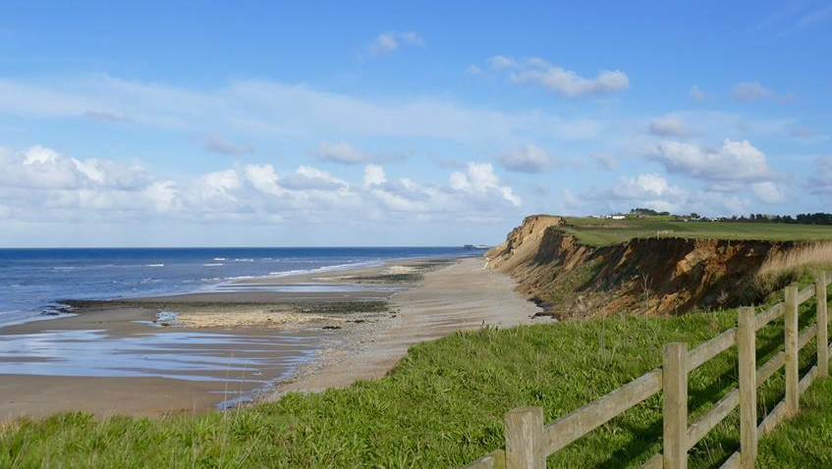
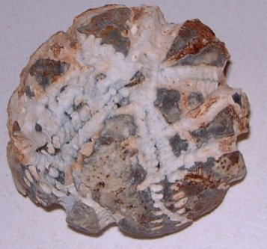
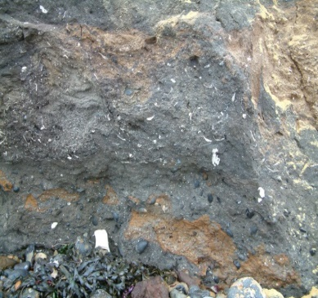
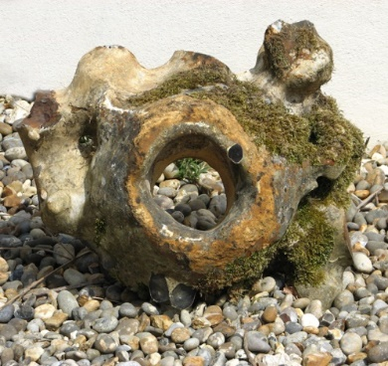
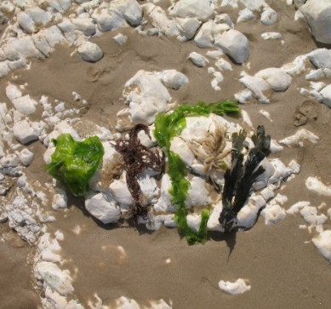
Cliffs
Saving Norfolk’s Wildlife for the Future
Notes:
From top left: Echinoid, fossilised shell fragments, flint paramoudra, chalk, belemnite
Photos: UK Fossil Hunting, Geograph, Walk Cromer, Discovering Fossils and West Runton Beach Café.

Slide 11
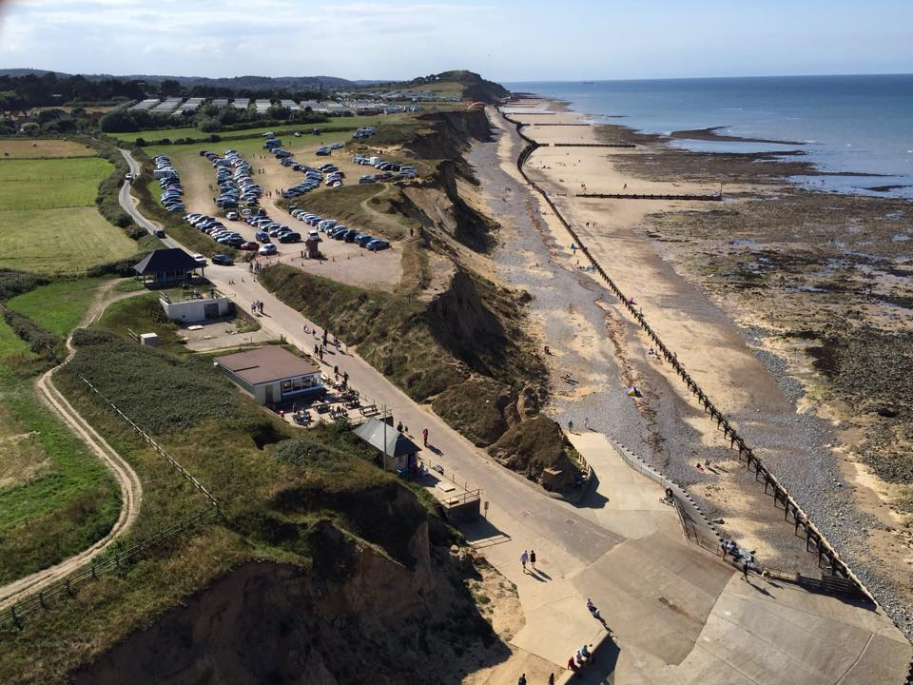
Your coach will drop you off in the car park before we make the short walk down to the beach. You’ll be able to use the toilets when you arrive, at lunch time and before you leave.
Saving Norfolk’s Wildlife for the Future

Slide 12
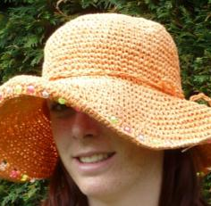
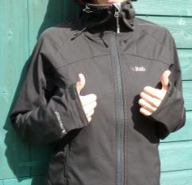
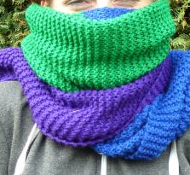
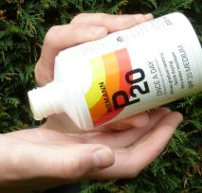
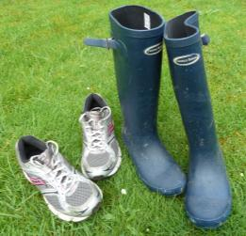
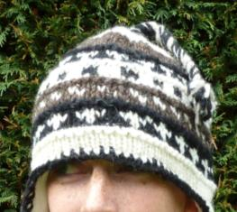
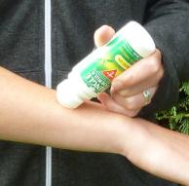
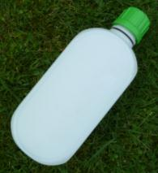
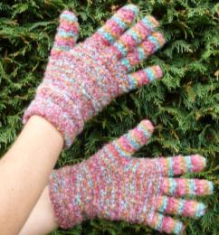
What to wear and bring
Hot and sunny
Whatever the weather
Cold
Waterproof
jacket/trousers, quick drying clothes or spare cloths
Sun hat
Scarf
Welly boots or shoes
you can get dirty
NOT YOUR BEST SHOES!
Sun cream
Warm hat
Insect repellent
or long trousers and sleeves
A re-sealable
drink
Gloves
Saving Norfolk’s Wildlife for the Future

Slide 13
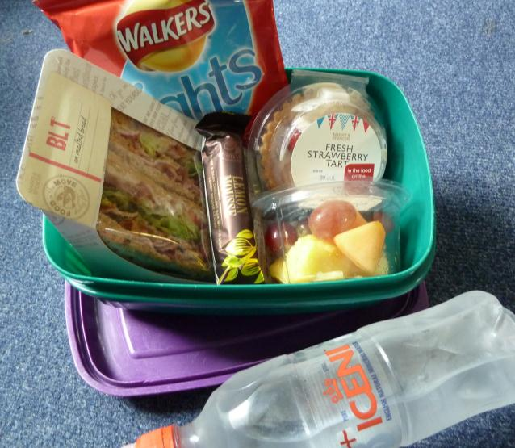
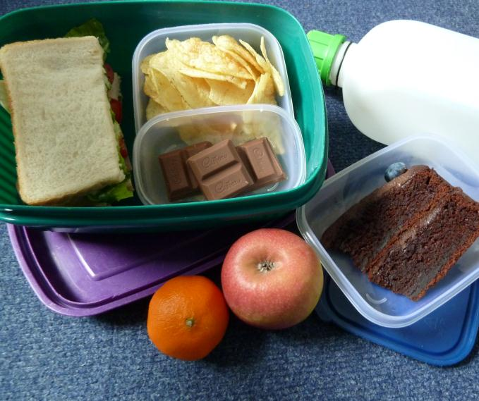
Low Impact Lunch Challenge
A ‘low impact’ lunch is one that doesn’t damage the environment much
Compare the two lunches below, work out which is better and why
Follow our tips to see if you can make your lunch box like the low impact one
This one has less packaging,
which means less rubbish
Ask whoever does the shopping to
buy in bulk rather than
buying lots of individual bags
Use reusable bottles
Try to eat food which has not travelled too far
Use reusable boxes
Take apple cores and orange
peel home to compost.
Saving Norfolk’s Wildlife for the Future
Notes:
Low Impact Lunch – the photo on the right has a lower impact as there is less packaging being made for the food, which uses a lot of energy. This also means that there is less rubbish afterwards, which takes up more energy through rubbish collection services and has to be disposed of somewhere in the countryside, destroying areas of habitat and possibly causing pollution.
Home-made sandwiches and cake in reusable tubs are lower impact than shop bought, over-packaged versions - and they work out cheaper!
By buying big bags of crisps or chocolate or nuts and pouring out a day’s serving into a tub for each lunch box saves packaging – individual lunch box-sized chocolate bars or mini yoghurts or single serving bags of dried fruit produce tonnes of unnecessary waste every year.
Don’t buy pre-prepared fruit, it just creates more packaging. Instead, buy fruit as locally as possible and either take whole or prepare fruit salads at home and put into a reusable tub.
Don’t buy bottled water, tap water is fine. In Great Britain we have some of the best quality tap water in the world! Use a refillable bottle, it’s much cheaper and much, much kinder to the planet.

Slide 14
What would you like to find out about West Runton’s wildlife?
Can you each come up with 2 questions?
Saving Norfolk’s Wildlife for the Future
Notes:
These don’t necessarily have to be answerable.
Photo: Merkinth

Slide 15

See you soon!
Saving Norfolk’s Wildlife for the Future
Notes:
Photo: West Runton Beach Café.

