Slide 1

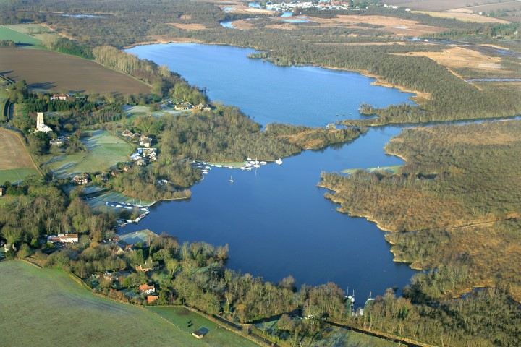
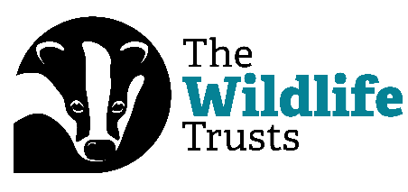
Welcome to Ranworth Broad
Saving Norfolk’s Wildlife for the Future
Notes:
Photo: Mike Page.

Slide 2
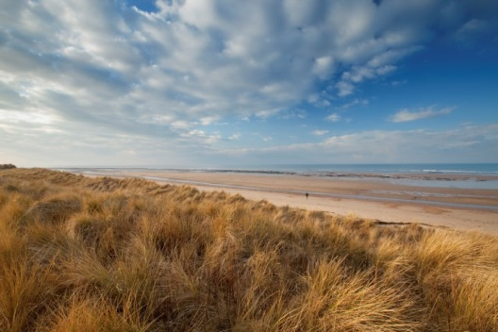
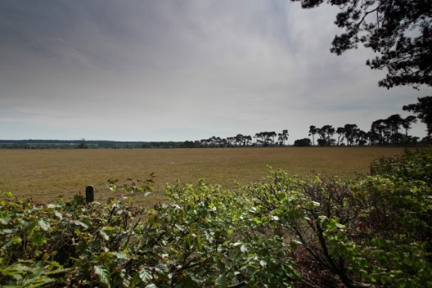
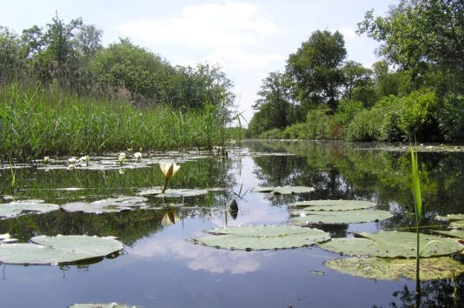
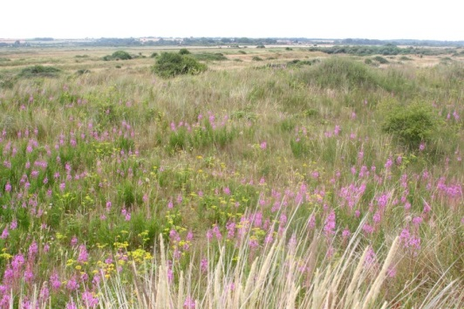
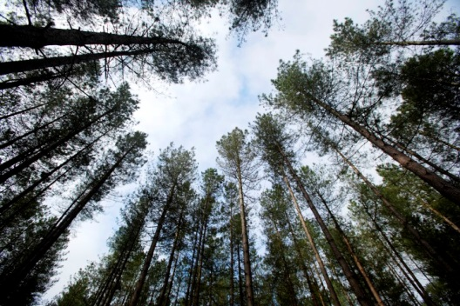
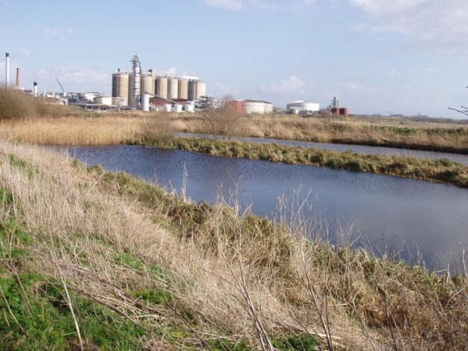
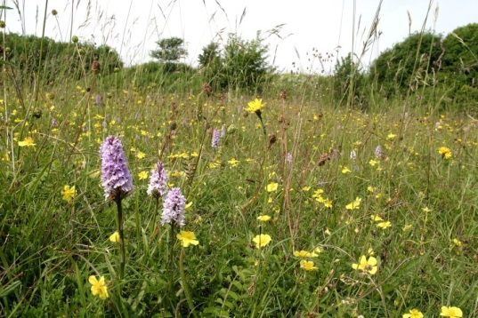
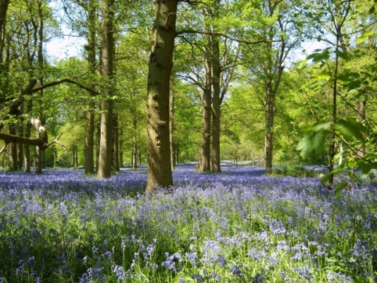
A bit about Norfolk Wildlife Trust…
We protect more than 60 nature reserves across Norfolk for wildlife and people
Saving Norfolk’s Wildlife for the Future
Notes:
Different animals and plants need different sorts of places to live.
Photos: Richard Osbourne, Ray Jones, Tasha North, Nick Carter, Wildstock and Russel Bayell.

Slide 3
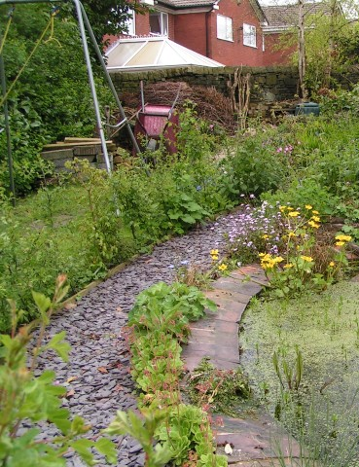
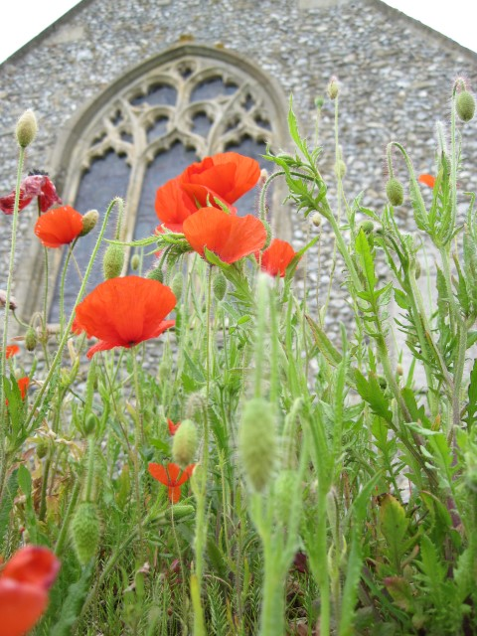
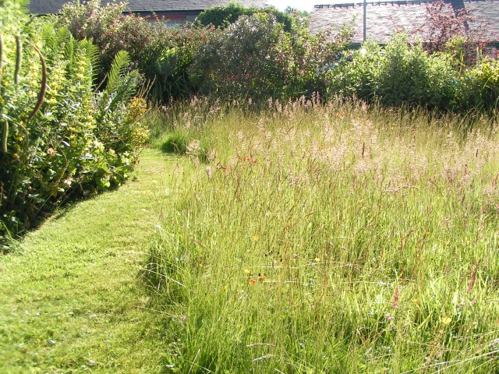
We also help to make gardens, parks, schools, churchyards, roadsides and other areas more wildlife-friendly so that nature reserves are joined up. We call this a “Nature Recovery Network”.
Saving Norfolk’s Wildlife for the Future
Notes:
These areas aren’t immaculately tidy, which is great for wildlife. Some grass is long, there is a pond and the species are native to Britain.
Photos: Richard Burkmarr and David North

Slide 4
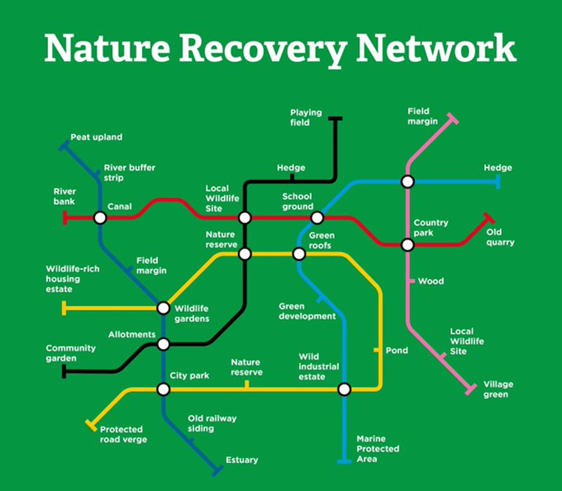
Notes:
Diagram: The Wildlife Trusts

Slide 5
These are words we might use during your visit. Can you work out what they are?
1) A place where plants and animals can live
H
A
B
I
T
A
T
2) An exact type of animal or plant
S
P
E
C
I
E
S
3) An area which is protected for wildlife
N
A
T
U
R
E
R
E
S
E
R
V
E
4) Something plants and animals have done over time so that they can live in their habitat
A
D
A
P
T
5) The number of different plant and animal species in an area
B
I
O
D
I
T
Y
V
E
R
S
I
6) A person who looks after a nature reserve
W
A
R
D
E
N
Saving Norfolk’s Wildlife for the Future

Slide 6
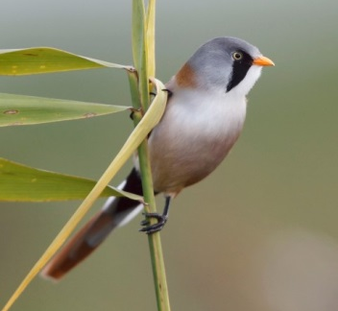
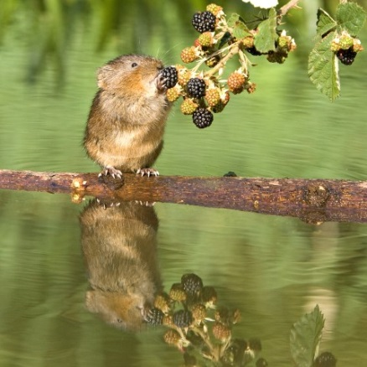
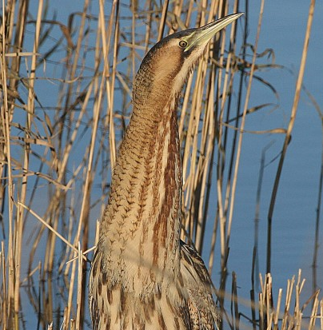
After your visit, you’ll know more about different environments and what lives in them
We’ll find plenty of plants and some small animals, but they’re all wild so what we’ll see is a mystery!
We’ll explore different habitats at Hickling, each with its own different species
Saving Norfolk’s Wildlife for the Future
Notes:
Bearded tit (rare bird) – feet adapted for clinging onto small twigs
Water vole – rare because it needs muddy, plant-covered river banks for its burrow, not concrete! “Ratty” in “Wind in the Willows” was a water vole
Bittern (rare bird) – very well camouflaged in the reeds
Photos: Steve Bond, Peter Mallet and Ian Simmons.

Slide 7
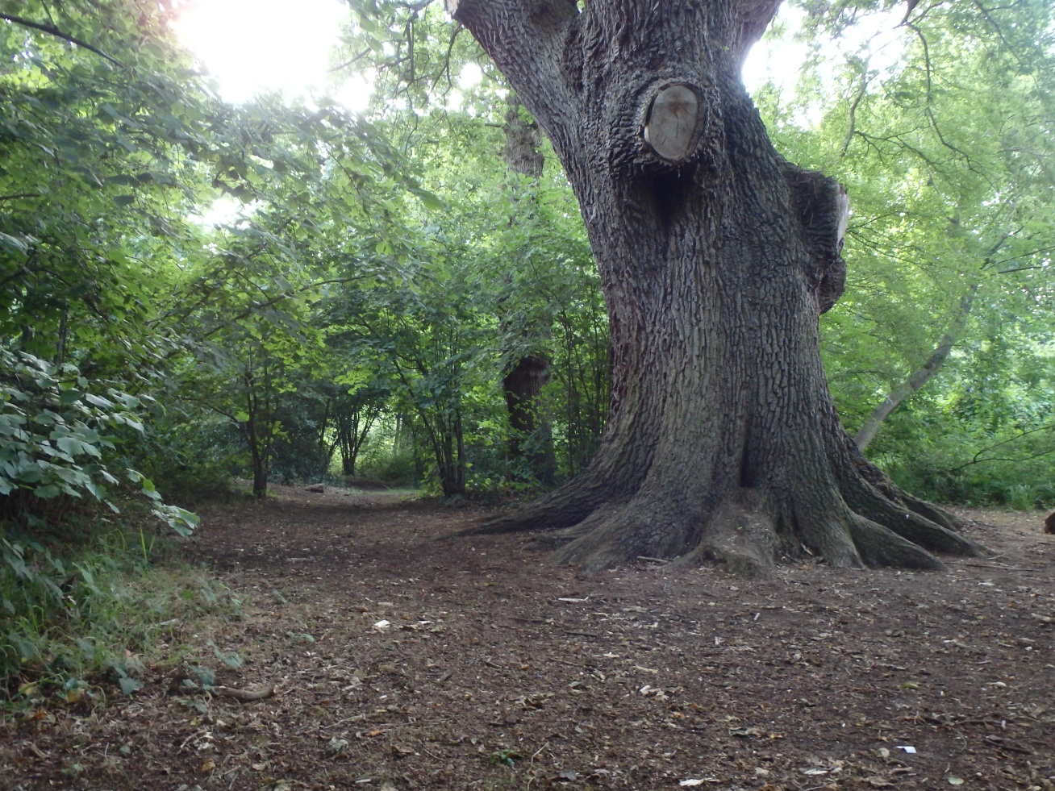
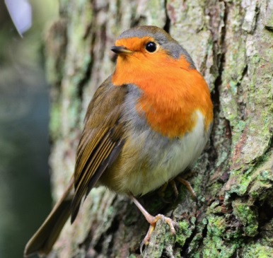
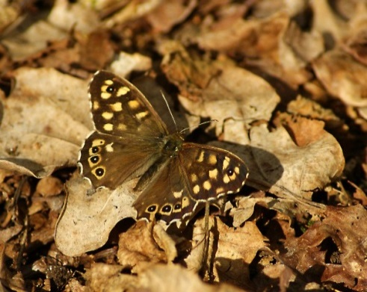
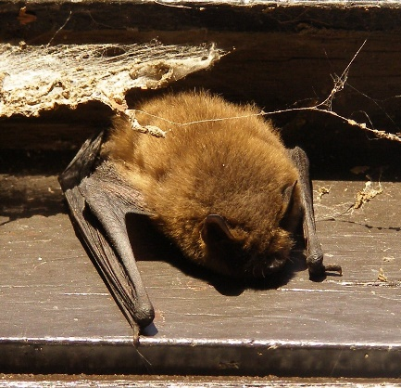
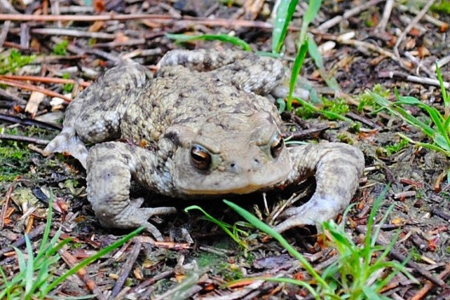
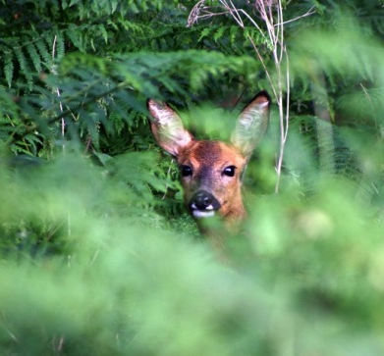
Woodland
Saving Norfolk’s Wildlife for the Future
Notes:
Could discuss camouflage, in/vertebrates, different vertebrate groups
From top left anticlockwise: robin, speckled wood, common toad, woodlouse, roe deer, pipestrelle bat.
Photos: Elizabeth Dack, Amy Lewis, Robert Williamson, Alan Pricek and Yvonne Jones.

Slide 8
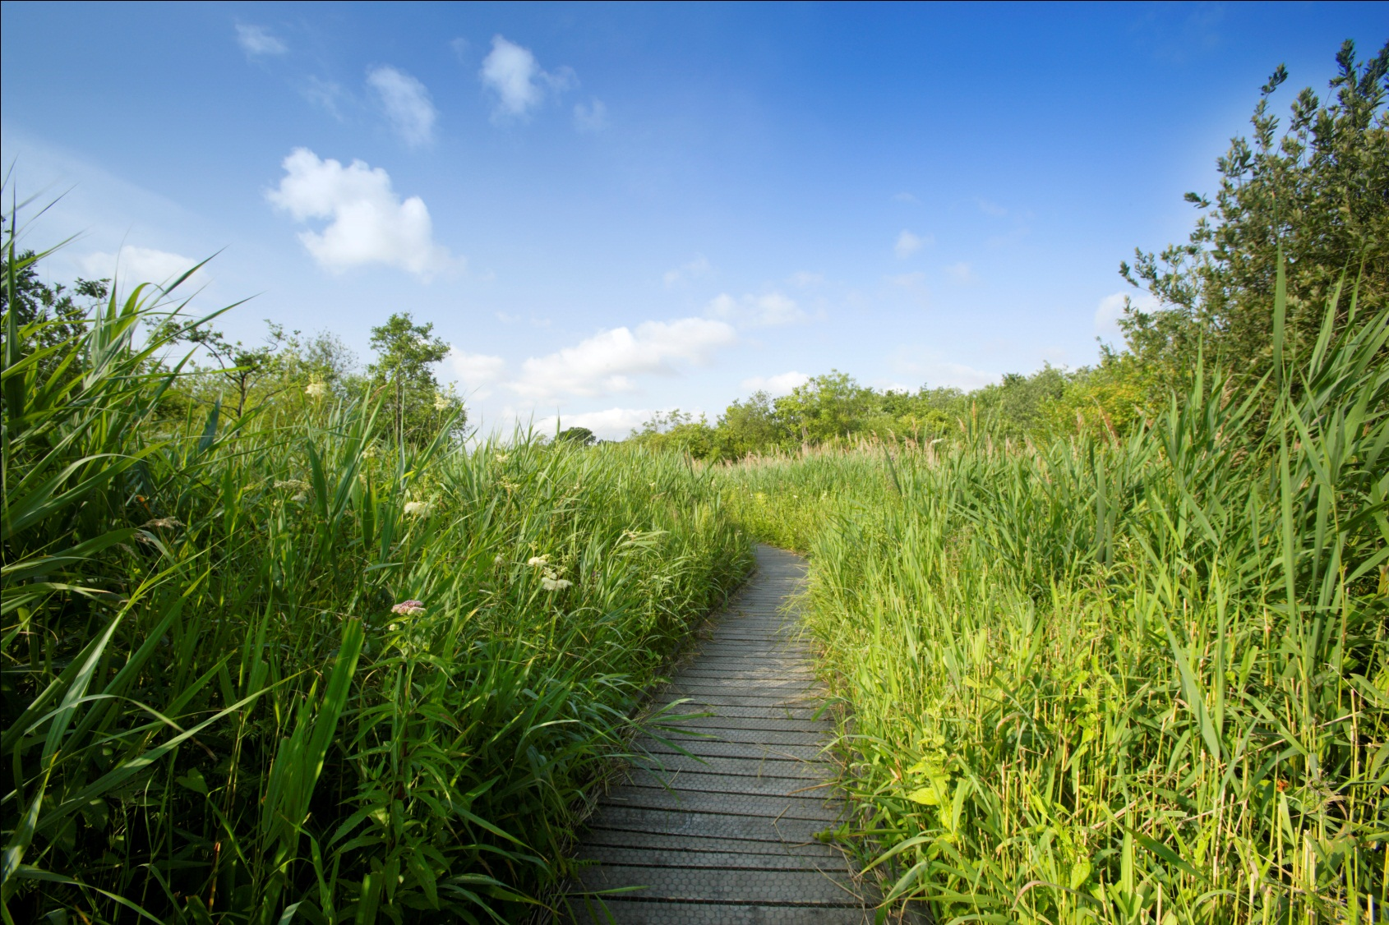
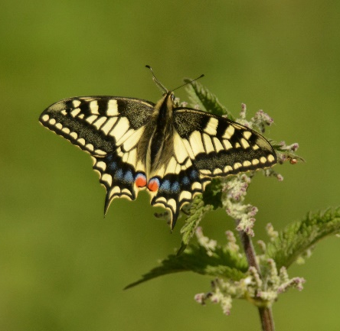
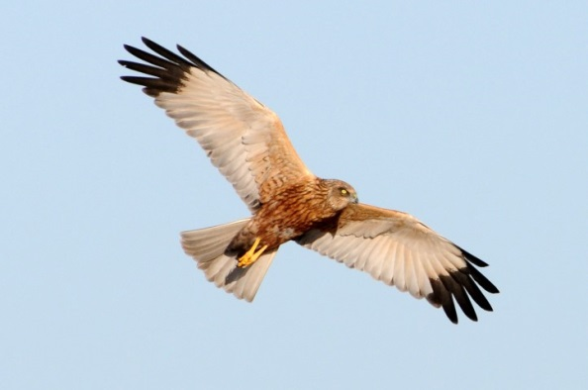
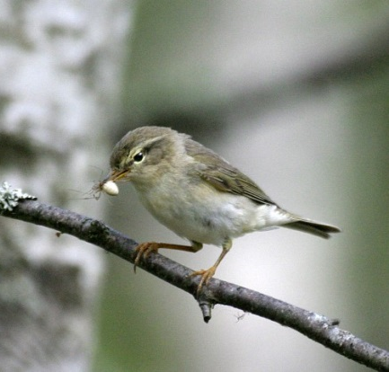
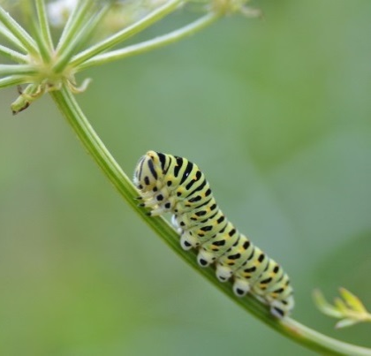
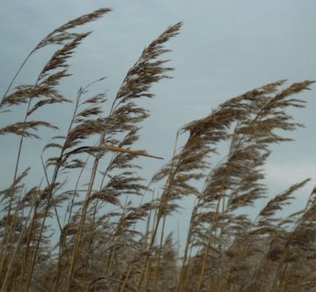
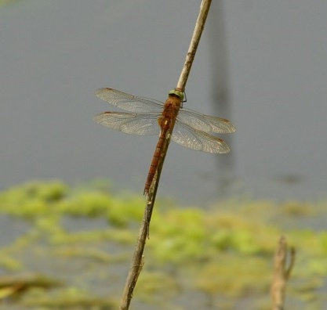
Reed bed
Saving Norfolk’s Wildlife for the Future
Notes:
Anticlockwise from top left: Swallowtail butterfly, swallowtail caterpillar, reeds, Norfolk hawker dragonfly, willow warbler, marsh harrier
Photos: Elizabeth Dack, Nick Appleton, Wildstock, Janine Hawkins and Natural Connections.

Slide 9
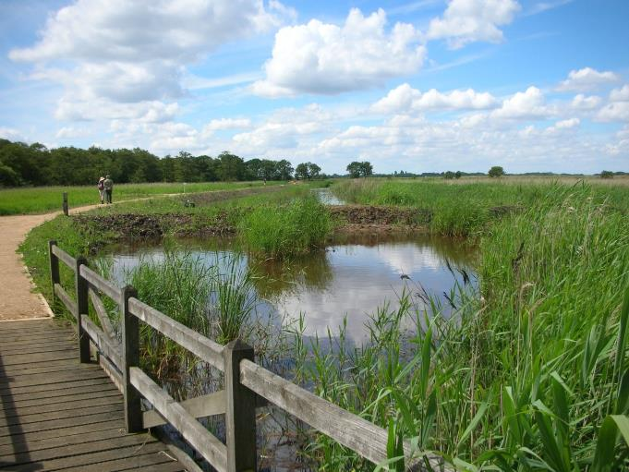
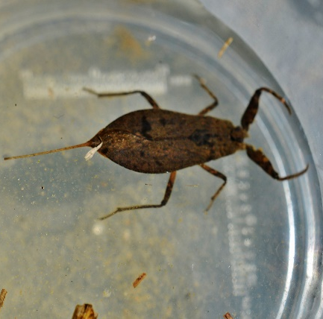
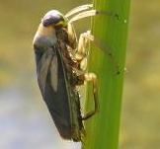
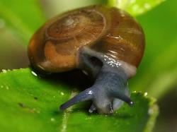
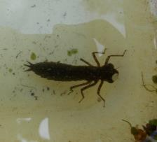
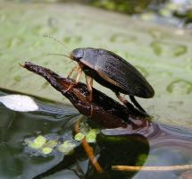
Freshwater Dyke
Saving Norfolk’s Wildlife for the Future
Notes:
Anti- Clockwise from top left: Water scorpion, dragonfly nymph, great diving beetle, ramshorn snail, greater water boatman.
Photos: Elizabeth Dack, Jamie McMillian, Brian Valentine, Richard Burkmarr and Isabelle Mudge

Slide 10
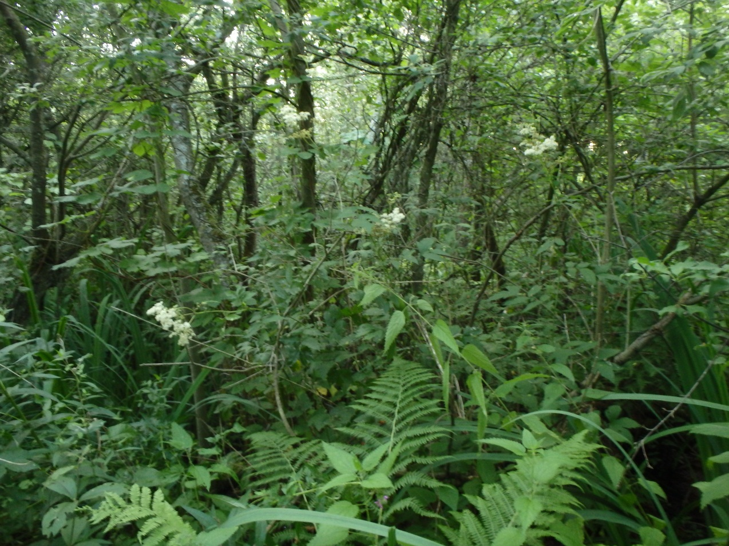
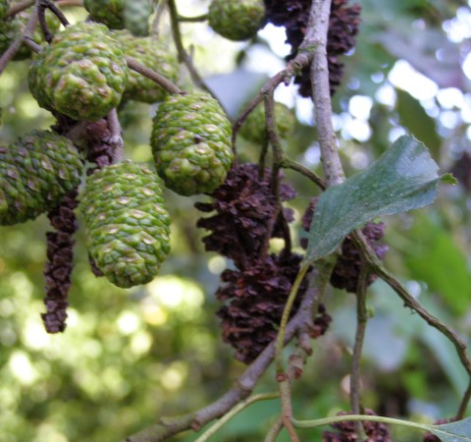
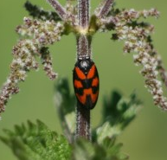
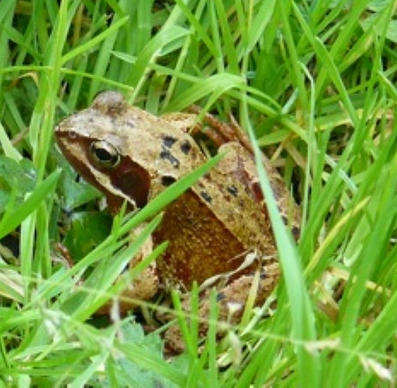
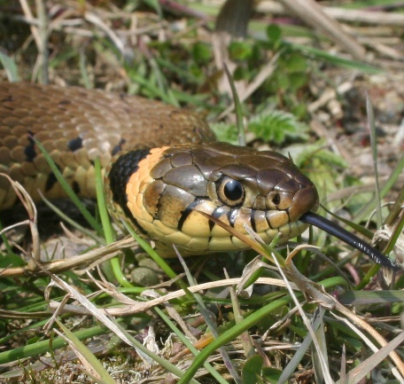
Carr Woodland
Saving Norfolk’s Wildlife for the Future
Notes:
Anticlockwise from top left:Willow warbler eating spider, common frog, grass snake, froghopper, alder,
Grass snakes are completely harmless and very good at swimming.
Photos: Wildstock, Elizabeth Dack, Brenda Gough, Darren Williams, Julian Thomas and Wendy Pollard.

Slide 11
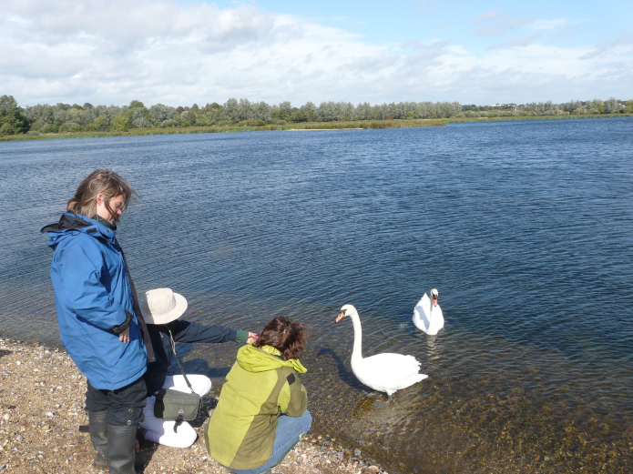
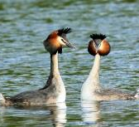
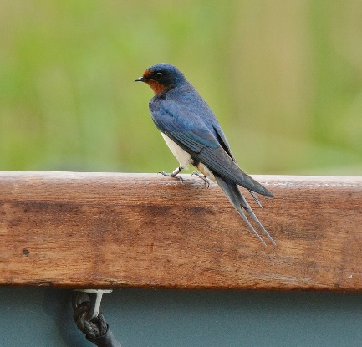
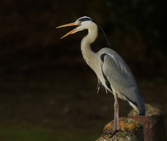
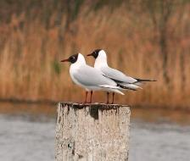
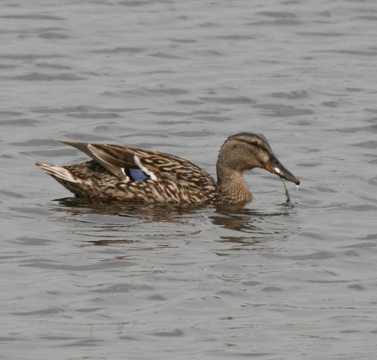
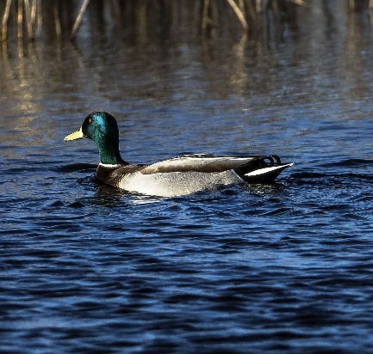
Open Water
Saving Norfolk’s Wildlife for the Future
Notes:
Clockwise from top left: Great crested grebes, swallow, grey heron, male mallard, female mallard, black headed gulls.
Photos: Peter Mallet, Elizabeth Dack, Nick Goodrun, Maurice Funnell, David Savoury and Robert Powell.

Slide 12
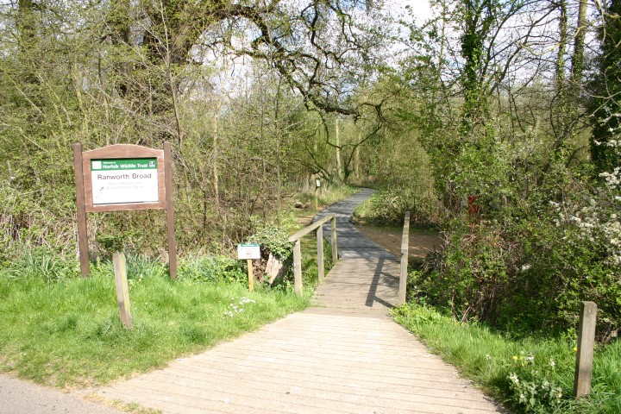
Your coach will drop you off in Ranworth village before we make the short walk to the nature reserve. You’ll be able to use the toilets when you arrive, at lunch time and before you leave.
Saving Norfolk’s Wildlife for the Future
Notes:
Photo: Norfolk Wildlife Trust

Slide 13
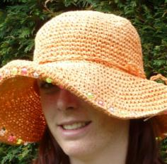








What to wear and bring
Hot and sunny
Whatever the weather
Cold
Waterproof
jacket/trousers, quick drying clothes or spare cloths
Sun hat
Scarf
Welly boots or shoes
you can get dirty
NOT YOUR BEST SHOES!
Sun cream
Warm hat
Insect repellent
or long trousers and sleeves
A re-sealable
drink
Gloves
Saving Norfolk’s Wildlife for the Future

Slide 14


Low Impact Lunch Challenge
A ‘low impact’ lunch is one that doesn’t damage the environment much
Compare the two lunches below, work out which is better and why
Follow our tips to see if you can make your lunch box like the low impact one
This one has less packaging,
which means less rubbish
Ask whoever does the shopping to
buy in bulk rather than
buying lots of individual bags
Use reusable bottles
Try to eat food which has not travelled too far
Use reusable boxes
Take apple cores and orange
peel home to compost.
Saving Norfolk’s Wildlife for the Future
Notes:
Low Impact Lunch – the photo on the right has a lower impact as there is less packaging being made for the food, which uses a lot of energy. This also means that there is less rubbish afterwards, which takes up more energy through rubbish collection services and has to be disposed of somewhere in the countryside, destroying areas of habitat and possibly causing pollution.
Home-made sandwiches and cake in reusable tubs are lower impact than shop bought, over-packaged versions - and they work out cheaper!
By buying big bags of crisps or chocolate or nuts and pouring out a day’s serving into a tub for each lunch box saves packaging – individual lunch box-sized chocolate bars or mini yoghurts or single serving bags of dried fruit produce tonnes of unnecessary waste every year.
Don’t buy pre-prepared fruit, it just creates more packaging. Instead, buy fruit as locally as possible and either take whole or prepare fruit salads at home and put into a reusable tub.
Don’t buy bottled water, tap water is fine. In Great Britain we have some of the best quality tap water in the world! Use a refillable bottle, it’s much cheaper and much, much kinder to the planet.

Slide 15

What would you like to find out
about Hickling’s wildlife?
Can you each come up with 2 questions?
Saving Norfolk’s Wildlife for the Future
Notes:
These don’t necessarily have to be answerable.
Photo; Elizabeth Dack.

Slide 16

See you soon!
Saving Norfolk’s Wildlife for the Future
Notes:
Photo: Richard Osbourne

