Slide 1

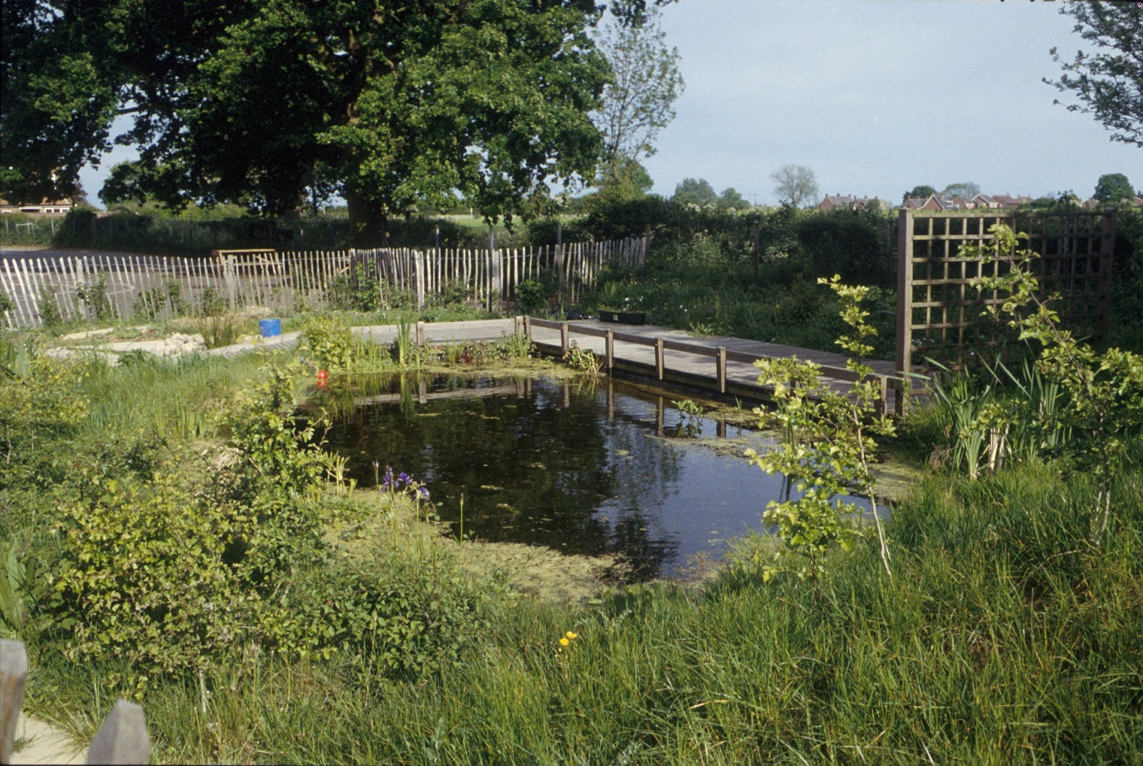

The Norfolk Wildlife Trust is
visiting your school!
Saving Norfolk’s Wildlife for the Future
Saving Norfolk’s Wildlife for the Future

Slide 2
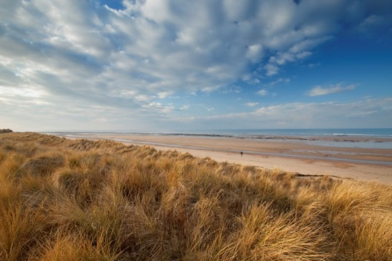
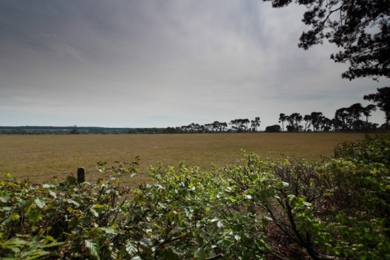
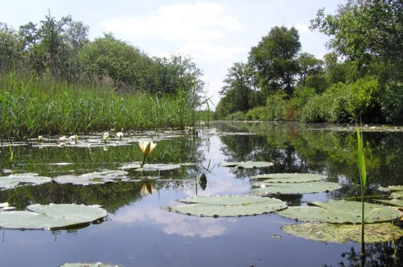
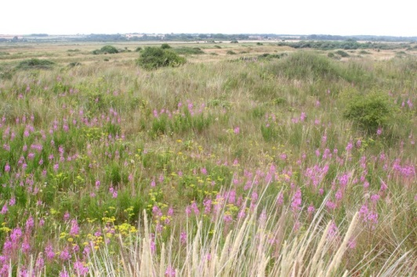
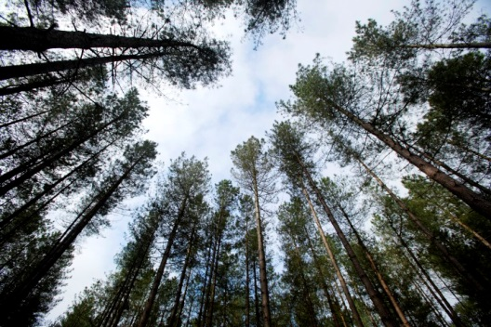
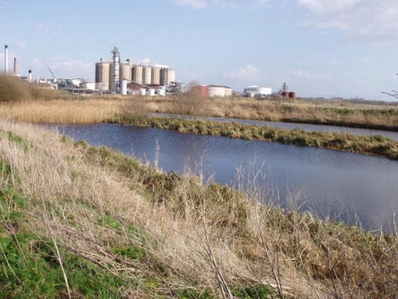
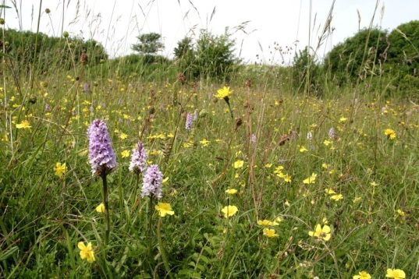
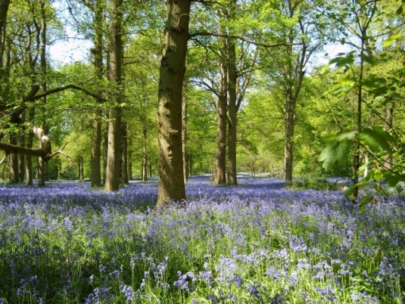
A bit about Norfolk Wildlife Trust…
We protect more than 60 nature reserves across Norfolk for wildlife and people
Saving Norfolk’s Wildlife for the Future
Notes:
Different animals and plants need different sorts of places to live.
Photos: Richard Osbourne, Ray Jones, Tasha North, Nick Carter, Wildstock and Russel Bayell.

Slide 3
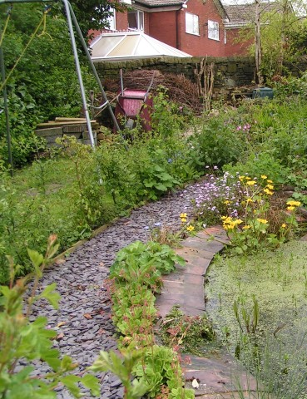
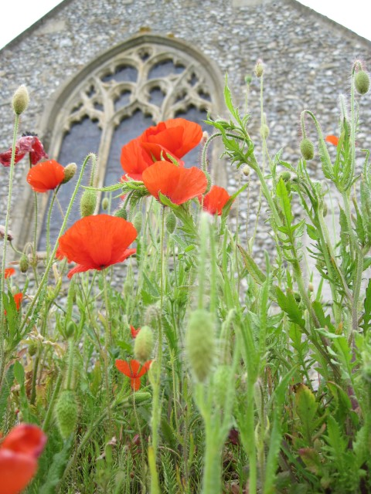
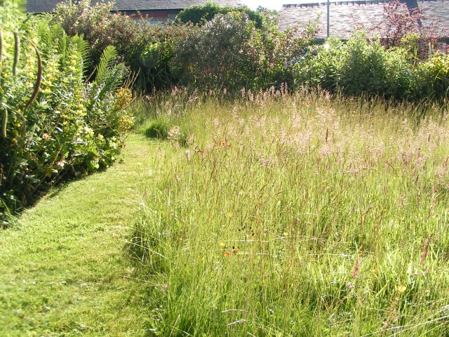
We also help to make gardens, parks, schools, churchyards, roadsides and other areas more wildlife-friendly so that nature reserves are joined up. We call this a “Nature Recovery Network”.
Saving Norfolk’s Wildlife for the Future
Notes:
These areas aren’t immaculately tidy, which is great for wildlife. Some grass is long, there is a pond and the species are native to Britain.
Photos: Richard Burkmarr and David North

Slide 4
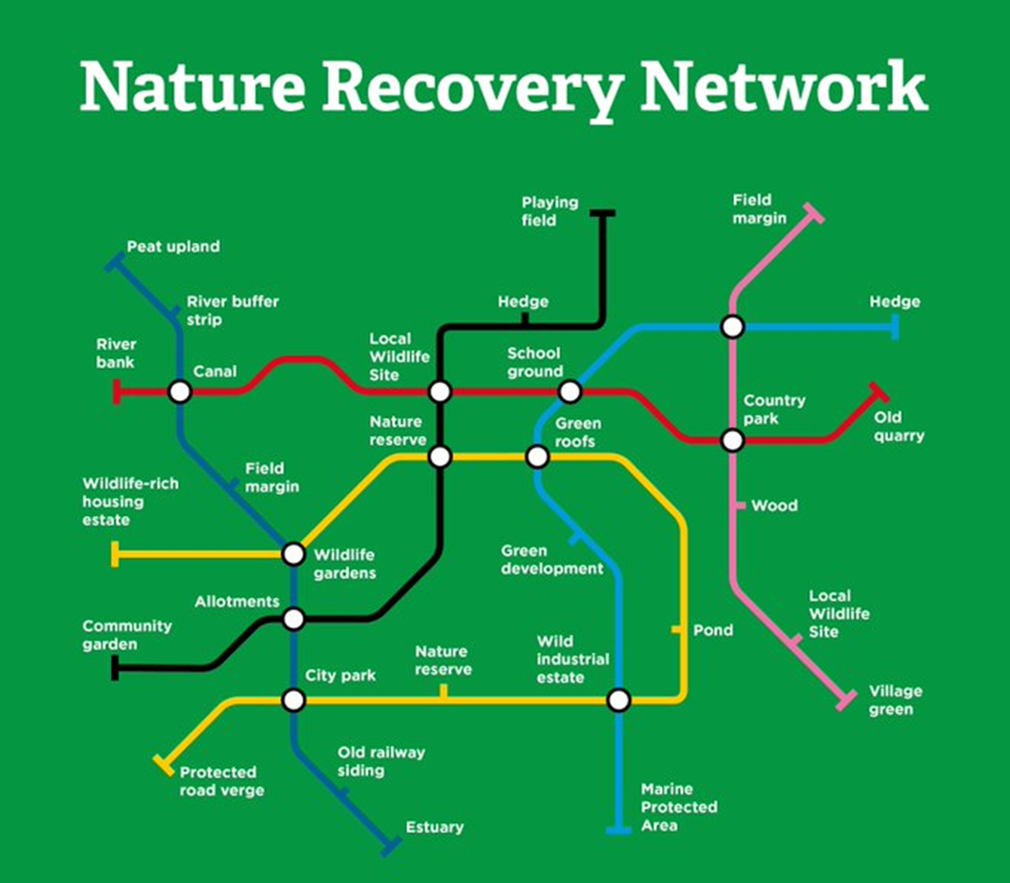
Notes:
Diagram: The Wildlife Trusts

Slide 5
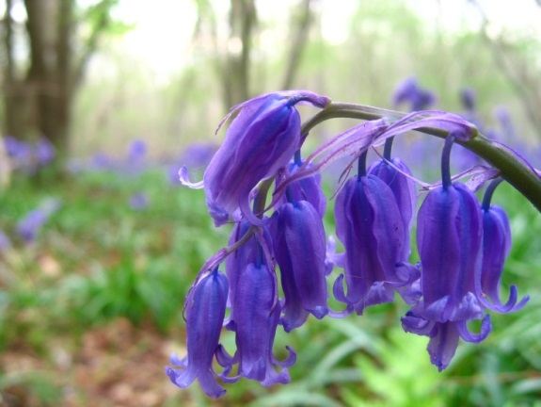
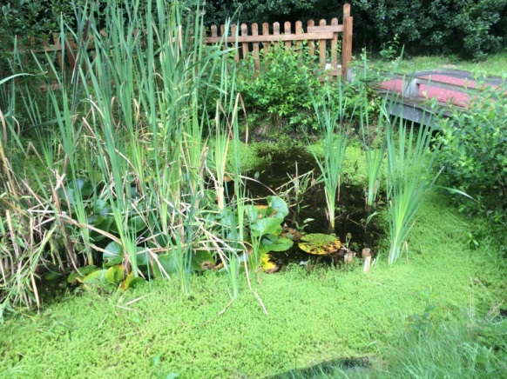
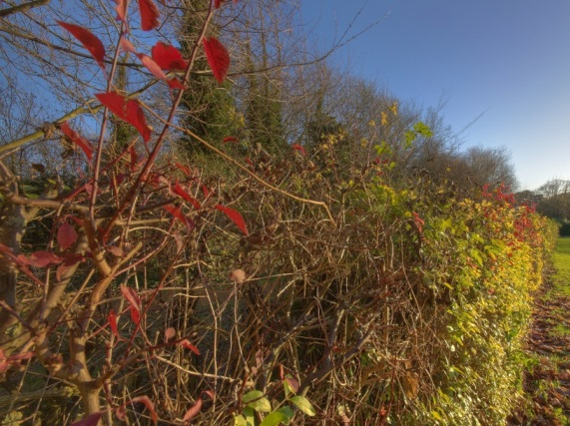
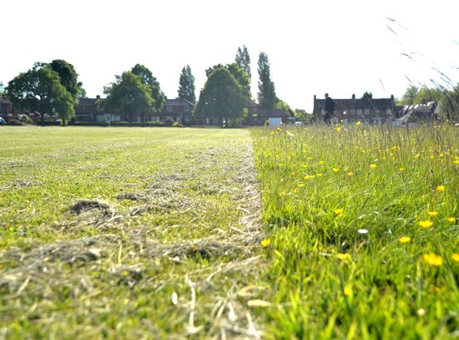
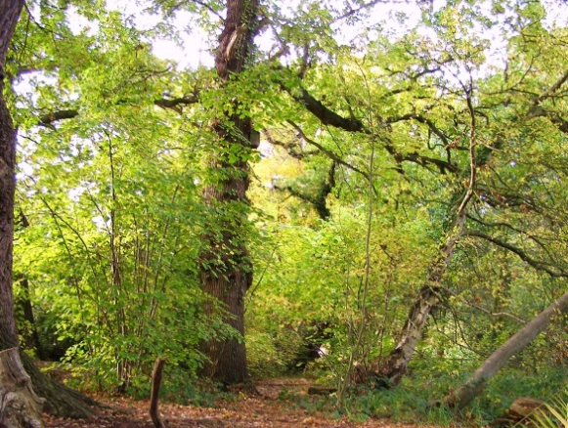
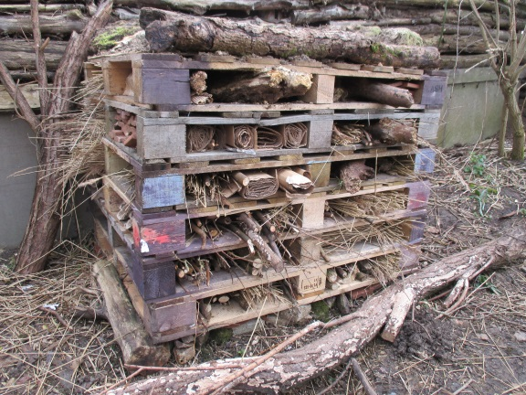
Which of these habitats do you
have at your school?
Wildflowers
Pond
Hedgerow
Playing field
Woodland
Minibeast hotel
Saving Norfolk’s Wildlife for the Future
Notes:
Habitats come in all shapes and sizes, from large woodlands to a small patch of flowers. How many of these habitats do you have on your school grounds?
Photos: Matthew Tebbutt, Sutton Primary, Mark Burr, Birmingham Mail, Elizabeth Dack, Gemma Walker

Slide 6
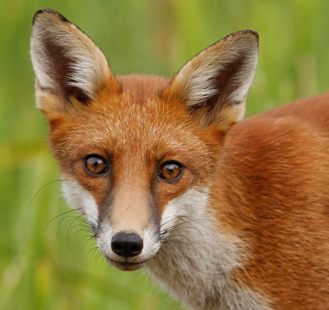
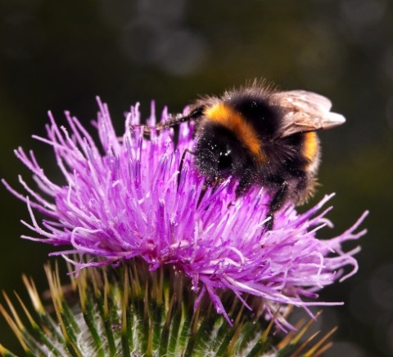
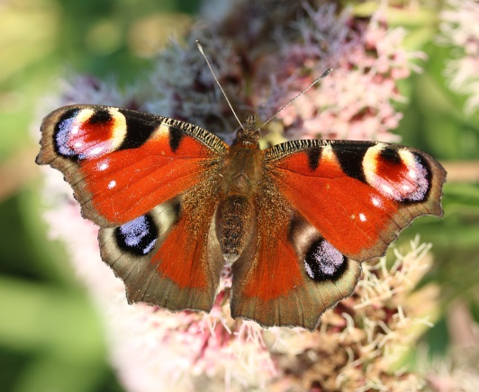
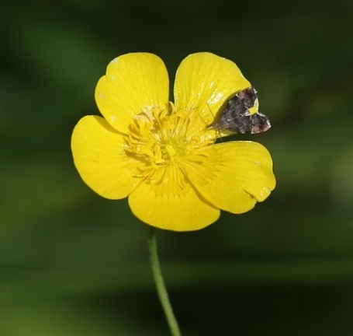
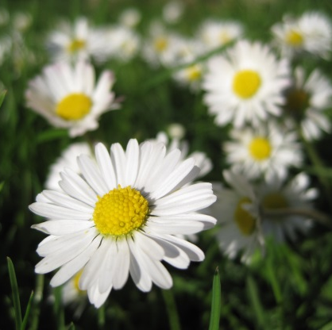
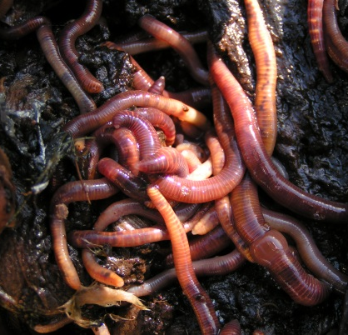
Can you name some of the species you might find on your playing field?
Saving Norfolk’s Wildlife for the Future
Notes:
Your playing field is full of life, especially if some of the grass has been left to grow long. Can you name these species? Clockwise from top left: Fox, bumble bee (buff tailed), butterfly (peacock), earthworm, daisy, buttercup.
Photos: Brian Macfarlane, David Rose, David Goodrum, Ian Davis, Elizabeth Dack, Mark Burr

Slide 7

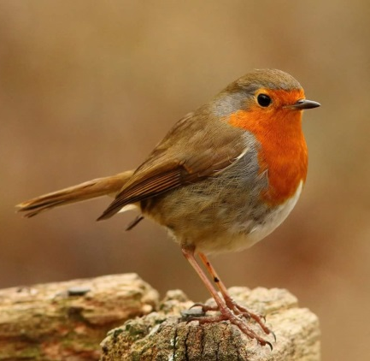
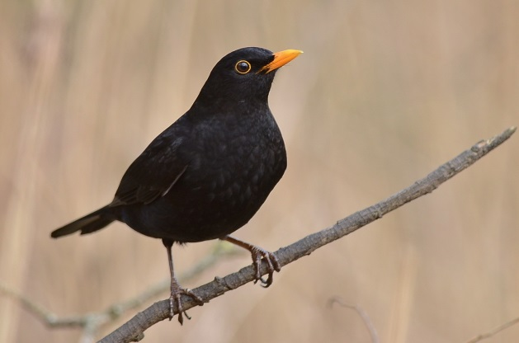
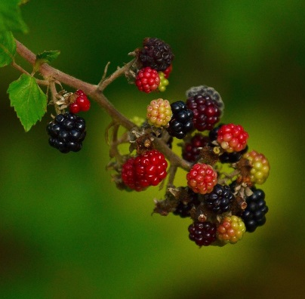
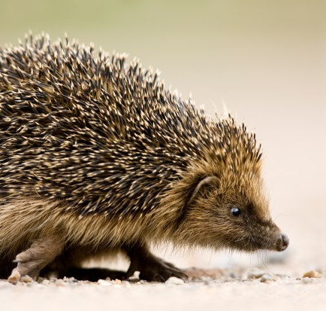
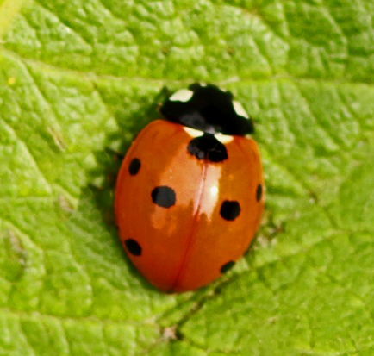
Can you name some of the
species you might find in a hedge?
Saving Norfolk’s Wildlife for the Future
Notes:
Hedges used to criss-cross the whole of Britain, due to the intensification of farming and the construction of towns and roads, there are far fewer today. Some of them can be hundreds of years old! Can you name these species? Clockwise from top left: Robin, blackbird, blackberries, ladybird, hedgehog.
Photos: Leigh Gallant, Peter Mallet, Elizabeth Dack, Howard Stone

Slide 8
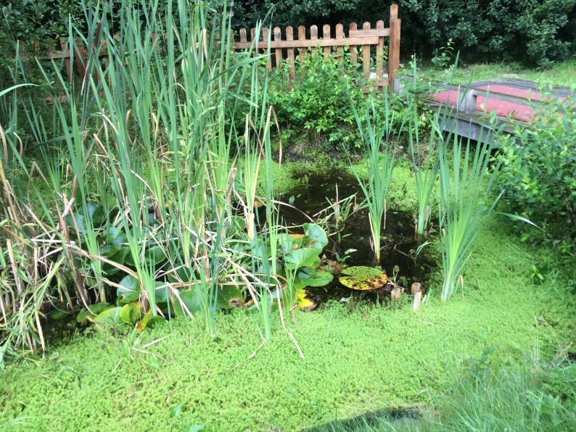
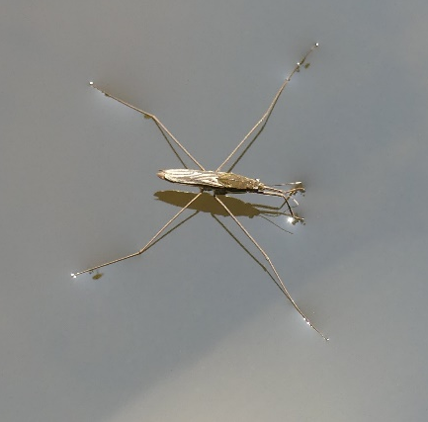
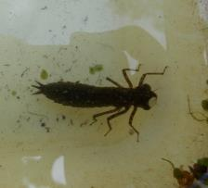
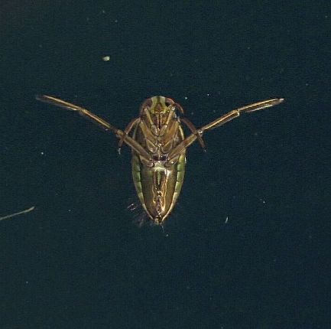
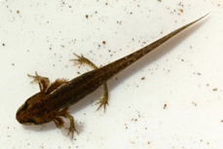
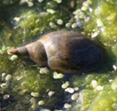
Can you name some of the
species you might find in a pond?
Saving Norfolk’s Wildlife for the Future
Notes:
Many species of freshwater minibeasts spend most of their lives underwater as nymphs before leaving the pond as adults. Can you name some of these species? Clockwise from top left: Pond skater, dragonfly nymph, lesser water boatman, pond snail, smooth newt.
Photos: RVA News, Jessica Reiderer, FSC Guides, Hazel Munt, Cliff Baldwin, Pat Adams, Isabelle Mudge

Slide 9
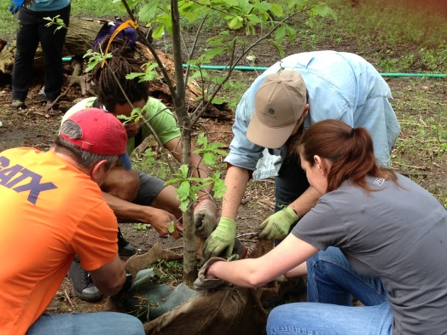
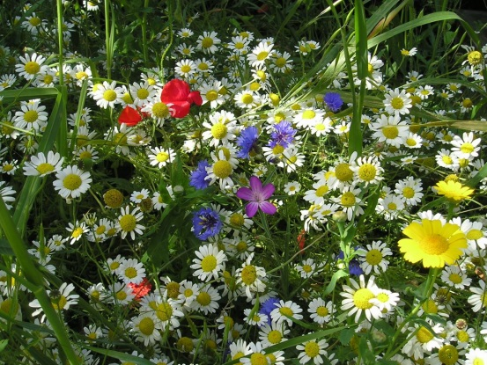
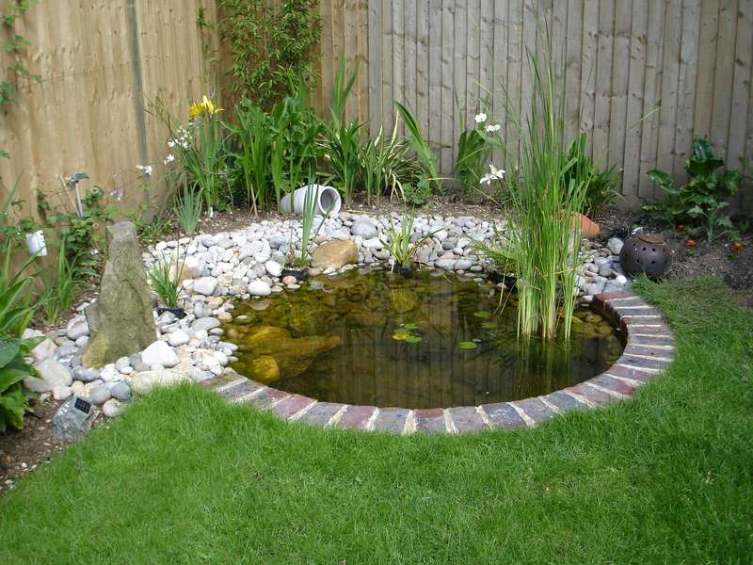
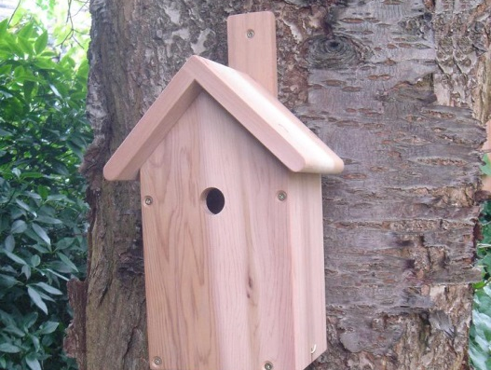
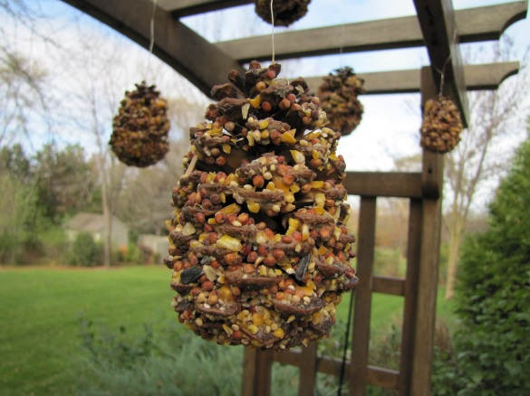

How could you make your school
a better place for wildlife?
Plant trees
Plant wildflowers
Build a pond
Put up bird boxes
Make bird feeders
Make a bug hotel
Saving Norfolk’s Wildlife for the Future
Notes:
Everyone can help by doing a little bit for wildlife. All of those little bits add up to make a living landscape. What things could you do around your school to help wildlife? Clockwise from top left: Plant trees, plant wildflowers, build a pond, put up bird boxes, make bird feeders, make a bug hotel. How many ideas did you come up with? Can you think of any which aren’t included on this slide?
Photos: RVA News, wildflowers.uk.com, Pinterest, Nature Cameras, Icon Home Design, Gemma Walker

Slide 10
These are words we might use during your visit. Can you work out what they are?
1) A place where plants and animals can live
H
A
B
I
T
A
T
2) An exact type of animal or plant
S
P
E
C
I
E
S
3) An area which is protected for wildlife
N
A
T
U
R
E
R
E
S
E
R
V
E
4) Something plants and animals have done over time so that they can live in their habitat
A
D
A
P
T
5) The number of different plant and animal species in an area
B
I
O
D
I
T
Y
V
E
R
S
I
6) A person who looks after a nature reserve
W
A
R
D
E
N
Saving Norfolk’s Wildlife for the Future

Slide 11
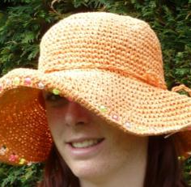
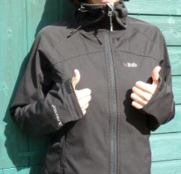
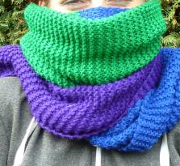
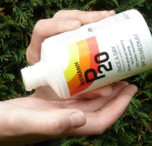
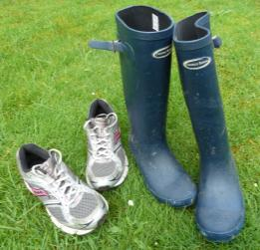
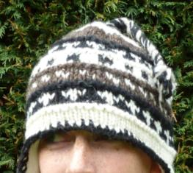
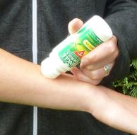
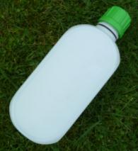
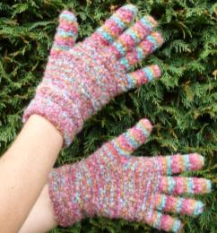
What to wear and bring
Hot and sunny
Whatever the weather
Cold
Waterproof
jacket/trousers, quick drying clothes or spare cloths
Sun hat
Scarf
Welly boots or shoes
you can get dirty
NOT YOUR BEST SHOES!
Sun cream
Warm hat
Insect repellent
or long trousers and sleeves
A re-sealable
drink
Gloves
Saving Norfolk’s Wildlife for the Future

Slide 12

What would you like to find out
about Norfolk’s wildlife?
Can you each come up with 2 questions?
Saving Norfolk’s Wildlife for the Future
Notes:
These don’t necessarily have to be answerable.
Photo; Elizabeth Dack.

Slide 13

See you soon!
Saving Norfolk’s Wildlife for the Future
Notes:
Photo: Copper Beech Natural Playgrounds

