Slide 1
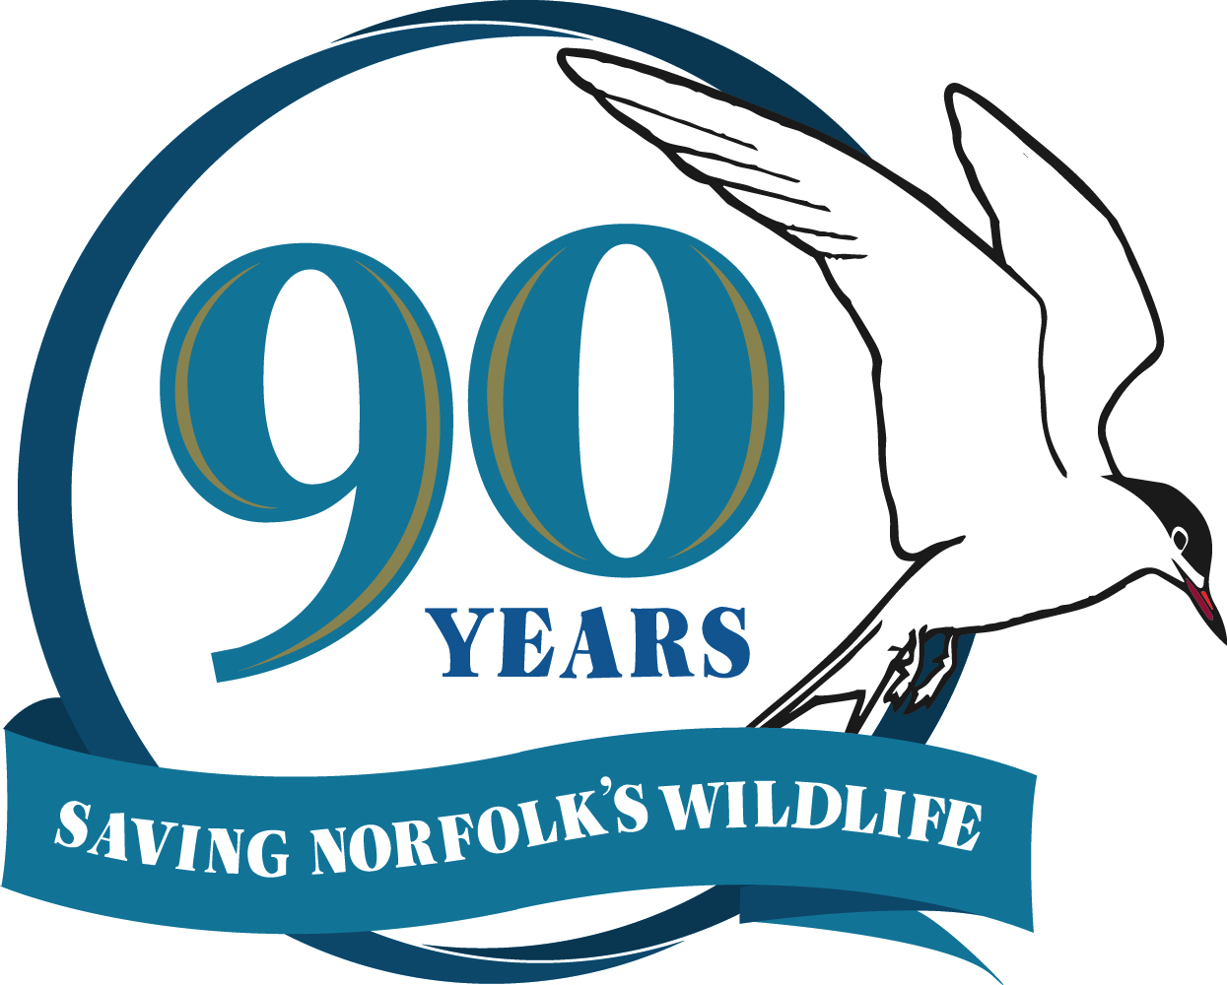
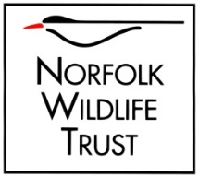
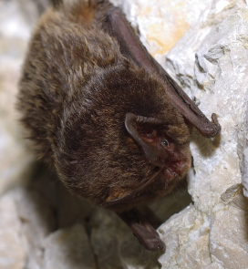
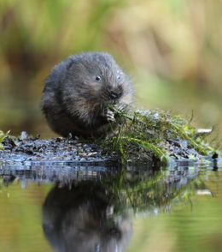
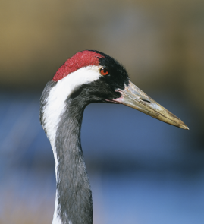
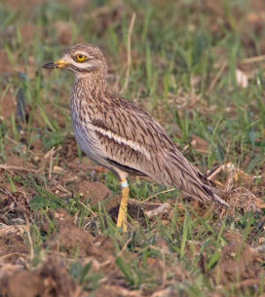
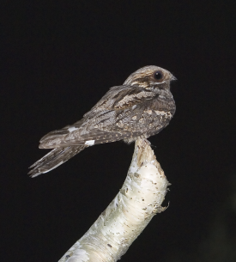
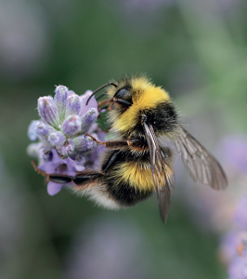
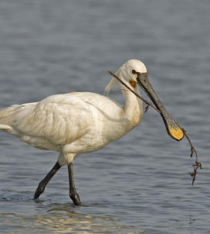
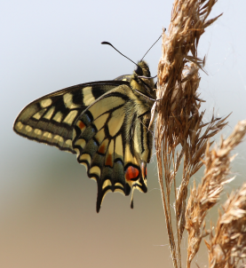
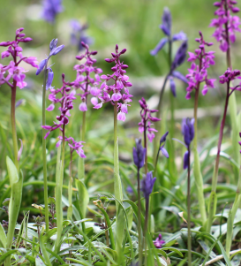
Year of Norfolk's Nature
Saving Norfolk’s Wildlife for the Future

Slide 2
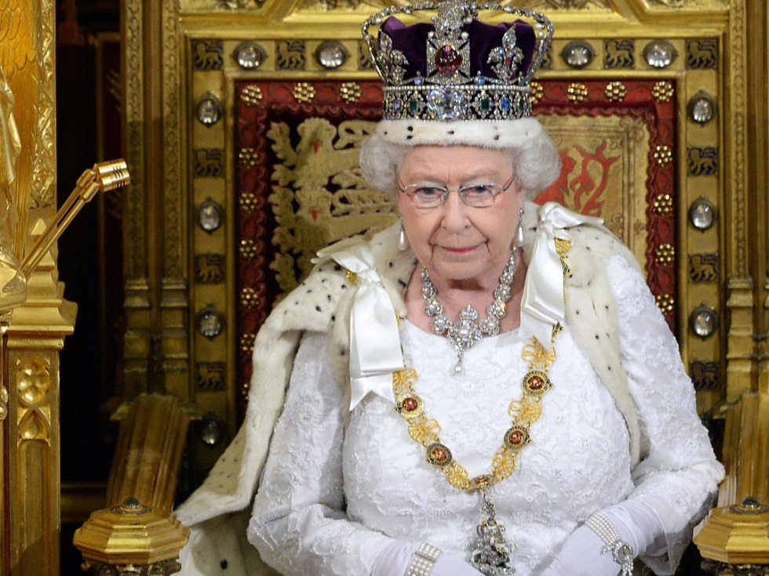
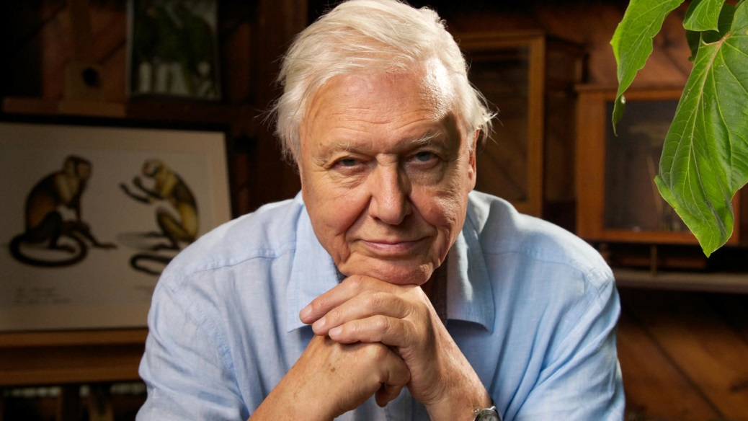
Queen Elizabeth
David Attenborough
Saving Norfolk’s Wildlife for the Future

Slide 3
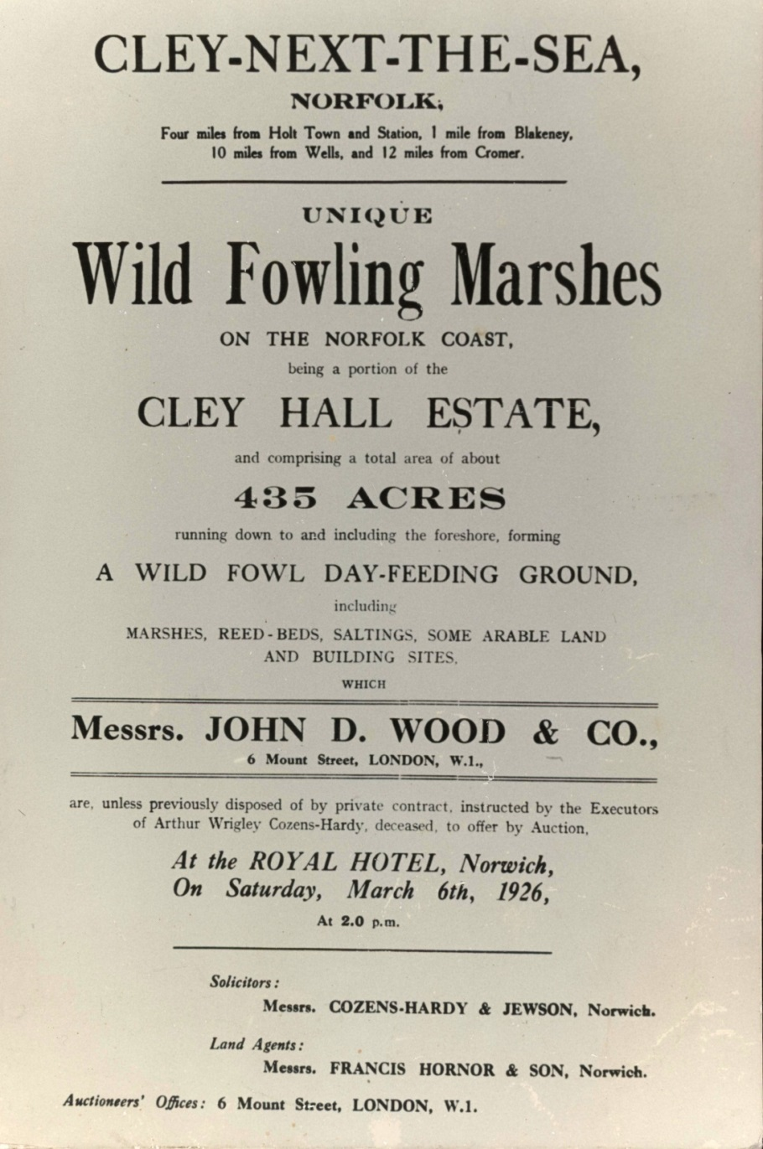
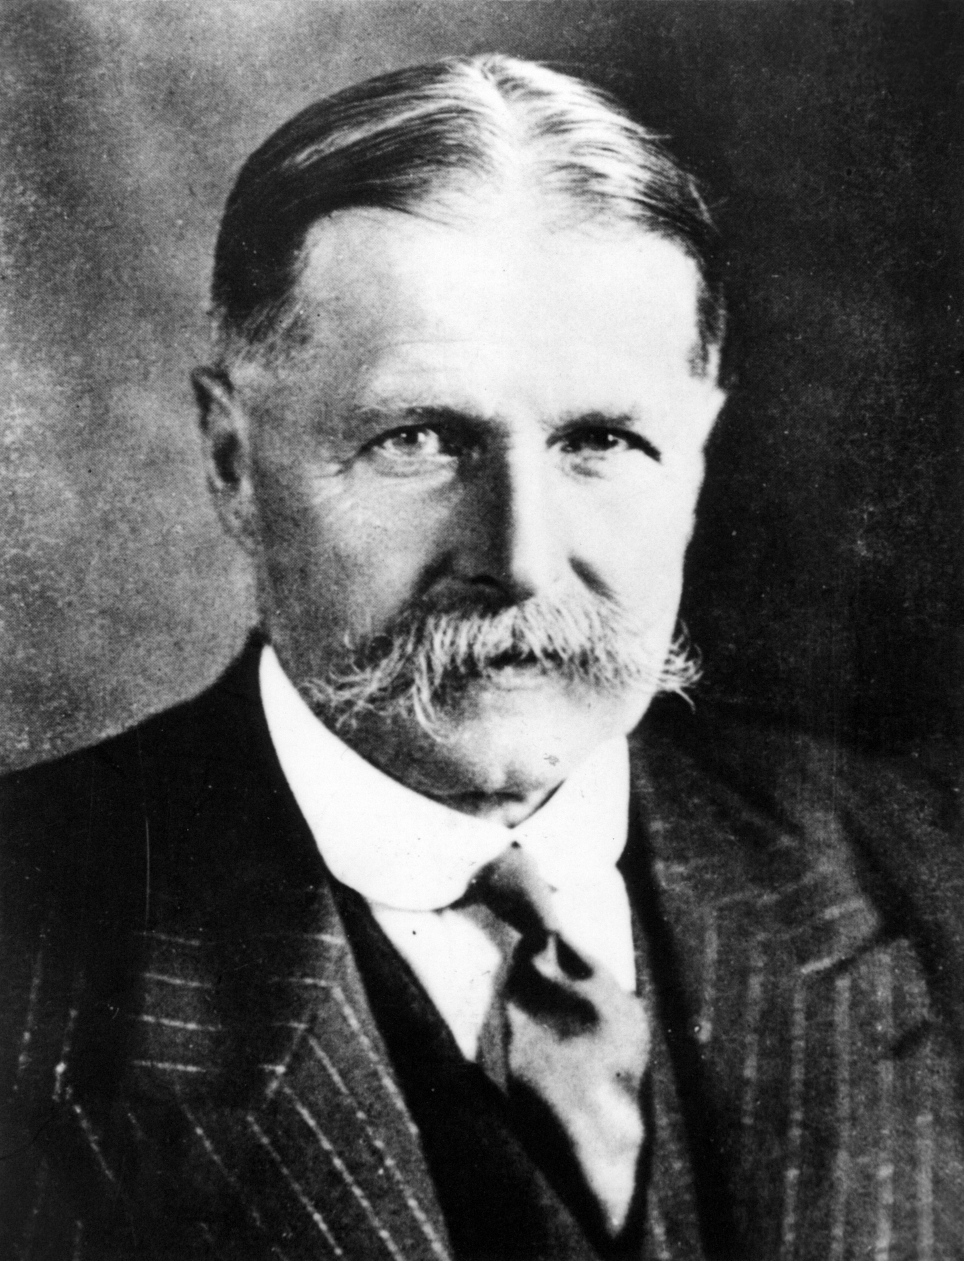
Saving Norfolk’s Wildlife for the Future

Slide 4
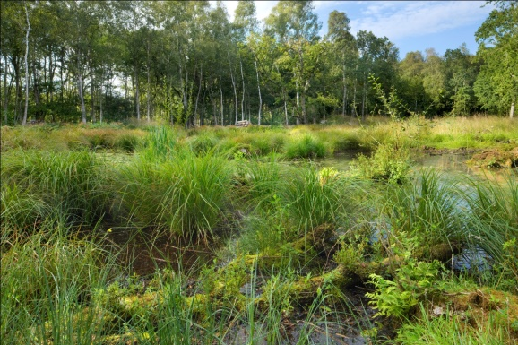
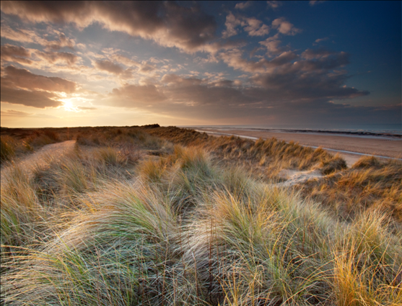
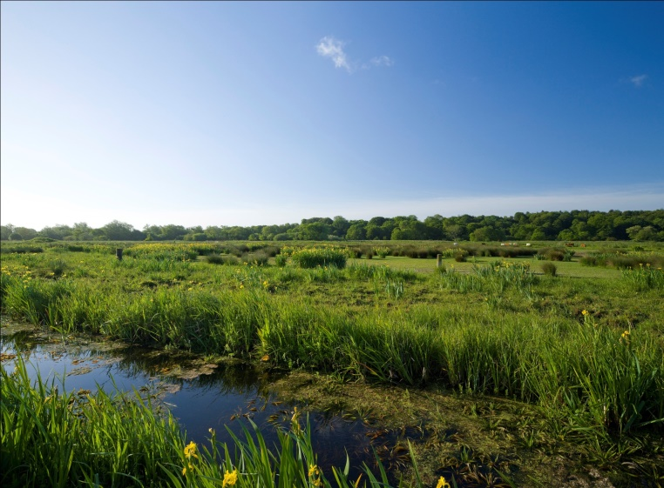
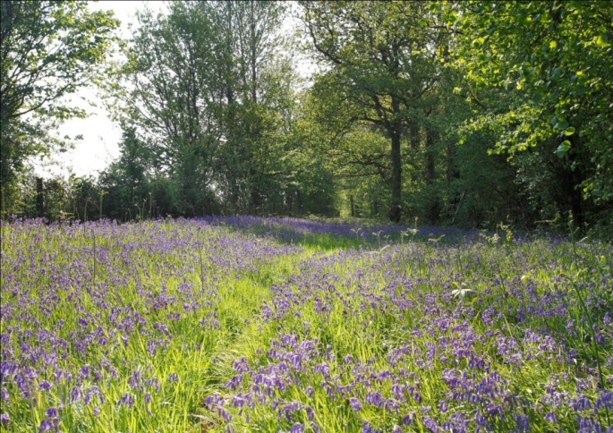
Today we have over 50 nature reserves!
Saving Norfolk’s Wildlife for the Future

Slide 5
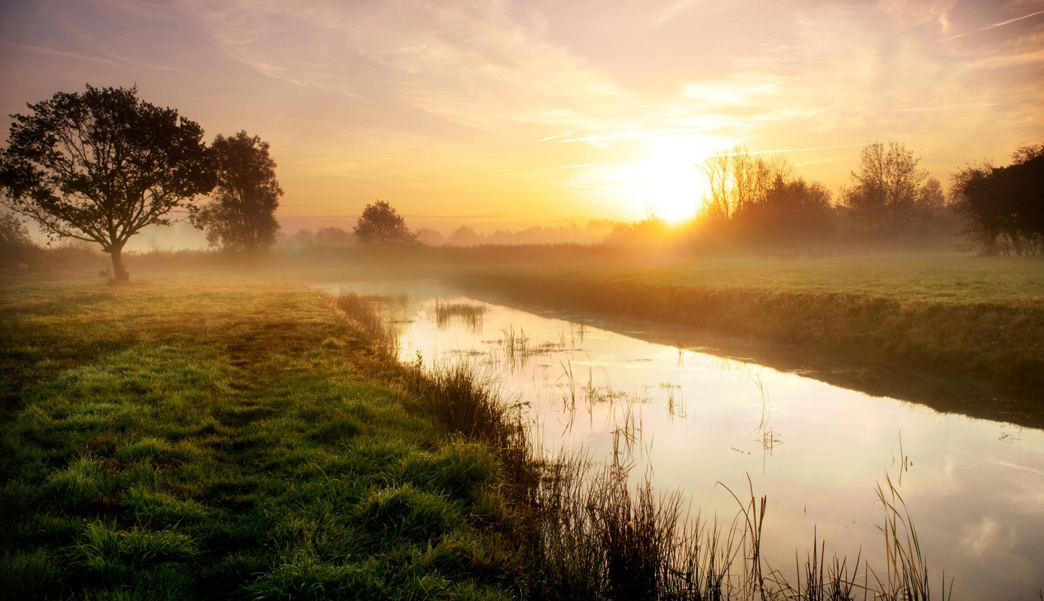
Norfolk Wildlife Trust seeks a sustainable environment for people and wildlife, where the future of wildlife is protected and enhanced through sympathetic management, and people are connected with and inspired by Norfolk’s wildlife and wild spaces.
Saving Norfolk’s Wildlife for the Future

Slide 6
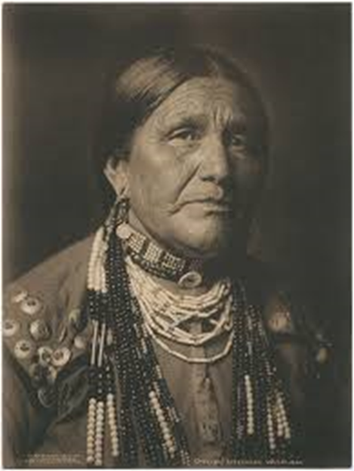
“We do not inherit the earth from our ancestors, we borrow it from our children”
Saving Norfolk’s Wildlife for the Future

Slide 7
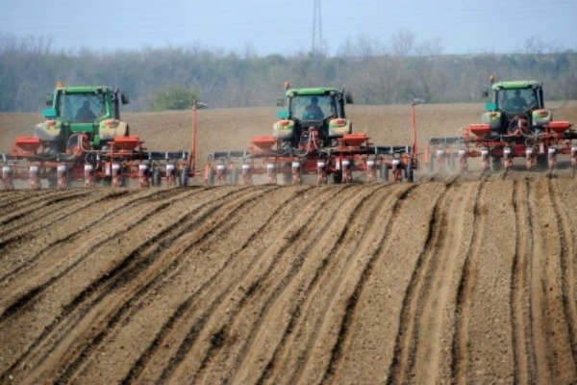
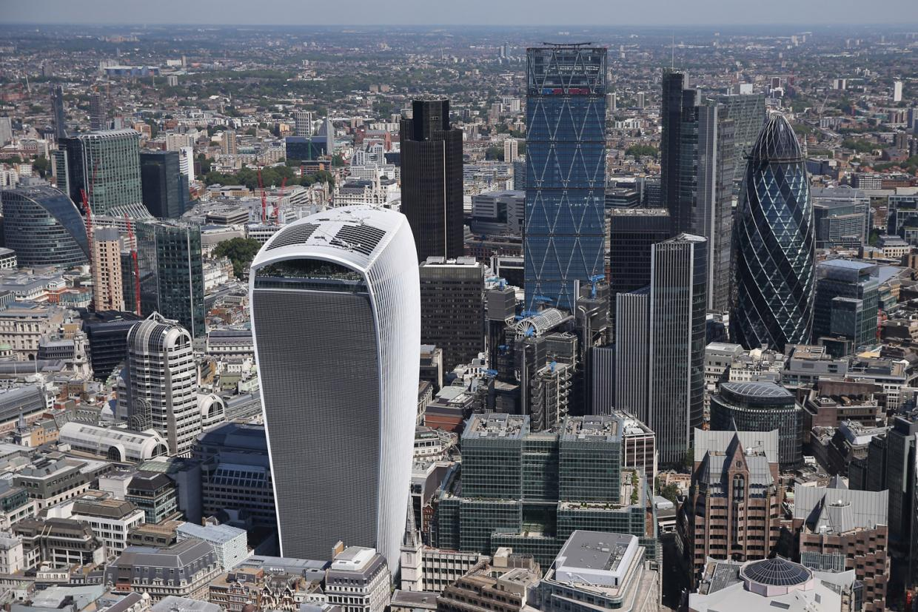
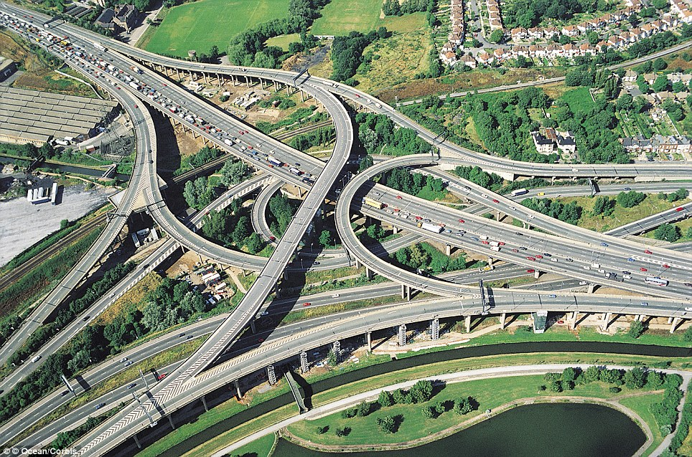
Saving Norfolk’s Wildlife for the Future

Slide 8
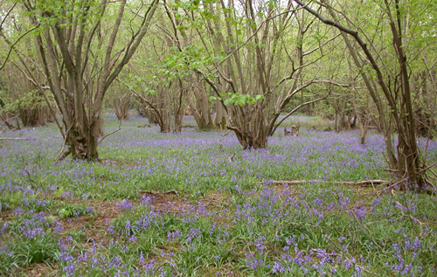
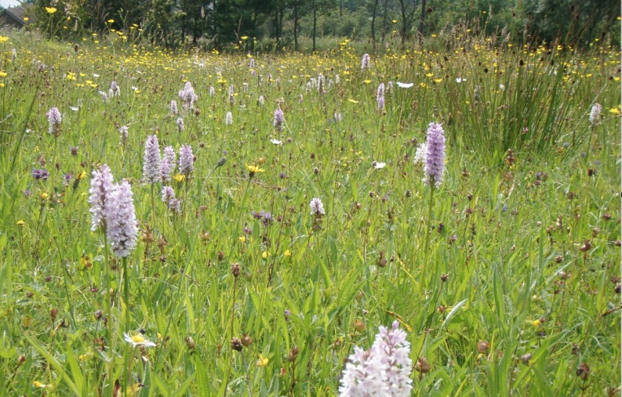
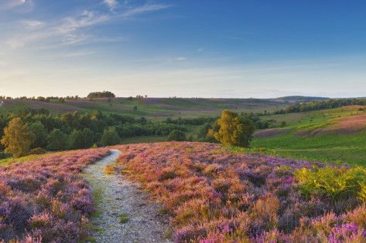
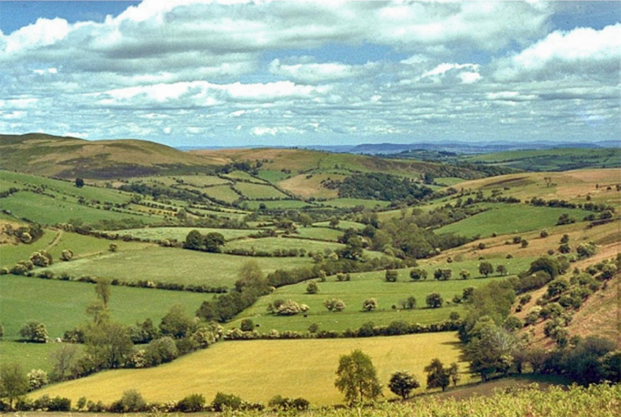
Coppiced Woodland
Lowland Meadow
Lowland Heathland
Ancient Hedgerows
Saving Norfolk’s Wildlife for the Future

Slide 9
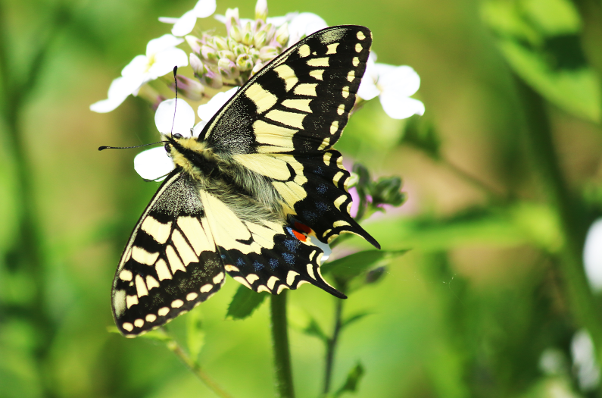
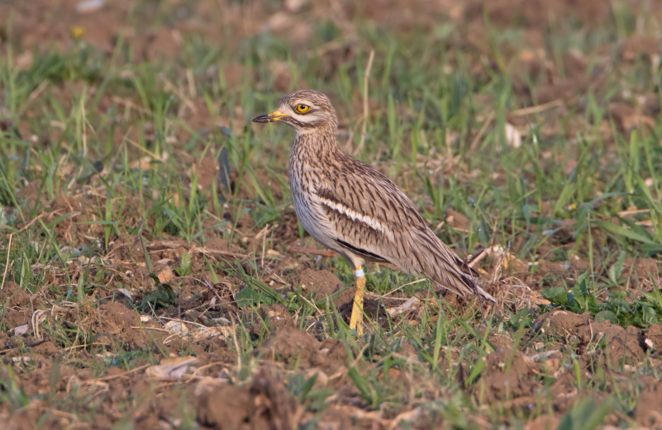
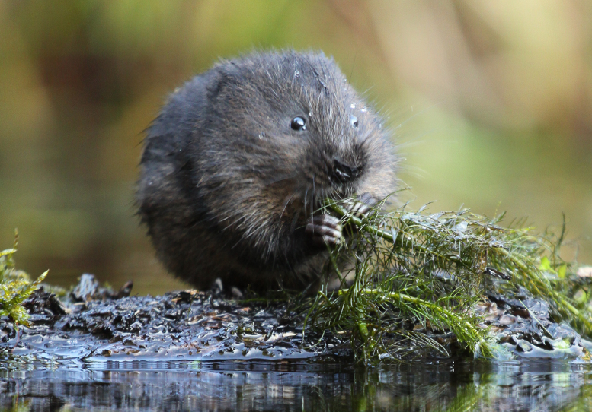
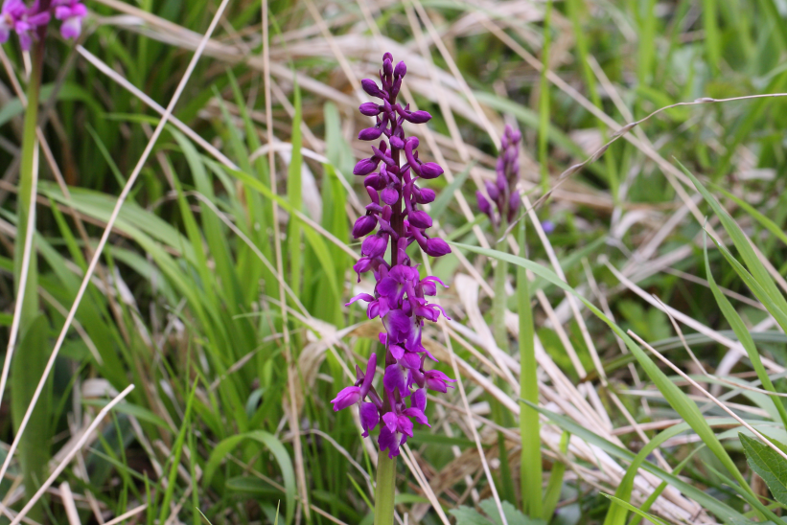
Swallowtail Butterfly
Stone Curlew
Water Vole
Early Purple Orchid
Saving Norfolk’s Wildlife for the Future

Slide 10
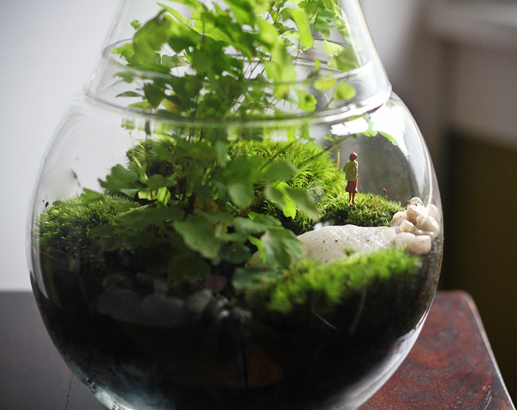
Saving Norfolk’s Wildlife for the Future

Slide 11
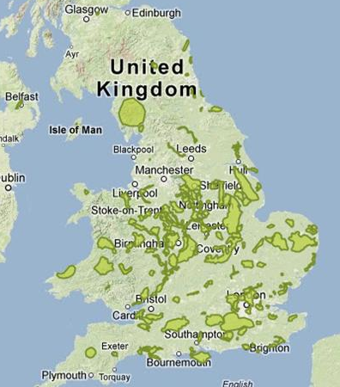
Living Landscape Areas Across the UK
Saving Norfolk’s Wildlife for the Future

Slide 12
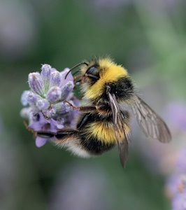
9 for 90
Saving Norfolk’s Wildlife for the Future

Slide 13
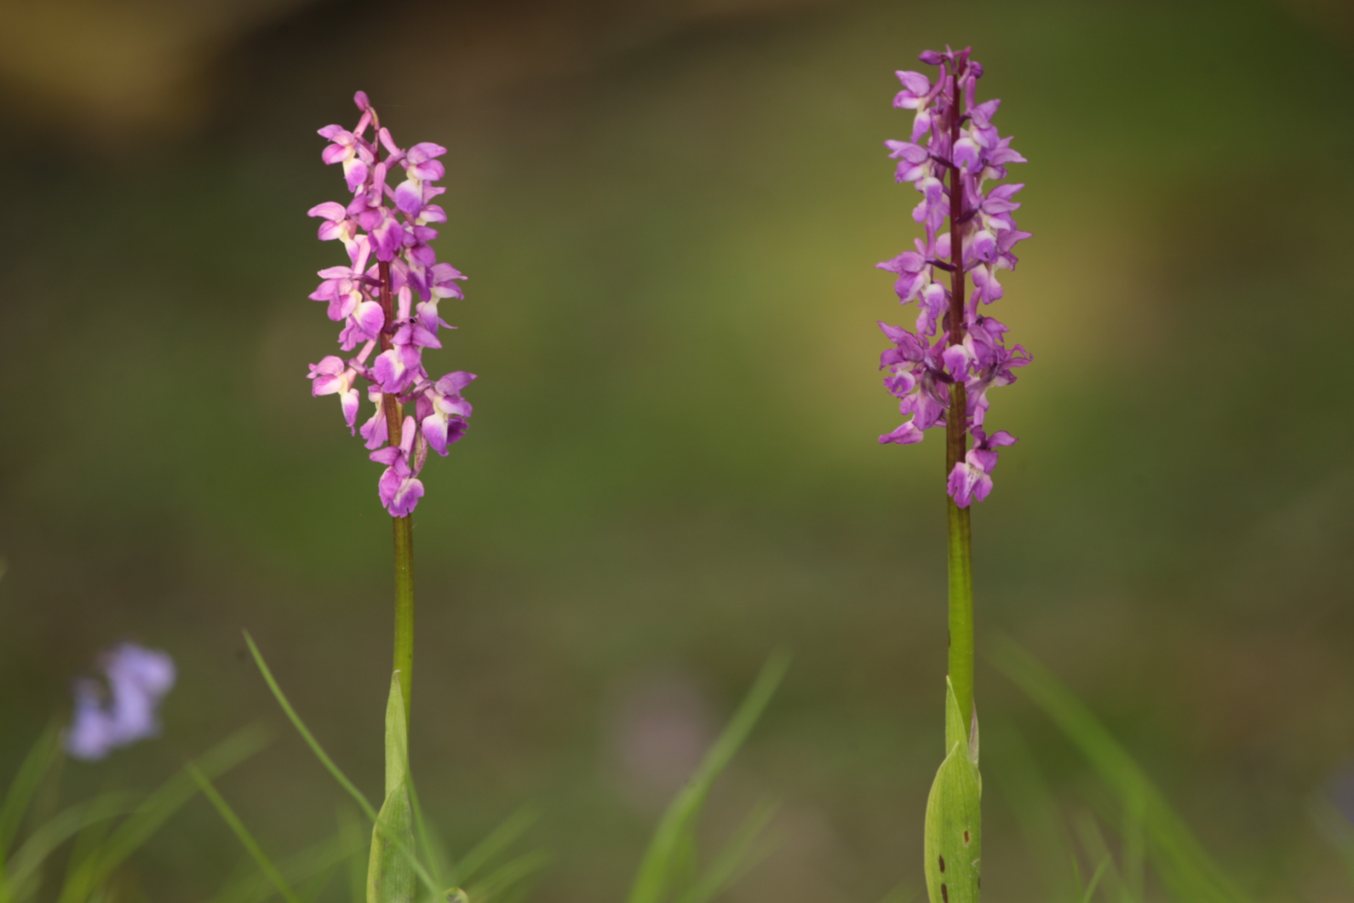
Early purple orchid
Saving Norfolk’s Wildlife for the Future

Slide 14
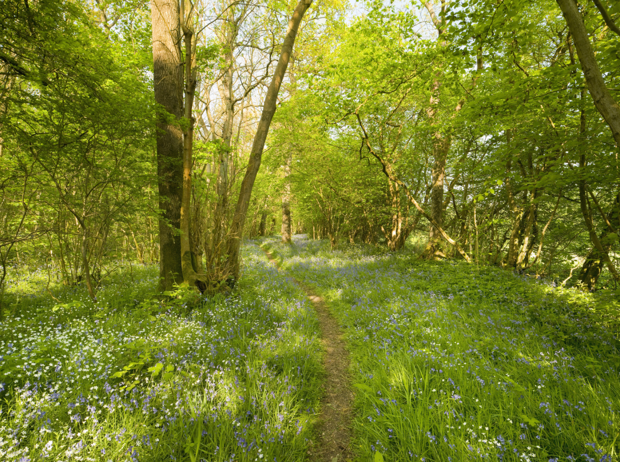
Saving Norfolk’s Wildlife for the Future

Slide 15
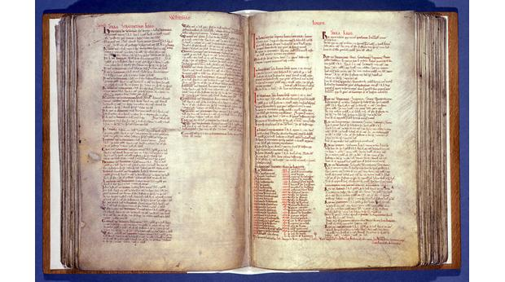
Saving Norfolk’s Wildlife for the Future

Slide 16
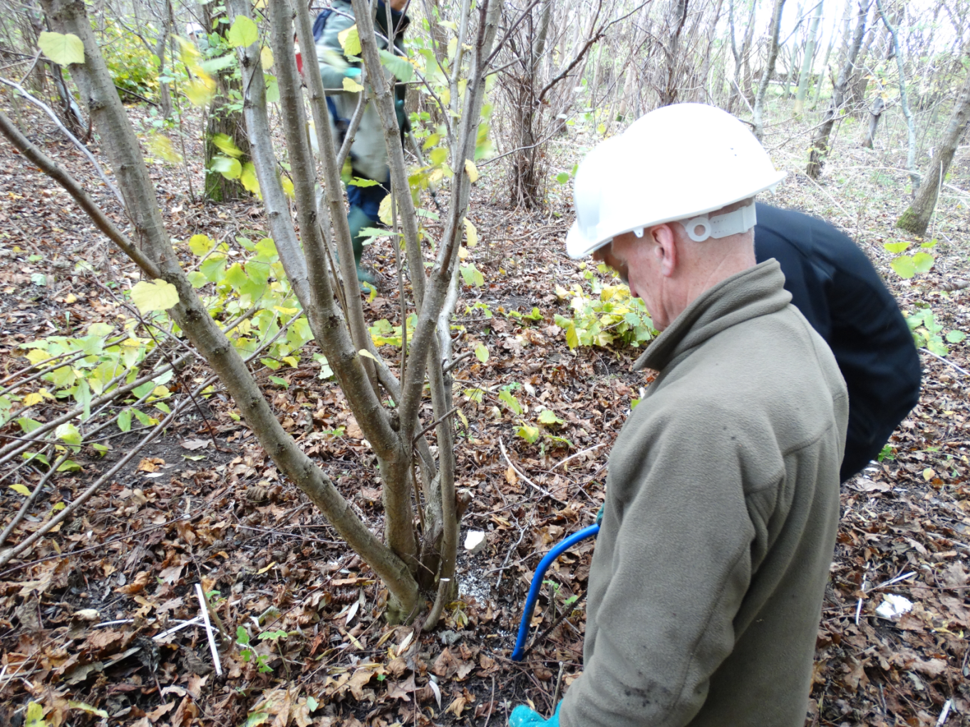
Saving Norfolk’s Wildlife for the Future

Slide 17
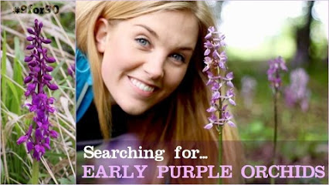
Saving Norfolk’s Wildlife for the Future

