Slide 1
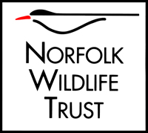
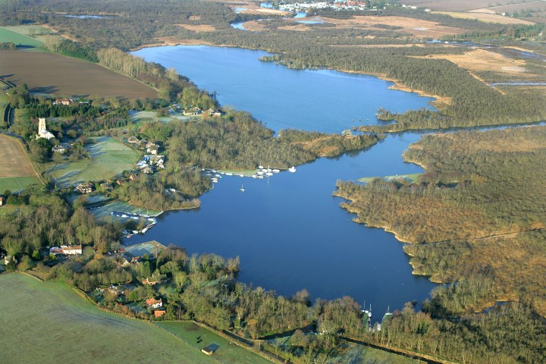
Welcome to Ranworth Broad
Saving Norfolk’s Wildlife for the Future
Notes:
Photo: Mike Page.

Slide 2
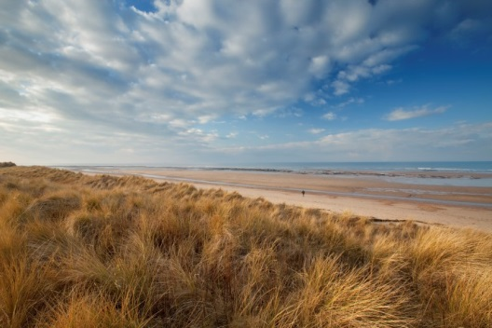
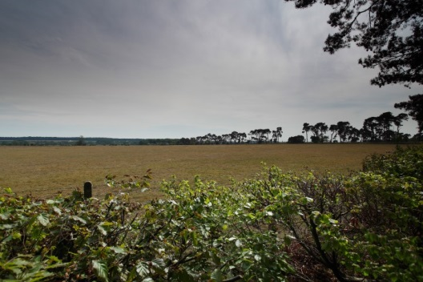
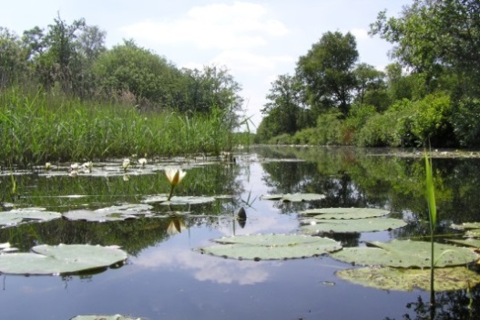
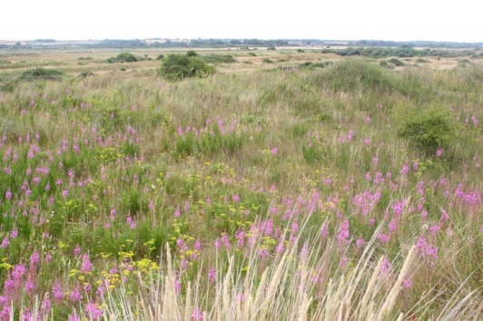
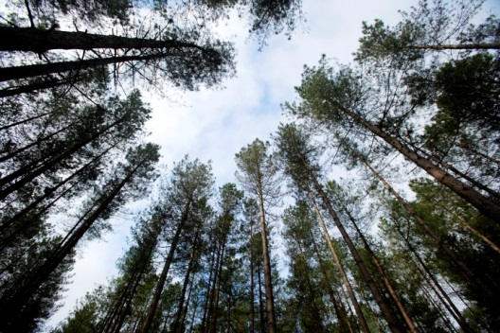
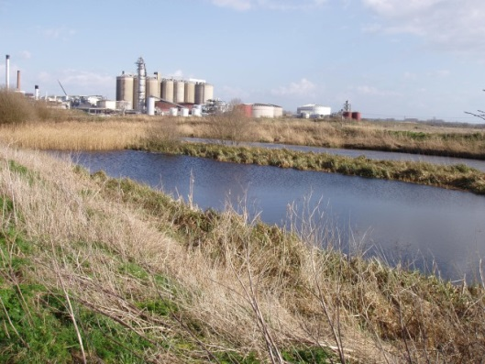
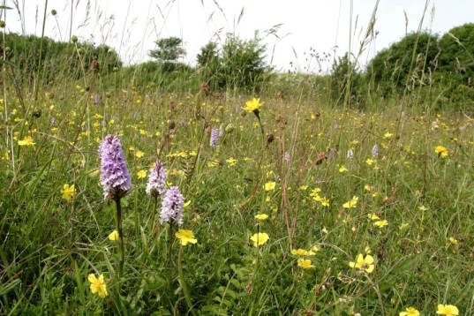
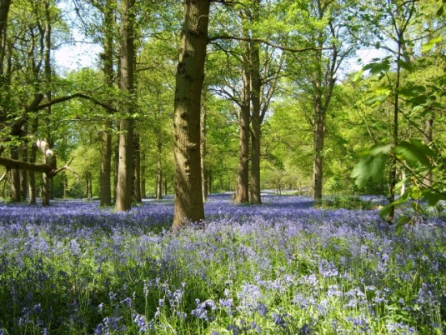
A bit about Norfolk Wildlife Trust…
We protect more than 50 nature reserves across Norfolk for wildlife and people.
Saving Norfolk’s Wildlife for the Future
Notes:
Different animals and plants need different sorts of places to live.
Photos: Richard Osbourne, Ray Jones, Tasha North, Nick Carter, Wildstock and Russel Bayell.

Slide 3
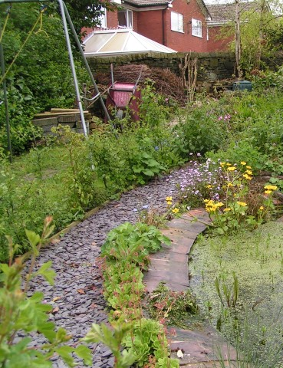
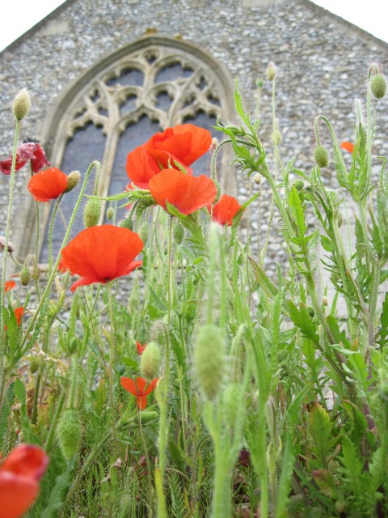
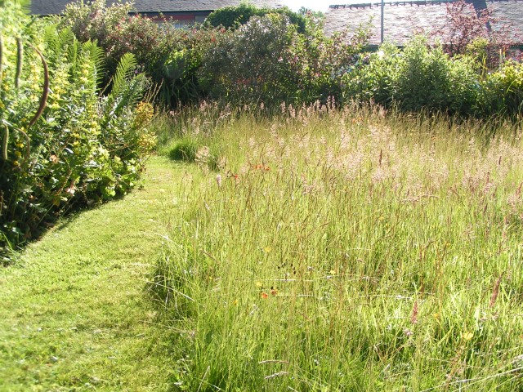
We also help to make gardens, parks, schools, churchyards, roadsides and other areas more wildlife-friendly so that nature reserves are joined up. We call this a “Living Landscape”.
Saving Norfolk’s Wildlife for the Future
Notes:
These areas aren’t immaculately tidy, which is great for wildlife. Some grass is long, there is a pond and the species are native to Britain.
Photos: Richard Burkmarr and David North

Slide 4
Here are some of the words we might use during your visit. Can you guess what they are?
1) A place where plants and animals can live
H
A
B
I
T
A
T
2) An exact type of animal or plant
S
P
E
C
I
E
S
3) An area which is protected for wildlife
N
A
T
U
R
E
R
E
S
E
R
V
E
4) Something plants and animals have done over time so that they can live in their habitat
A
D
A
P
T
5) The number of different plant and animal species in an area
B
I
O
D
I
T
Y
V
E
R
S
I
6) A person who looks after a nature reserve
W
A
R
D
E
N
Saving Norfolk’s Wildlife for the Future

Slide 5
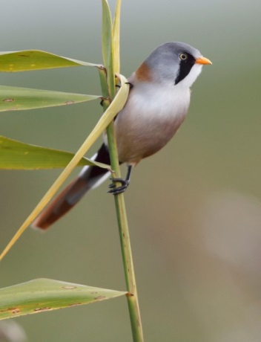
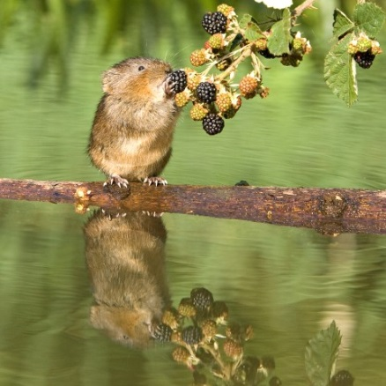
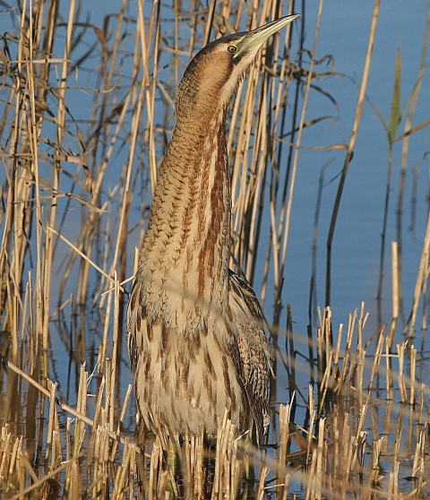
After your visit, you’ll know more about different environments and what lives in them.
We’ll find plenty of plants and some small animals but they’re all wild so what we’ll see is a mystery!
We’ll explore different habitats at Ranworth each with different species
Saving Norfolk’s Wildlife for the Future
Notes:
Bearded tit (rare bird) – feet adapted for clinging onto small twigs
Water vole – rare because it needs muddy, plant-covered river banks for its burrow, not concrete! “Ratty” in “Wind in the Willows” was a water vole
Bittern (rare bird) – very well camouflaged in the reeds
Photos: Steve Bond, Peter Mallet and Ian Simmons.

Slide 6
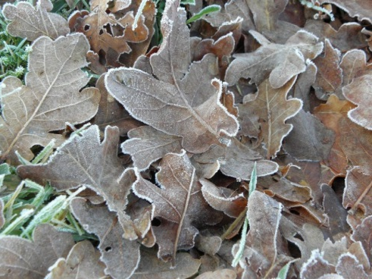
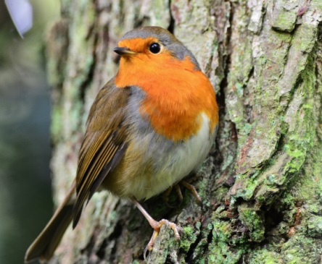
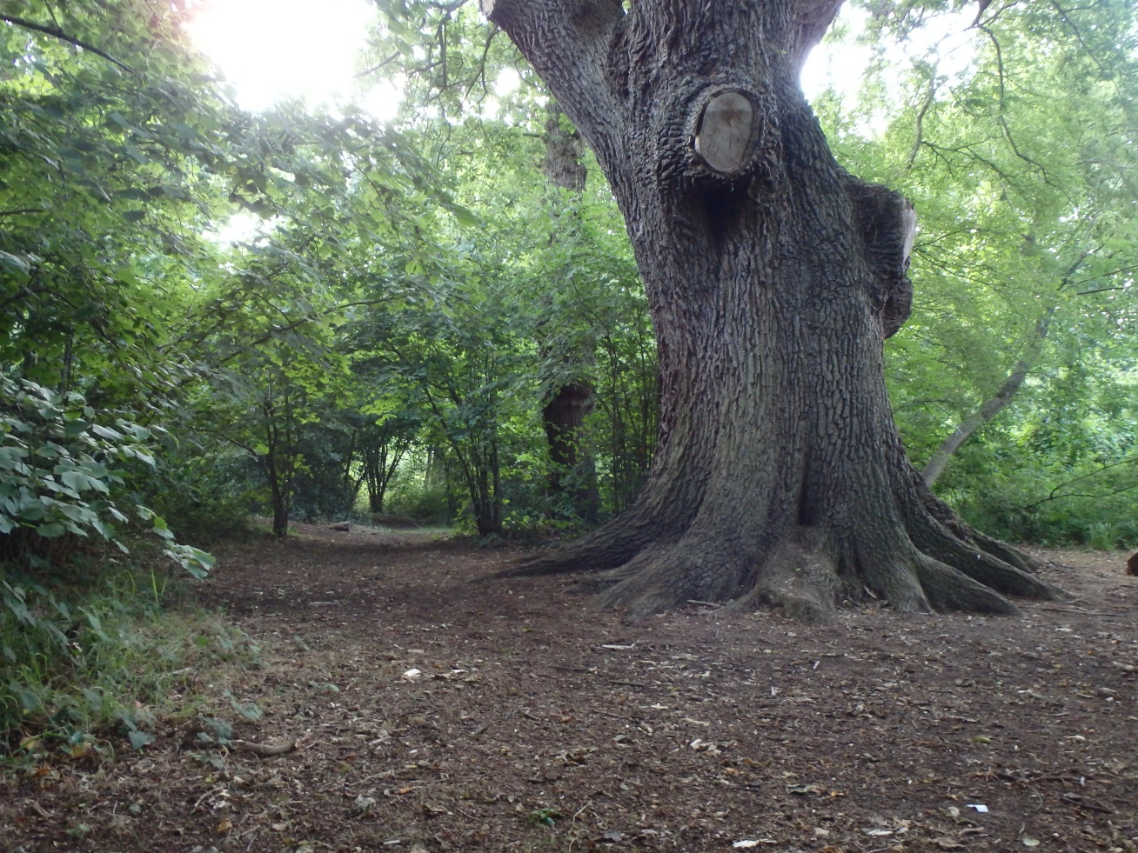
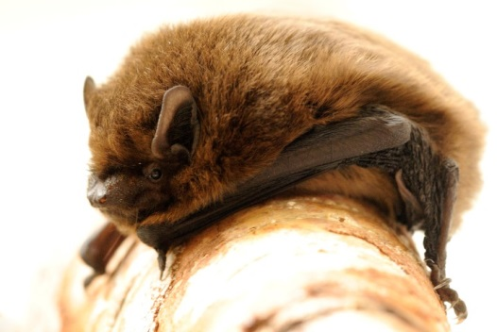
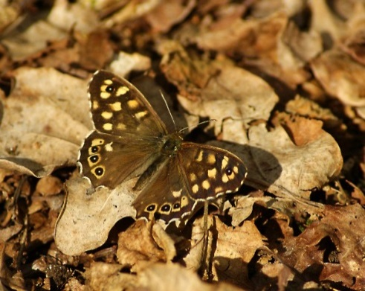
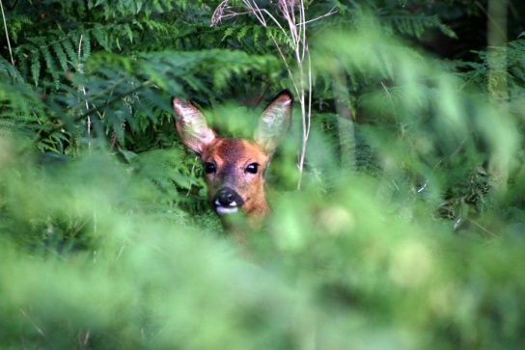
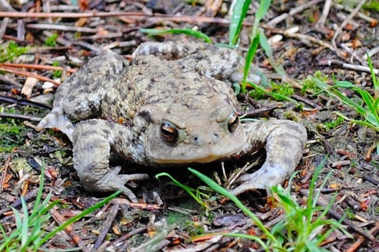
Woodland
Saving Norfolk’s Wildlife for the Future
Notes:
From top left anticlockwise: robin, speckled wood, common toad, woodlouse, roe deer, pipestrelle bat, oak leaves
Could discuss camouflage, in/vertebrates, different vertebrate groups
Photos: Elizabeth Dack, Amy Lewis, Robert Williamson, Alan Priceck, Yvonne Jones and Jessica Reiderer.

Slide 7
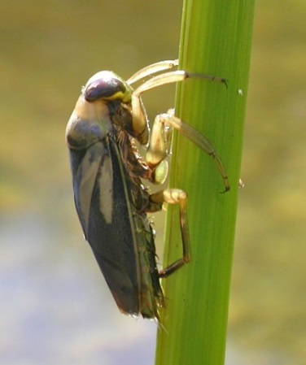
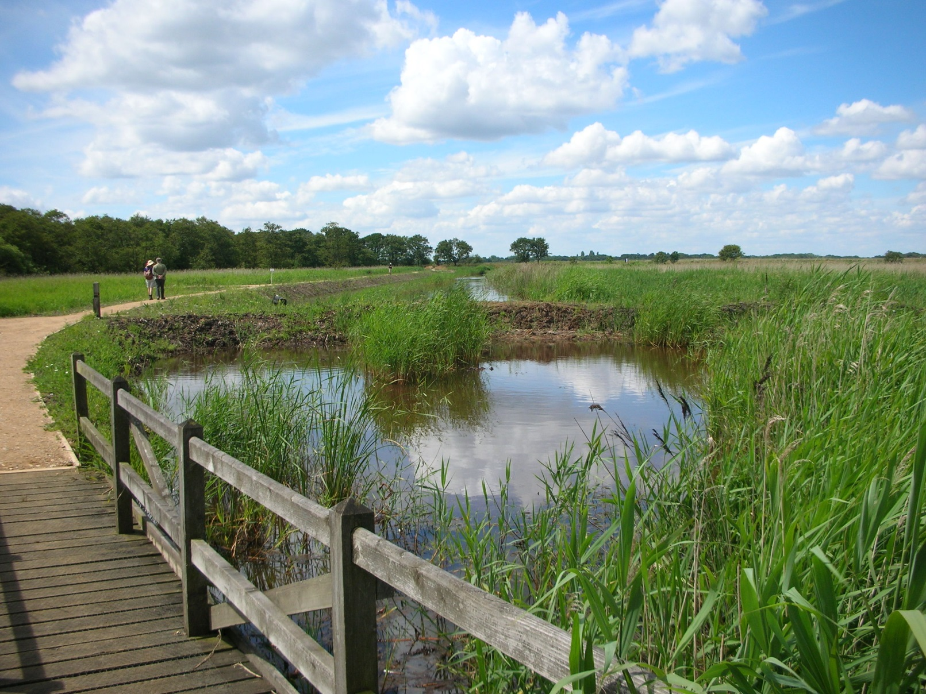
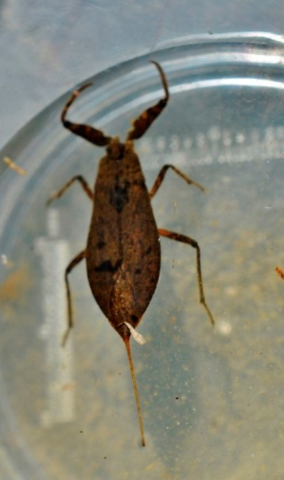
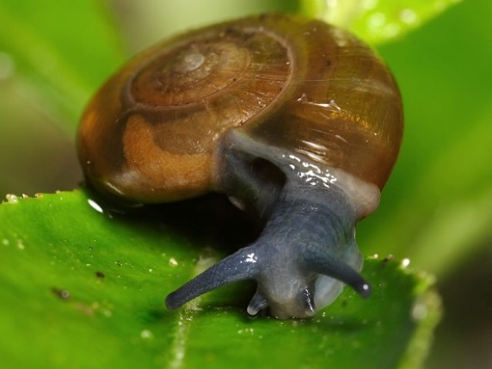
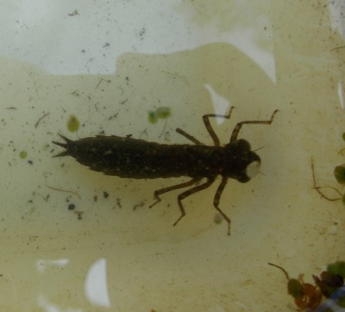
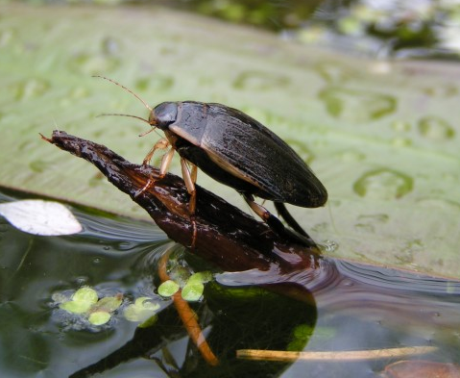
Freshwater Dyke
Saving Norfolk’s Wildlife for the Future
Notes:
Water scorpion, dragonfly nymph, great diving beetle, ramshorn snail, greater water boatmen.
Photos: Elizabeth Dack, Jamie Mcmillian, Brian Valentine, Richard Burkmarr and Isabelle Mudge.

Slide 8
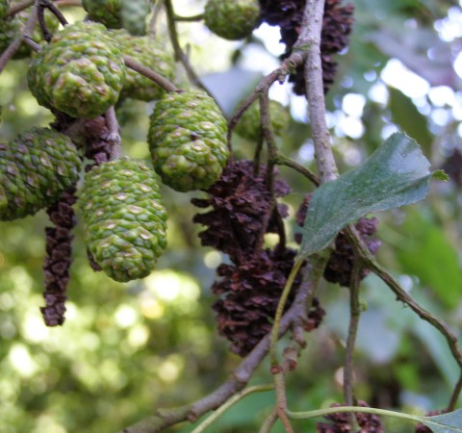
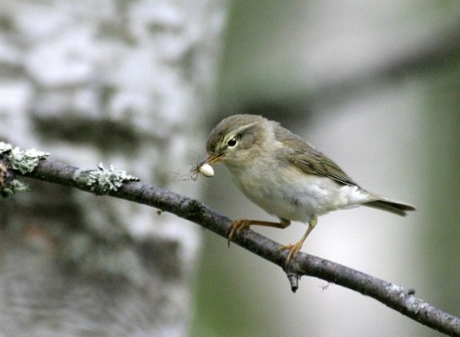
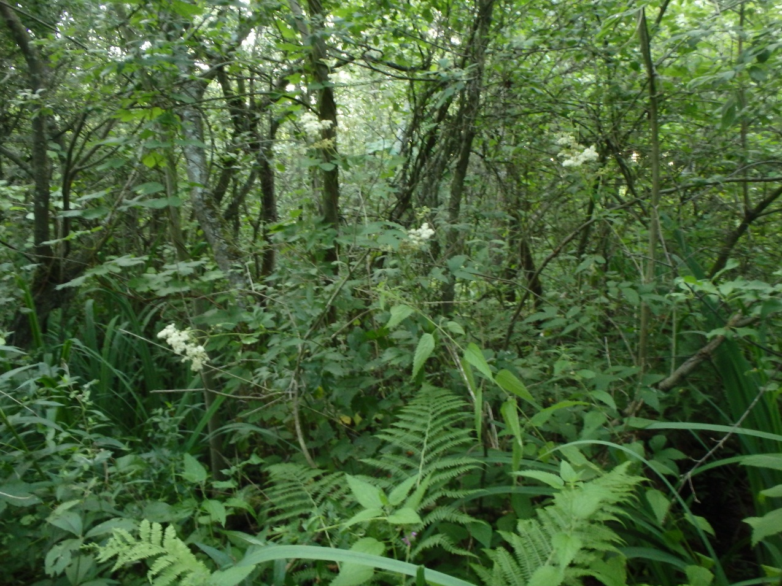
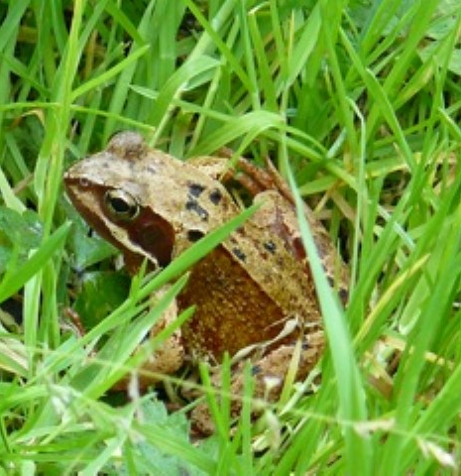
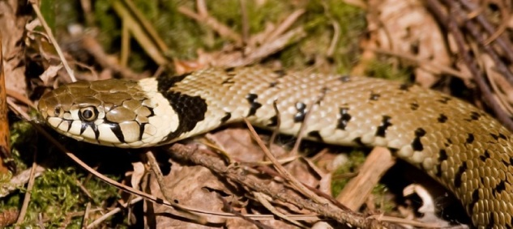
Carr woodland
Saving Norfolk’s Wildlife for the Future
Notes:
Anticlockwise from top left:Willow warbler eating spider, common frog, grass snake, froghopper, alder,
Grass snakes are completely harmless and very good at swimming.
Photos: Wildstock, Elizabeth Dack, Brenda Gough, Darren Williams and Wendy Pollard.

Slide 9
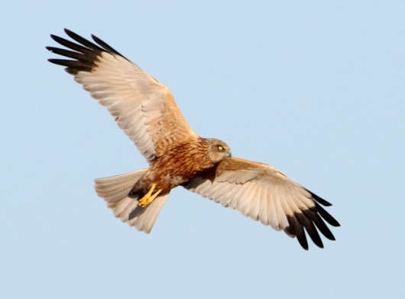
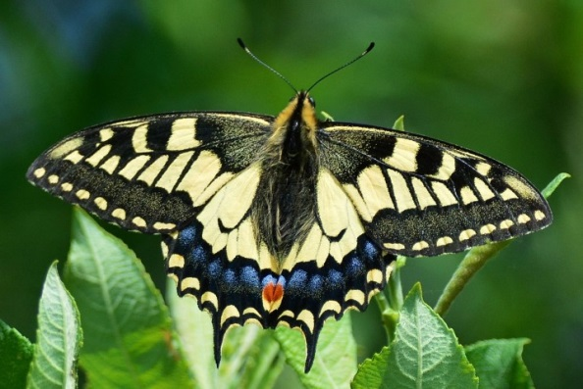
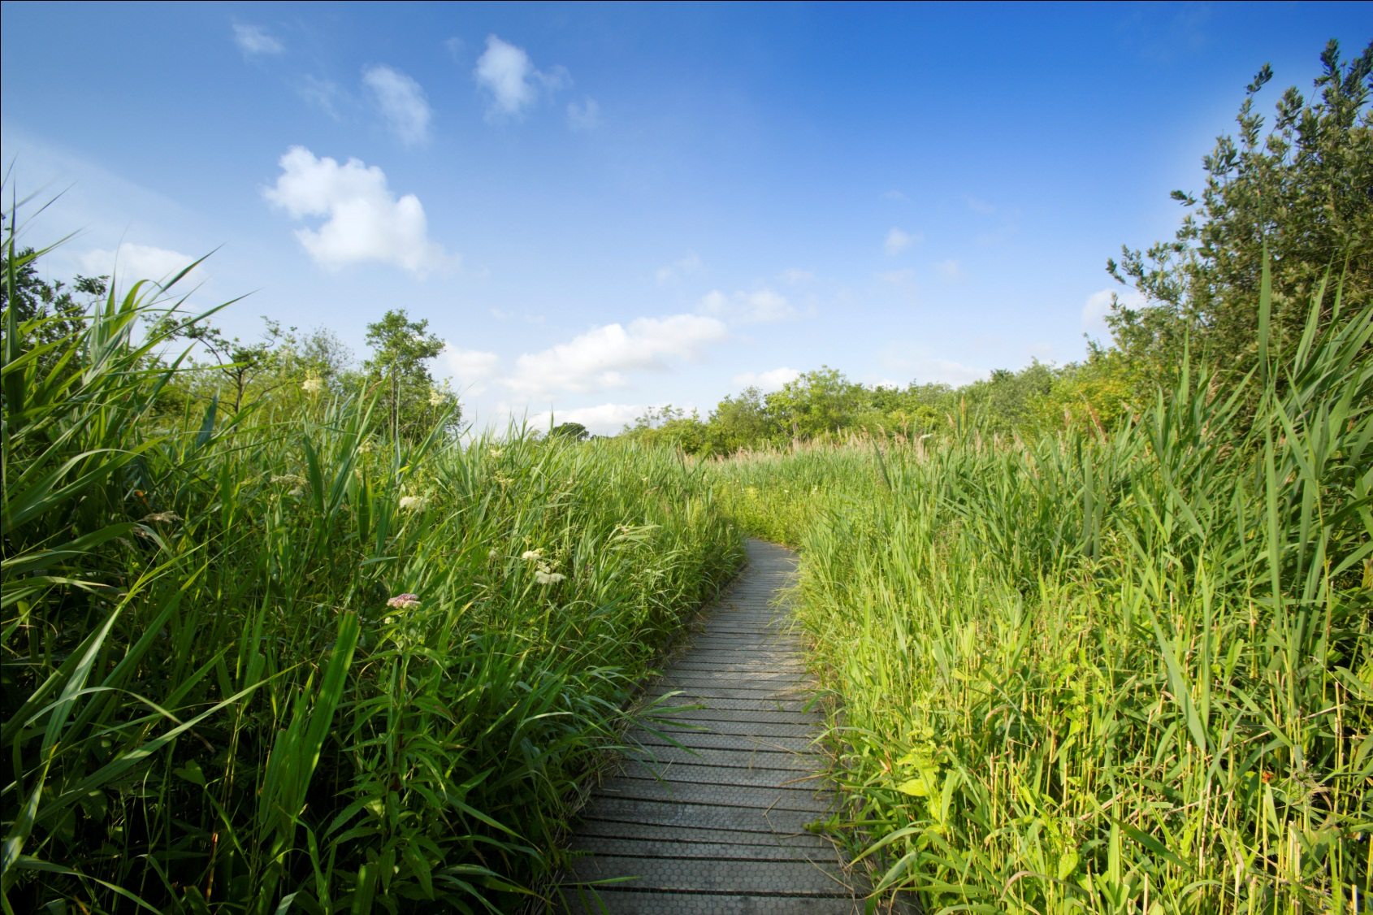
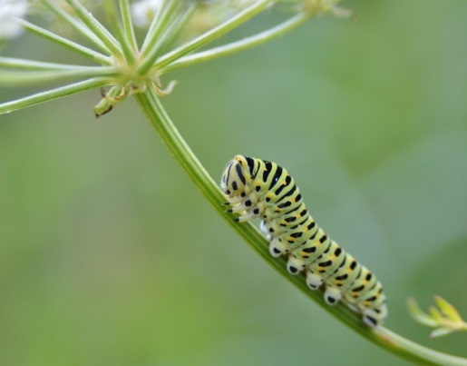
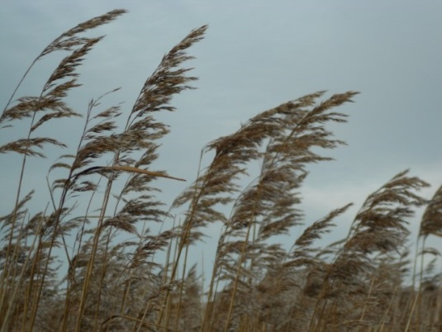
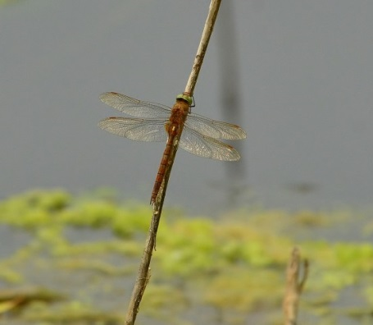
Reed bed
Saving Norfolk’s Wildlife for the Future
Notes:
Anticlockwise from top left: Swallowtail butterfly, swallowtail caterpillar, reeds, Norfolk hawker dragonfly, willow warbler, marsh harrier.
Photos: Elizabeth Dack, Nick Appleton, Wildstock, Janita Hawkins and Natural Connections.

Slide 10
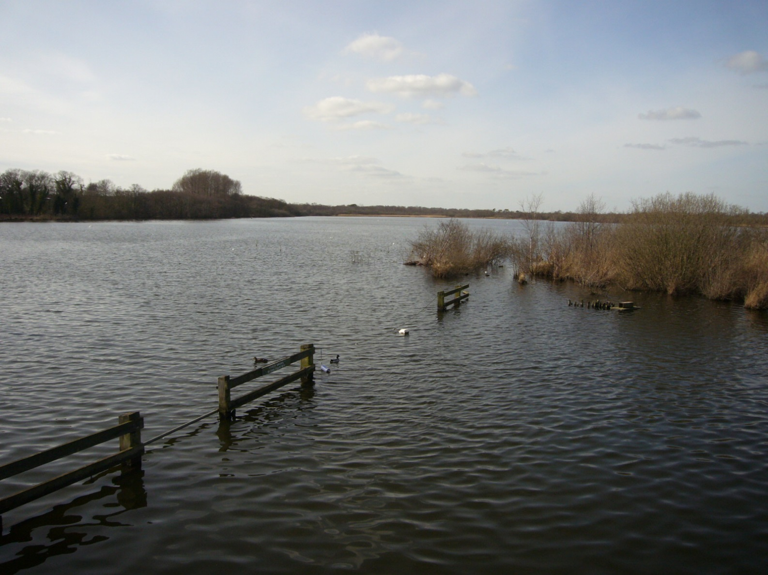
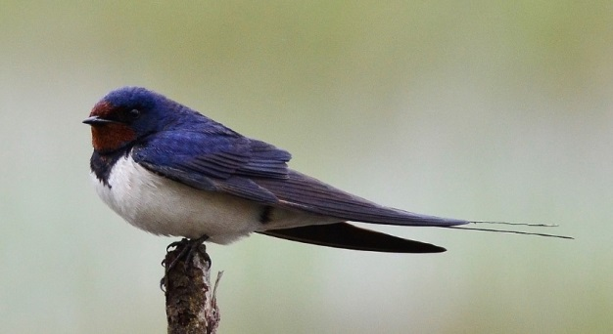
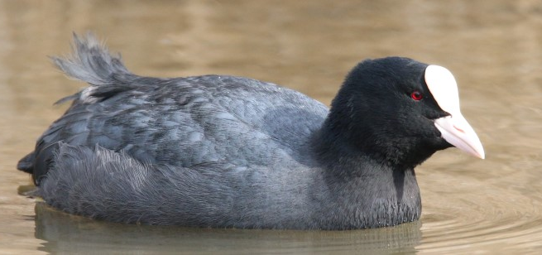
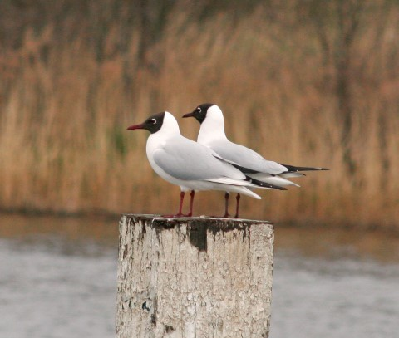
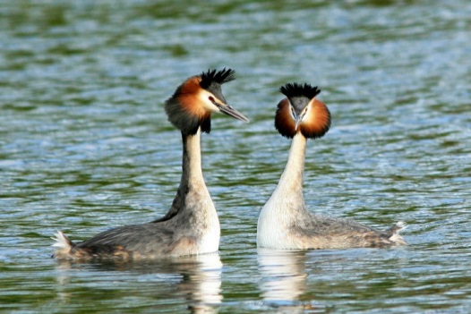
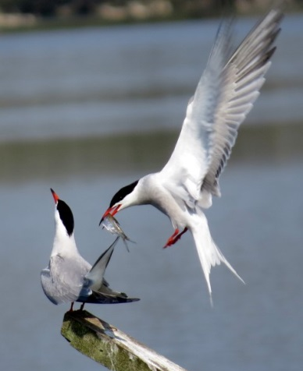
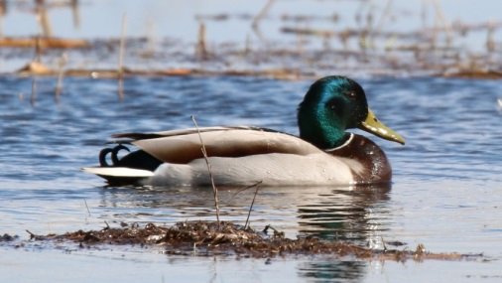
Open water
Saving Norfolk’s Wildlife for the Future
Notes:
Anti-clockwise from top left: coot, common tern feeding young, female then male mallard, great crested grebe eating fish, black headed gulls, swallow
Coot – large, flat toes for swimming and walking in mud
Terns and swallows – spend winter in Africa and summer in Britain
Mallards – femal more drab – typical of birds
It’s not just birds that live here but they are the animals that we can easily see.
Photos: Nick Goodrun, Elizabeth Dack, Robert Powell, Peter Mallet, Nick Goodrun, Maurice Funnell and Pauline Saggers.

Slide 11
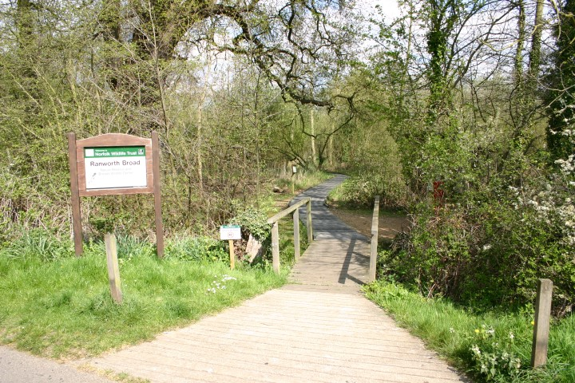
Your coach will drop you off in Ranworth village before we make the short walk to the nature reserve. You’ll be able to use the toilets when you arrive, at lunch time and before you leave.
Saving Norfolk’s Wildlife for the Future
Notes:
Photo: Norfolk Wildlife Trust

Slide 12
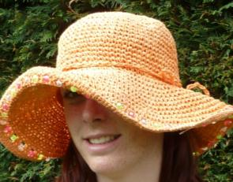
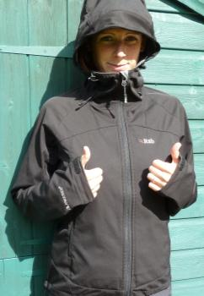
What to wear and bring
Hot and sunny weather
Whatever the weather
Cold weather
Waterproof
jacket
Sun hat
Scarf
Waterproof trousers,
quick drying trousers
or spare clothes
Sun cream
Warm
hat
A re-sealable
drink
Insect repellent or long trousers and sleeves
Welly boots or shoes
you can get dirty
NOT YOUR BEST SHOES!
Gloves
Saving Norfolk’s Wildlife for the Future

Slide 13
Low Impact Lunch Challenge
A ‘low impact’ lunch is one that doesn’t damage the environment much.
Compare the two lunches below, work out which is better and why
Follow our tips to see if you can make your lunch box like the low impact one.
Ask whoever does the shopping to
buy in bulk rather than
buying lots of individual bags.
This one has less packaging,
which means less rubbish.
Use reusable bottles.
Try to eat food which has not travelled too far.
Use reusable boxes.
Take apple cores and orange
peel home to compost.
Saving Norfolk’s Wildlife for the Future
Notes:
Low Impact Lunch – the photo on the right has a lower impact as there is less packaging being made for the food, which uses a lot of energy. This also means that there is less rubbish afterwards, which takes up more energy through rubbish collection services and has to be disposed of somewhere in the countryside, destroying areas of habitat and possibly causing pollution.
Home-made sandwiches and cake in reusable tubs are lower impact than shop bought, over-packaged versions - and they work out cheaper!
By buying big bags of crisps or chocolate or nuts and pouring out a day’s serving into a tub for each lunch box saves packaging – individual lunch box-sized chocolate bars or mini yoghurts or single serving bags of dried fruit produce tonnes of unnecessary waste every year.
Don’t buy pre-prepared fruit, it just creates more packaging. Instead, buy fruit as locally as possible and either take whole or prepare fruit salads at home and put into a reusable tub.
Don’t buy bottled water, tap water is fine. In Great Britain we have some of the best quality tap water in the world! Use a refillable bottle, it’s much cheaper and much, much kinder to the planet.

Slide 14
What would you like to find out about Ranworth’s wildlife?
Can you each come up with 2 questions?
Saving Norfolk’s Wildlife for the Future
Notes:
These don’t necessarily have to be answerable.
Photo: Elizabeth Dack

Slide 15
See you soon!
Saving Norfolk’s Wildlife for the Future
Notes:
Photo: Richard Osbourne

