Slide 1
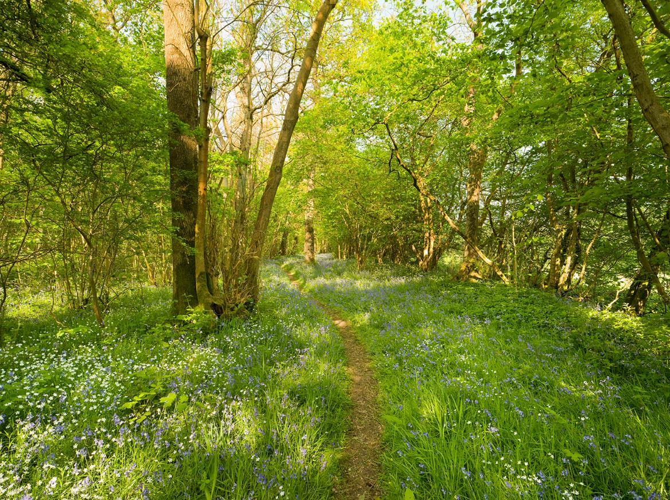
Welcome to Foxley Woods
Notes:
Photo: Richard Osbourne

Slide 2
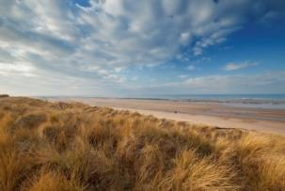
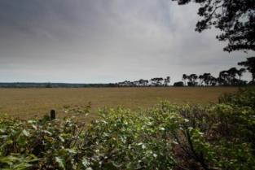
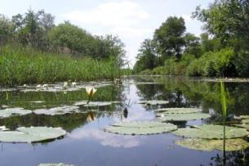
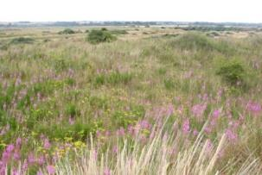
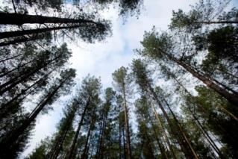
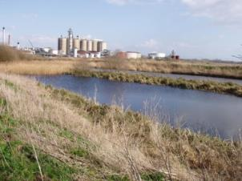
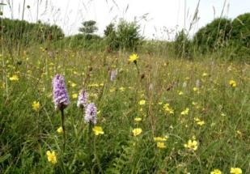
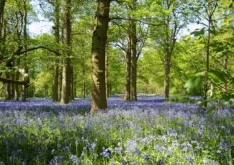
A bit about Norfolk Wildlife Trust…
We protect more than 50 nature reserves across Norfolk for wildlife and people.
Notes:
Different animals and plants need different sorts of places to live.
Photos: Richard Osbourne, Ray Jones, Tasha North, Nick Carter, Wildstock and Russel Bayell.

Slide 3
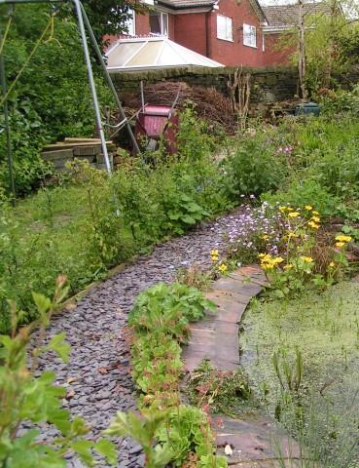
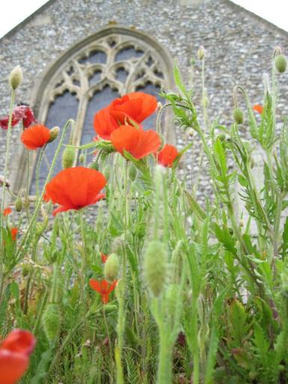
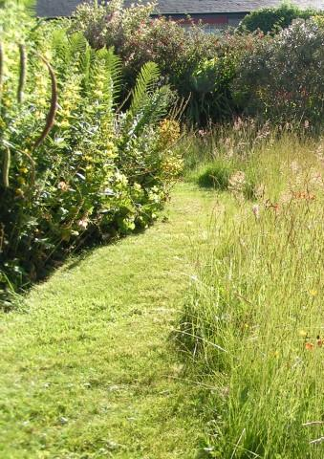
We also help to make gardens, parks, schools, churchyards, roadsides and other areas more wildlife-friendly so that nature reserves are joined up. We call this a “Living Landscape”.
Saving Norfolk’s Wildlife for the Future
Notes:
These areas aren’t immaculately tidy, which is great for wildlife. Some grass is long, there is a pond and the species are native to Britain.
Photos: Richard Burkmarr and David North

Slide 4
Here are some of the words we might use during your visit. Can you guess what they are?
1) A place where plants and animals can live
H
A
B
I
T
A
T
2) An exact type of animal or plant
S
P
E
C
I
E
S
3) An area which is protected for wildlife
N
A
T
U
R
E
R
E
S
E
R
V
E
4) Something plants and animals have done over time so that they can live in their habitat
A
D
A
P
T
5) The number of different plant and animal species in an area
B
I
O
D
I
T
Y
V
E
R
S
I
6) A person who looks after a nature reserve
W
A
R
D
E
N

Slide 5
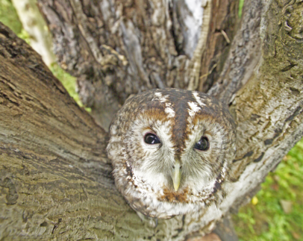
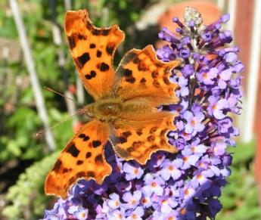
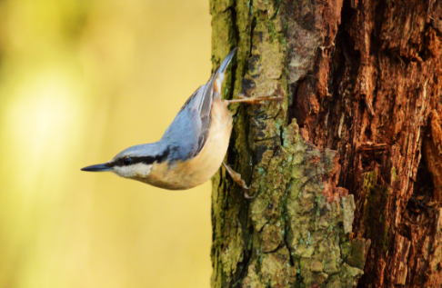
After your visit, you’ll know more about different environments and what lives in them.
We’ll find plenty of plants and some small animals but they’re all wild so what we’ll see is a mystery!
We’ll explore different habitats at Foxley Woods, each with its own different species
Notes:
Photos: David Tipling, Richard Burrmark and Barry Surrey.

Slide 6
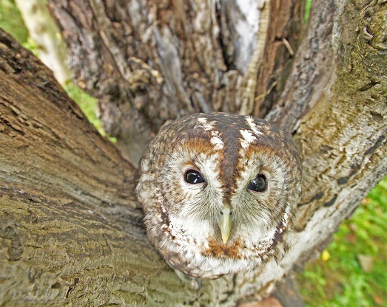
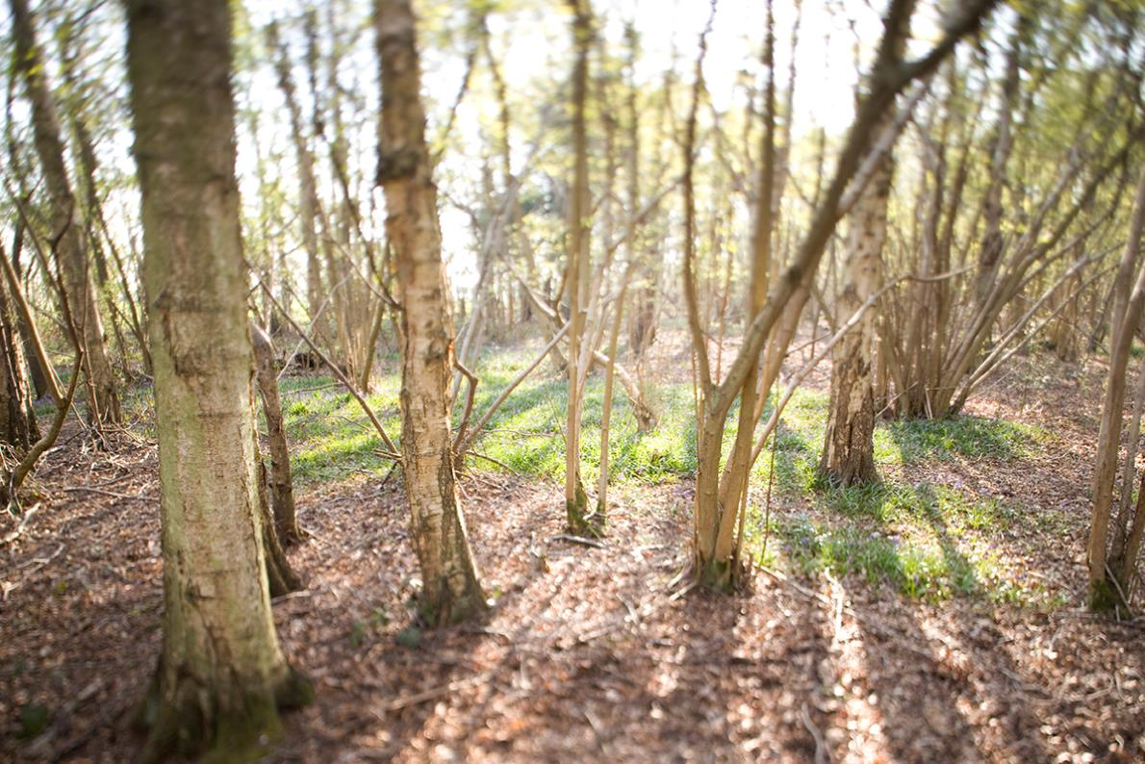
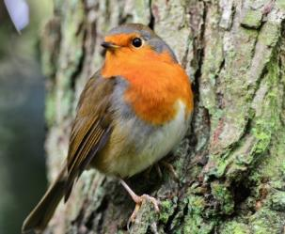
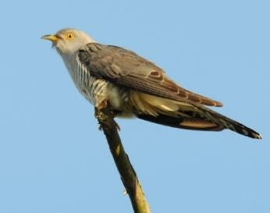
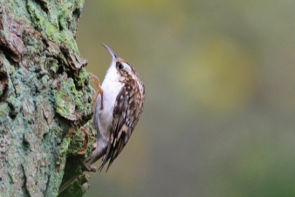
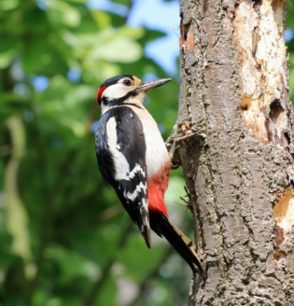
Ancient Woodland
Notes:
An ancient woodland is a woodland which is at least 500 years old! Foxley Woods was mentioned in the Domesday Book. This makes it at least 1000 years old! Photos clockwise from top left: Robin, tawny owl, greater spotted woodpecker, nuthatch and treecreeper.
Photos: Richard Osbourne, Elizabeth Dack, David Tipling, Nick Appleton, Paul Taylor and Danny Shurey.

Slide 7
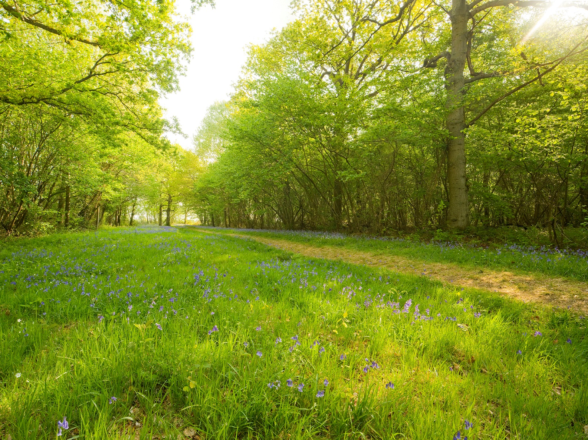
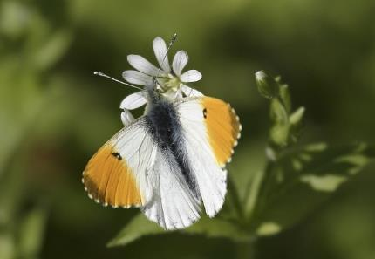
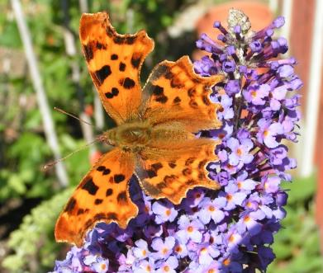
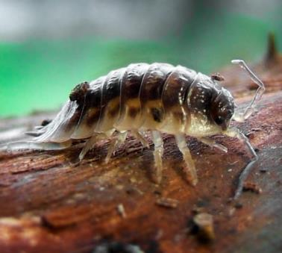
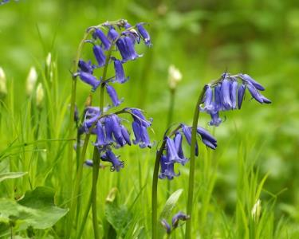
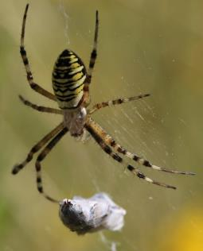
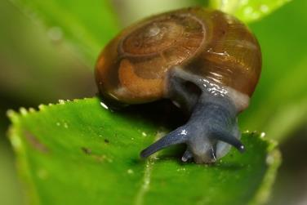
Edges and Undergrowth
Notes:
Clockwise from top left: orange tip butterfly, comma butterfly, woodlouse, wasp spider,
ramshorn snail, bluebells
Photos: Richard Osbourne, Wildstock, Richard Burrmark, Nick Goodrun, Brian Valentine and Jessica Reiderer.

Slide 8
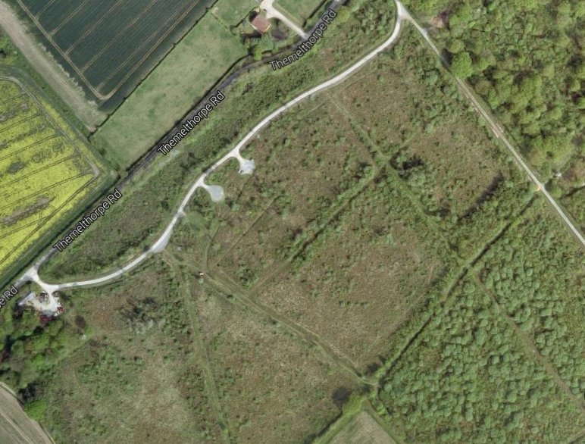
Your coach will drop you off in the car park where you will be met by an NWT Education Officer. Unfortunately, we don’t have toilet facilities on site.

Slide 9
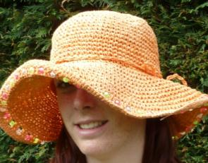
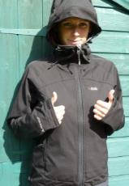
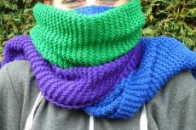
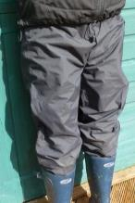
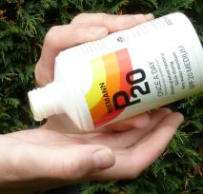
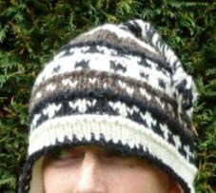
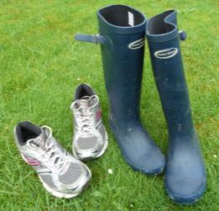
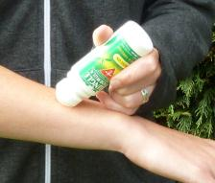
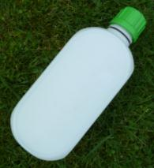
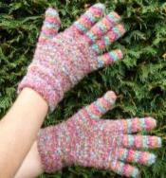
What to wear and bring
Hot and sunny weather
Whatever the weather
Sun hat
Waterproof
jacket
Cold weather
Scarf
Sun cream
Waterproof trousers,
quick drying trousers
or spare clothes
Warm
hat
Insect repellent or long trousers and sleeves
A re-sealable
drink
Welly boots or shoes
you can get dirty
NOT YOUR BEST SHOES!
Gloves

Slide 10
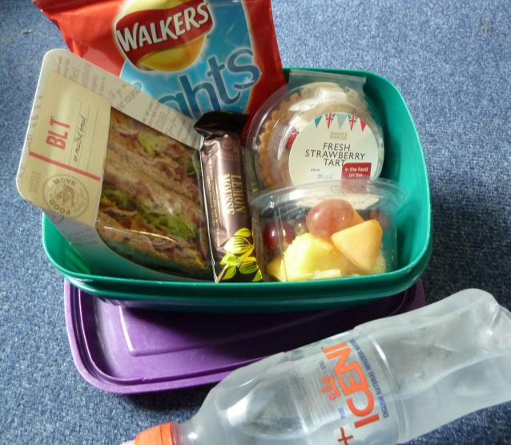
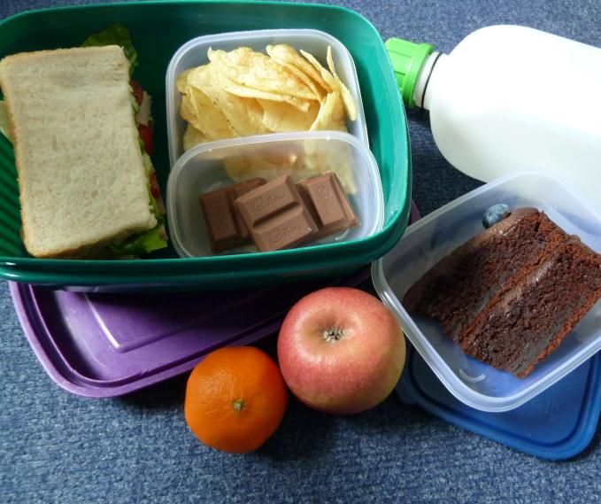
Low Impact Lunch Challenge
A ‘low impact’ lunch is one that doesn’t damage the environment much.
Compare the two lunches below, work out which is better and why
Follow our tips to see if you can make your lunch box like the low impact one.
This one has less packaging,
which means less rubbish.
Ask whoever does the shopping to
buy in bulk rather than
buying lots of individual bags.
Use reusable bottles.
Try to eat food which has not travelled too far.
Use reusable boxes.
Take apple cores and orange
peel home to compost.
Notes:
Low Impact Lunch – the photo on the right has a lower impact as there is less packaging being made for the food, which uses a lot of energy. This also means that there is less rubbish afterwards, which takes up more energy through rubbish collection services and has to be disposed of somewhere in the countryside, destroying areas of habitat and possibly causing pollution.
Home-made sandwiches and cake in reusable tubs are lower impact than shop bought, over-packaged versions - and they work out cheaper!
By buying big bags of crisps or chocolate or nuts and pouring out a day’s serving into a tub for each lunch box saves packaging – individual lunch box-sized chocolate bars or mini yoghurts or single serving bags of dried fruit produce tonnes of unnecessary waste every year.
Don’t buy pre-prepared fruit, it just creates more packaging. Instead, buy fruit as locally as possible and either take whole or prepare fruit salads at home and put into a reusable tub.
Don’t buy bottled water, tap water is fine. In Great Britain we have some of the best quality tap water in the world! Use a refillable bottle, it’s much cheaper and much, much kinder to the planet.

Slide 11
What would you like to find out about Foxley Wood’s wildlife?
Can you each come up with 2 questions?
Notes:
These don’t necessarily have to be answerable.
Photo: Elizabeth Dack

Slide 12
See you soon!
Notes:
Photo: Richard Osbourne

