Slide 1

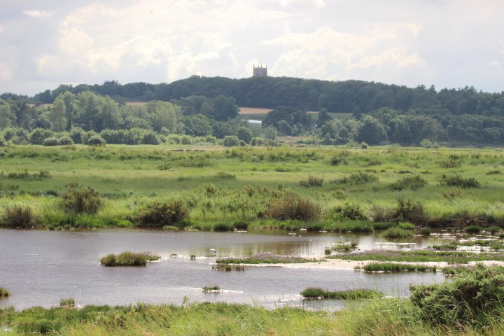
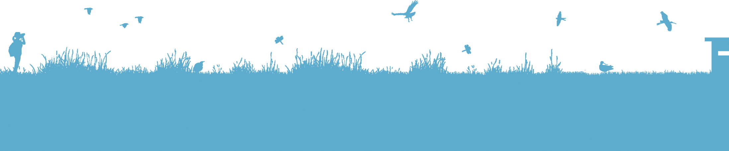
Welcome to Cley Marshes.
Saving Norfolk’s Wildlife for the Future
Notes:
Photo: Barry Madden

Slide 2
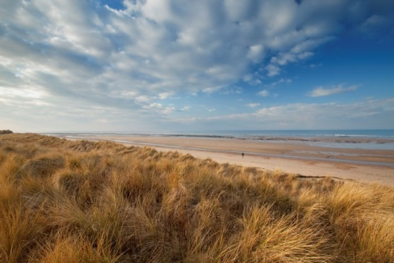
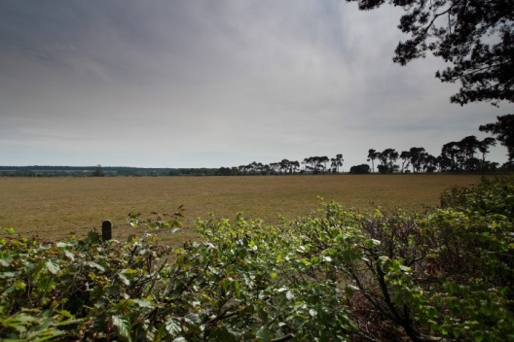
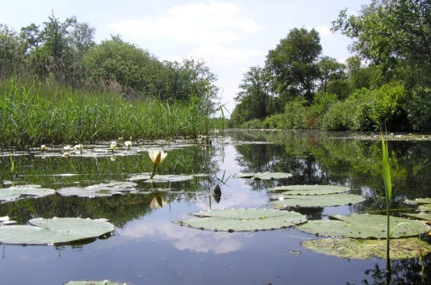
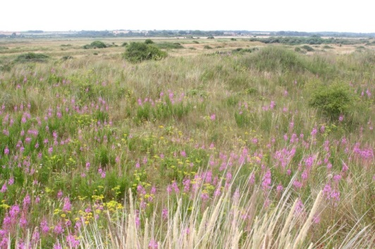
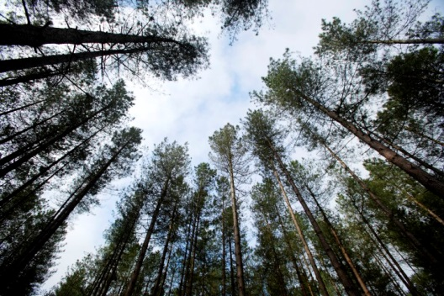
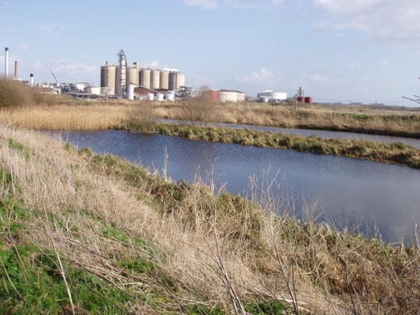
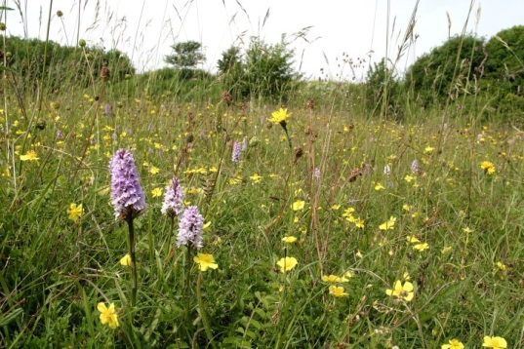
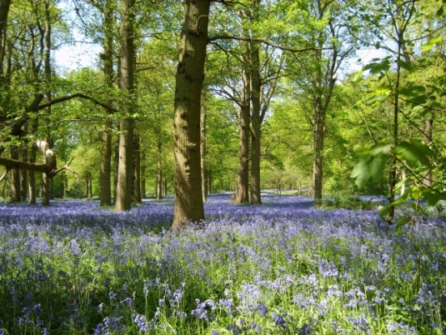
A Bit About Norfolk Wildlife Trust…
We protect more than 50 nature reserves across Norfolk for wildlife and people.
Saving Norfolk’s Wildlife for the Future
Saving Norfolk’s Wildlife for the Future
Notes:
Different animals and plants need different sorts of places to live.
Photos: Richard Osbourne, Ray Jones, Tasha North, Nick Carter, Wildstock and Russel Bayell.

Slide 3
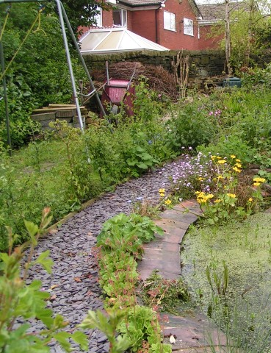
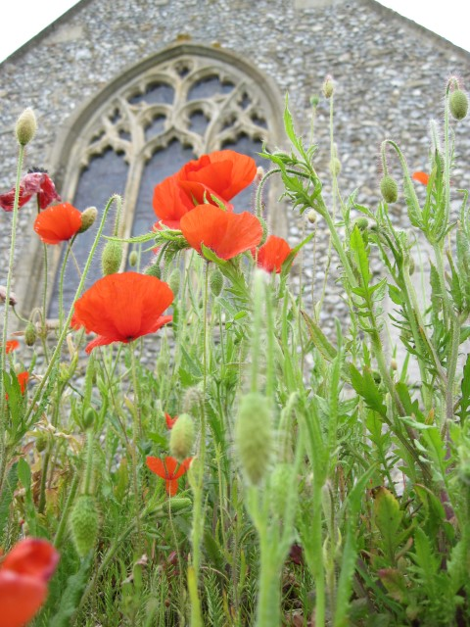
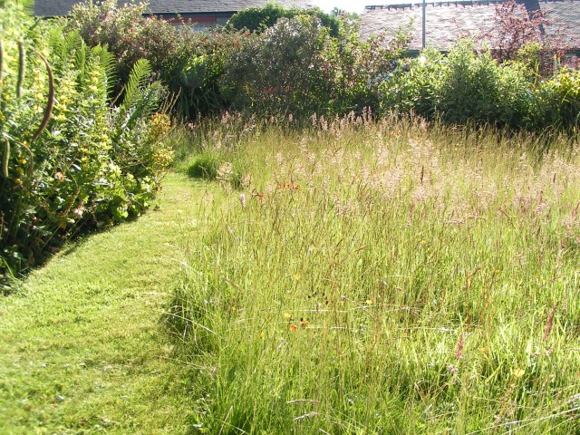
We also help to make gardens, parks, schools, churchyards, roadsides and other areas more wildlife-friendly so that nature reserves are joined up. We call this a “Living Landscape”.
Saving Norfolk’s Wildlife for the Future
Notes:
These areas aren’t immaculately tidy, which is great for wildlife. Some grass is long, there is a pond and the species are native to Britain.
Photos: Richard Burkmarr and David North

Slide 4
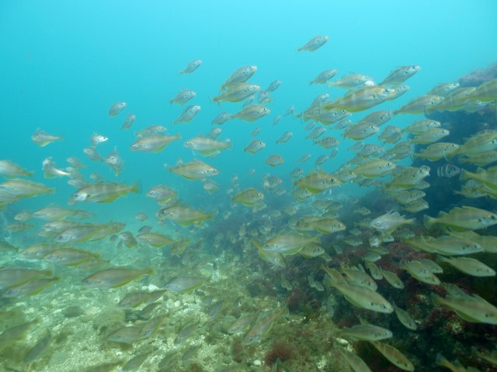
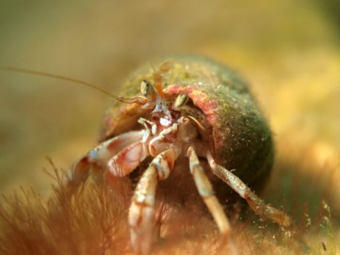
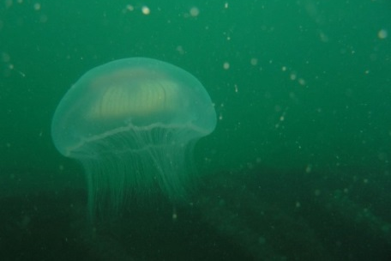
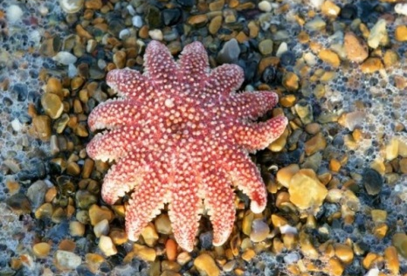
We would also like to create nature reserves in the sea as well as on land because sea life is just as important but far less protected. Can you think of problems that life in the sea faces? How about any ways that we can all help?
Photos: Rob Spray
Saving Norfolk’s Wildlife for the Future
Notes:
Hermit crab, jellyfish, sun star
Threats could include pollution, litter, climate change and overfishing.
Solutions could include taking litter home, buying less plastic, reducing waste, reducing fossil fuel use e.g. walking to school, switching off monitors etc. and buying sustainably caught seafood.
Photos: Rob Spray, Helen Nott and Terry Stabb.

Slide 5
Here are some of the words we might use during your visit. Can you guess what they are?
1) A place where plants and animals can live
H
A
B
I
T
A
T
2) An exact type of animal or plant
S
P
E
C
I
E
S
3) An area which is protected for wildlife
N
A
T
U
R
E
R
E
S
E
R
V
E
4) Something plants and animals have done over time so that they can live in their habitat
A
D
A
P
T
5) The number of different plant and animal species in an area
B
I
O
D
I
T
Y
V
E
R
S
I
6) A person who looks after a nature reserve
W
A
R
D
E
N
Saving Norfolk’s Wildlife for the Future

Slide 6
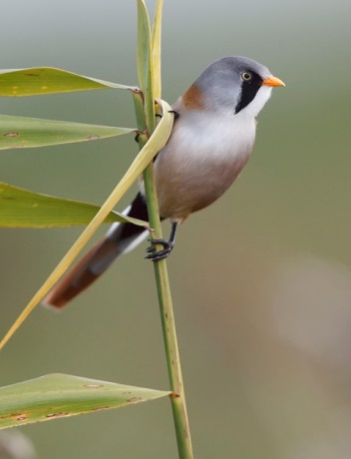
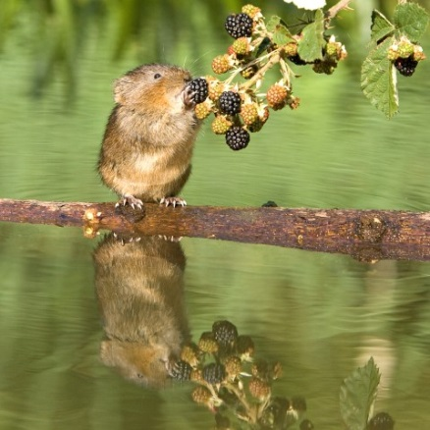
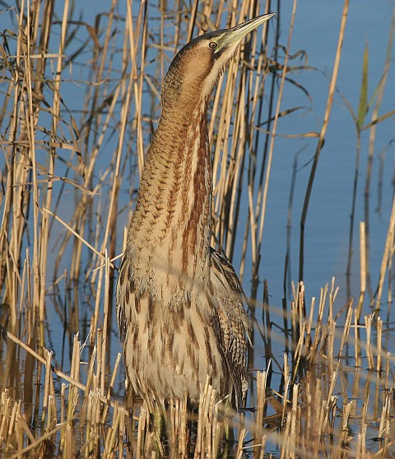
After your visit, you’ll know more about different environments and what lives in them.
We’ll find plenty of plants and some small animals but they’re all wild so what we’ll see is a mystery!
We’ll certainly see birds at Cley and find out a bit about how they survive where they live.
Saving Norfolk’s Wildlife for the Future
Notes:
Bearded tit (rare bird) – feet adapted for clinging onto small twigs
Water vole – rare because it needs muddy, plant-covered river banks for its burrow, not concrete! “Ratty” in “Wind in the Willows” was a water vole
Bittern (rare bird) – very well camouflaged in the reeds
Photos: Steve Bond, Peter Mallet and Ian Simmons.

Slide 7
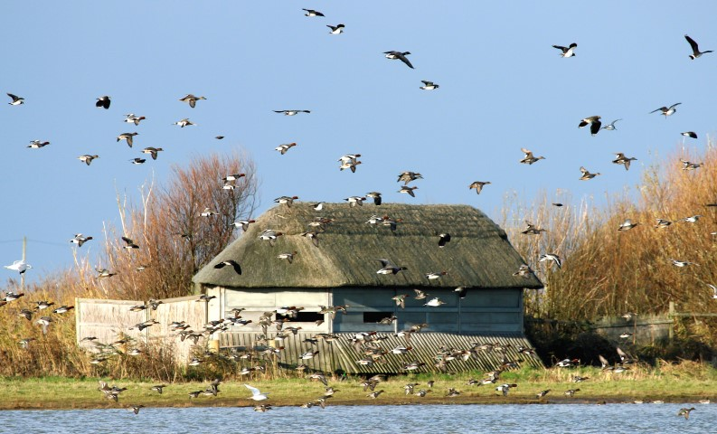
We’ll walk along a boardwalk through the reeds to the bird hide. We can peer quietly through the narrow windows and spy on the birds outside.
Saving Norfolk’s Wildlife for the Future
Notes:
A “hide” is for us to hide in. (Children sometimes think that the birds will be inside the hide.)
Photo: Barry Madden.

Slide 8
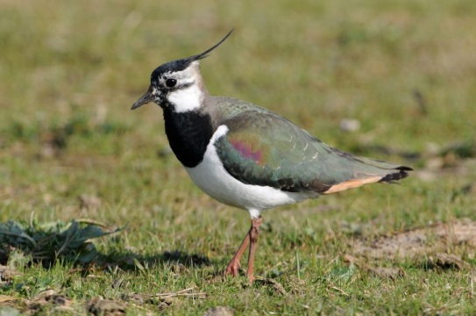
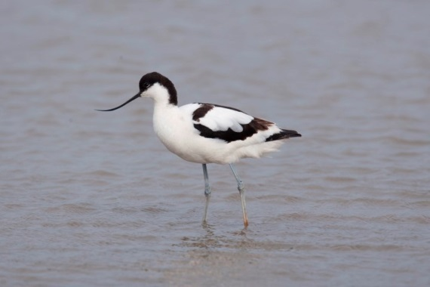
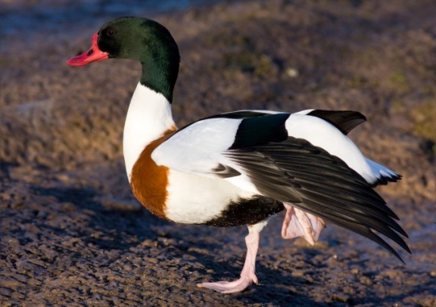
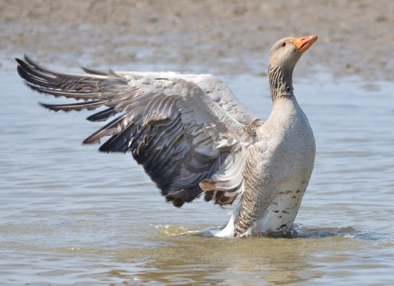
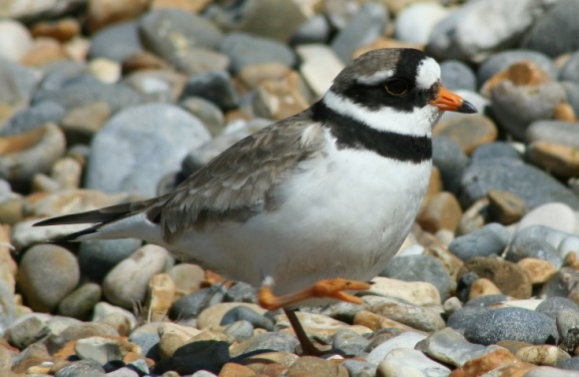
You might spot some of these:
Lapwing
Avocet
These bird species spend a lot of time in wet, muddy places so most of them have long legs, long beaks, waterproof feathers. Why do you think they are adapted like this?
Shelduck
Greylag goose
Ringed plover
Saving Norfolk’s Wildlife for the Future
Notes:
Lapwing – note tuft at back of head
Avocet – note up-curved bill
Shelduck – note the bright red, flat bill
Greylag goose – big with bright orange bill
Ringed plover – small with a black “necklace”

Slide 9
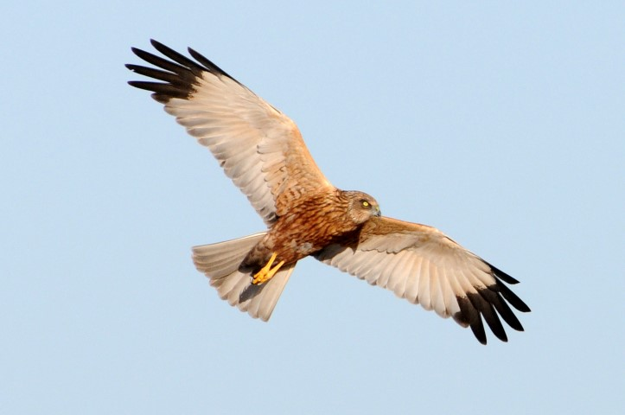
Keep your eyes open for a marsh harrier circling overhead.
It’s a bird of prey, which means it hunts other animals. They’re skilled fliers with amazing eyesight and very sharp beaks and talons.
Saving Norfolk’s Wildlife for the Future
Notes:
Photo: Nick Appleton

Slide 10
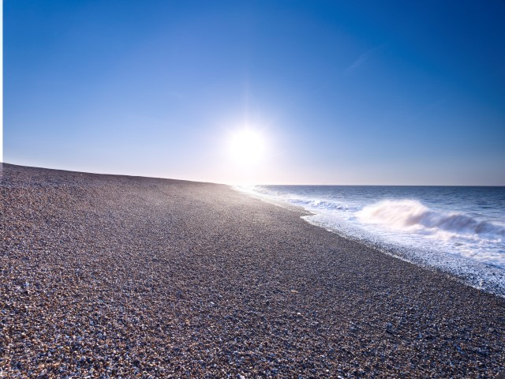
You may go to the beach by coach. It’s a shingle beach so it’s made mostly of pebbles rather than sand. The waves are always changing the shape of the beach. It can be colder on the coast than further inland so it’s a good idea to wear an extra layer.
The tide often washes interesting things up onto the shore so we’ll explore and see what natural sea treasures we can find.
Saving Norfolk’s Wildlife for the Future
Notes:
Photo: Richard Osbourne

Slide 11
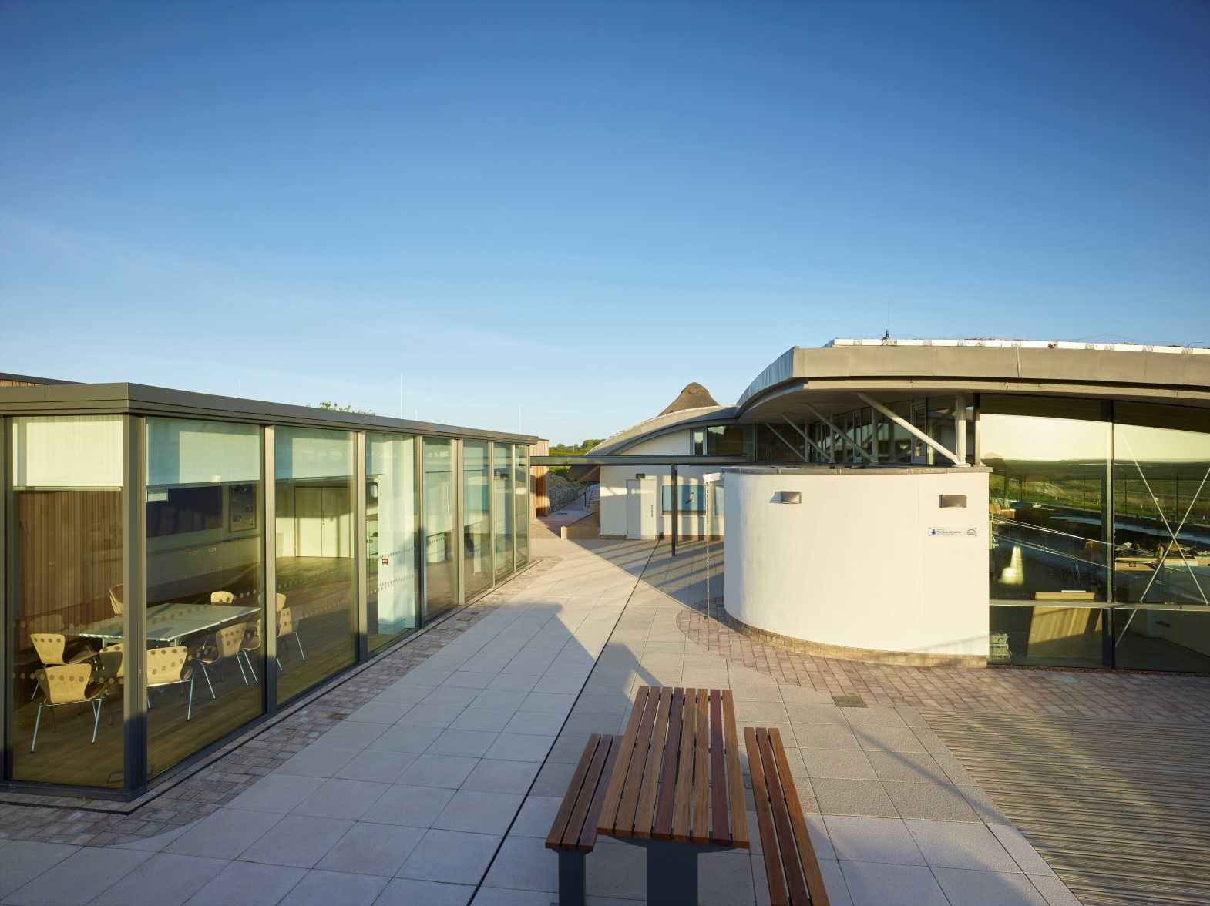
Your coach will bring you to the visitor centre and the Simon Aspinall Education Centre where an Education Officer will greet you.
Saving Norfolk’s Wildlife for the Future
Notes:
Children might notice:
A wind turbine for producing electricity to reduce fossil fuel use
A green, living roof to provide a small habitat
Large windows to let in natural light so we use less electricity
Wood because it is renewable
Photo: Richard Osbourne

Slide 12
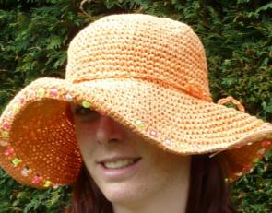
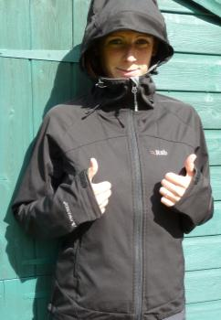
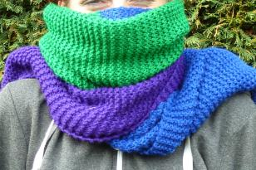
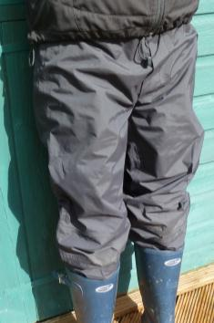
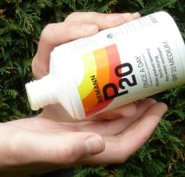
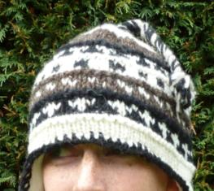
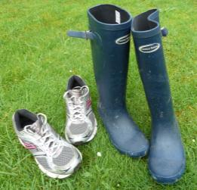
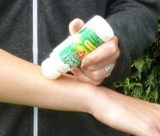
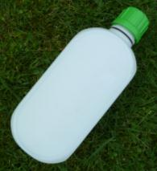
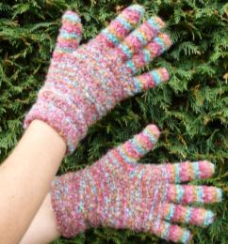
What to wear and bring
Hot and sunny weather
Whatever the weather
Cold weather
Waterproof
jacket
Sun hat
Scarf
Waterproof trousers,
quick drying trousers
or spare clothes
Sun cream
Warm
hat
A re-sealable
drink
Insect repellent
or long trousers and sleeves
Welly boots or shoes
you can get dirty
NOT YOUR BEST SHOES!
Gloves
Saving Norfolk’s Wildlife for the Future

Slide 13
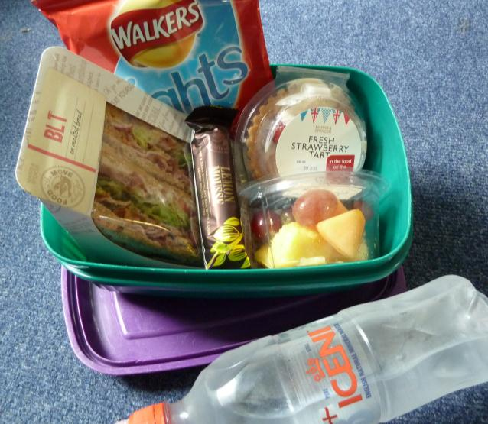
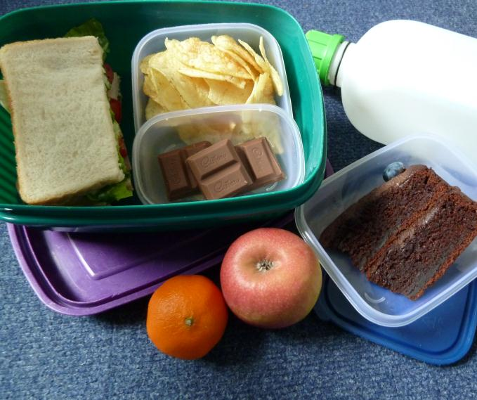
Low Impact Lunch Challenge
A ‘low impact’ lunch is one that doesn’t damage the environment much.
Compare the two lunches below, work out which is better and why
Follow our tips to see if you can make your lunch box like the low impact one.
This one has less packaging,
which means less rubbish
Ask whoever does the shopping to
buy in bulk rather than
buying lots of individual bags
Use reusable bottles
Try to eat food which has not travelled too far.
Use reusable boxes
Take apple cores and orange
peel home to compost
Saving Norfolk’s Wildlife for the Future
Notes:
Low Impact Lunch – the photo on the right has a lower impact as there is less packaging being made for the food, which uses a lot of energy. This also means that there is less rubbish afterwards, which takes up more energy through rubbish collection services and has to be disposed of somewhere in the countryside, destroying areas of habitat and possibly causing pollution.
Home-made sandwiches and cake in reusable tubs are lower impact than shop bought, over-packaged versions - and they work out cheaper!
By buying big bags of crisps or chocolate or nuts and pouring out a day’s serving into a tub for each lunch box saves packaging – individual lunch box-sized chocolate bars or mini yoghurts or single serving bags of dried fruit produce tonnes of unnecessary waste every year.
Don’t buy pre-prepared fruit, it just creates more packaging. Instead, buy fruit as locally as possible and either take whole or prepare fruit salads at home and put into a reusable tub.
Don’t buy bottled water, tap water is fine. In Great Britain we have some of the best quality tap water in the world! Use a refillable bottle, it’s much cheaper and much, much kinder to the planet.

Slide 14

What would you like to find out about Cley’s wildlife?
Can you each come up with 2 questions?
Saving Norfolk’s Wildlife for the Future
Notes:
These don’t necessarily have to be answerable.
Photo: Steve Bond

Slide 15
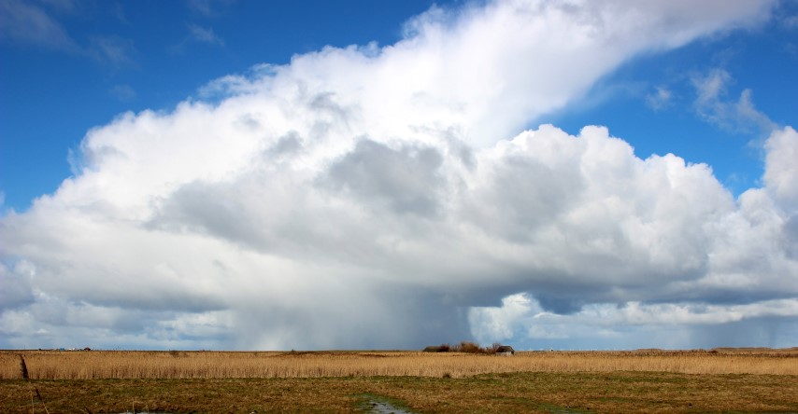
See you soon!
Saving Norfolk’s Wildlife for the Future
Notes:
Photo: Barry Madden

